Slide 1
2.4 Biomes

Slide 2
What is a biome?
A biome is a collection of ecosystems that share similar climates (do not stop a boarders!)
Climate vs. Weather
Climate: Area’s general pattern of atmospheric conditions over decades and longer.
Weather: Temperature, precipitation (rainfall), and insolation (sunlight) over a short period of time.

Slide 3
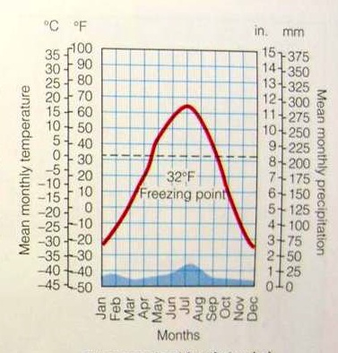
Climate Graphs
A graph showing the climate of a region over the course of a year
Bar graph shows precipitation
Line graph shows the temperature

Slide 4
North American Biomes

Slide 5
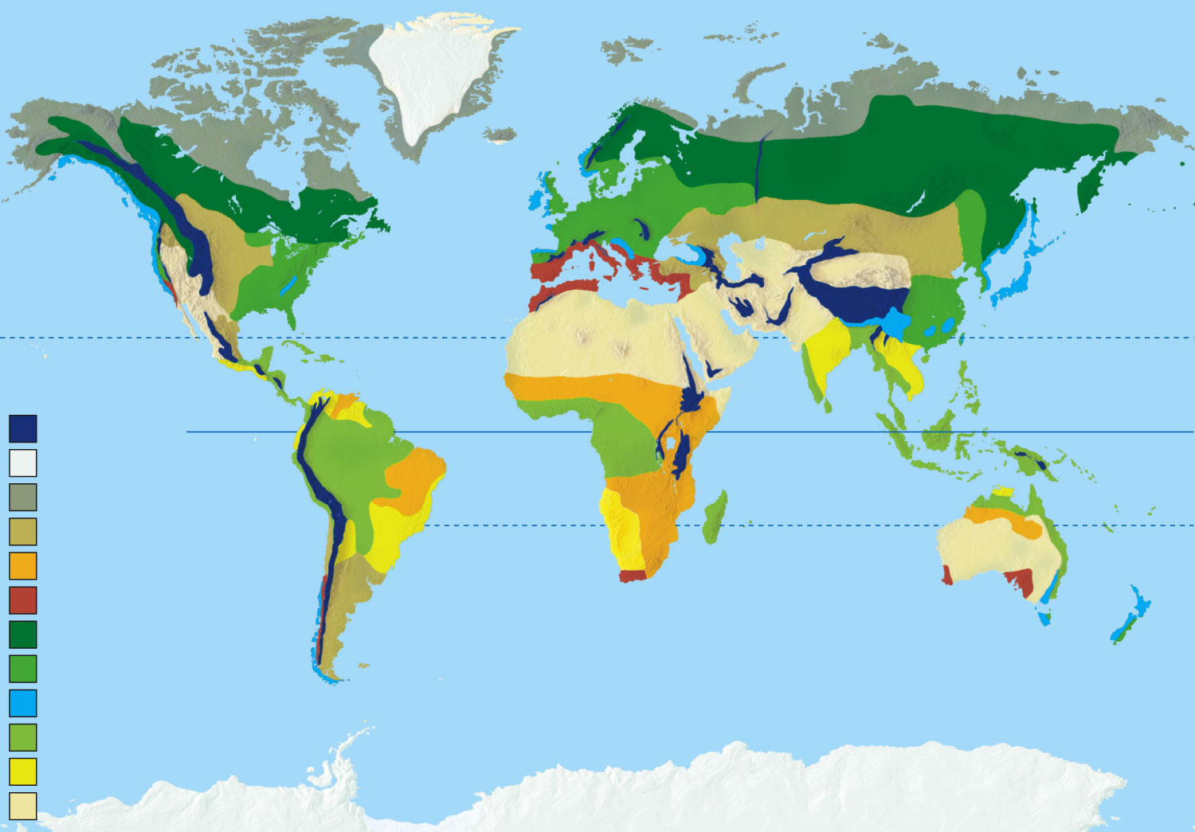
High mountains
Polar ice
Arctic tundra (cold grassland)
Temperate grassland
Tropical grassland (savanna)
Chaparral
Coniferous forest
Temperate deciduous forest
Temperate rain forest
Tropical rain forest
Tropical dry forest
Desert

Slide 6
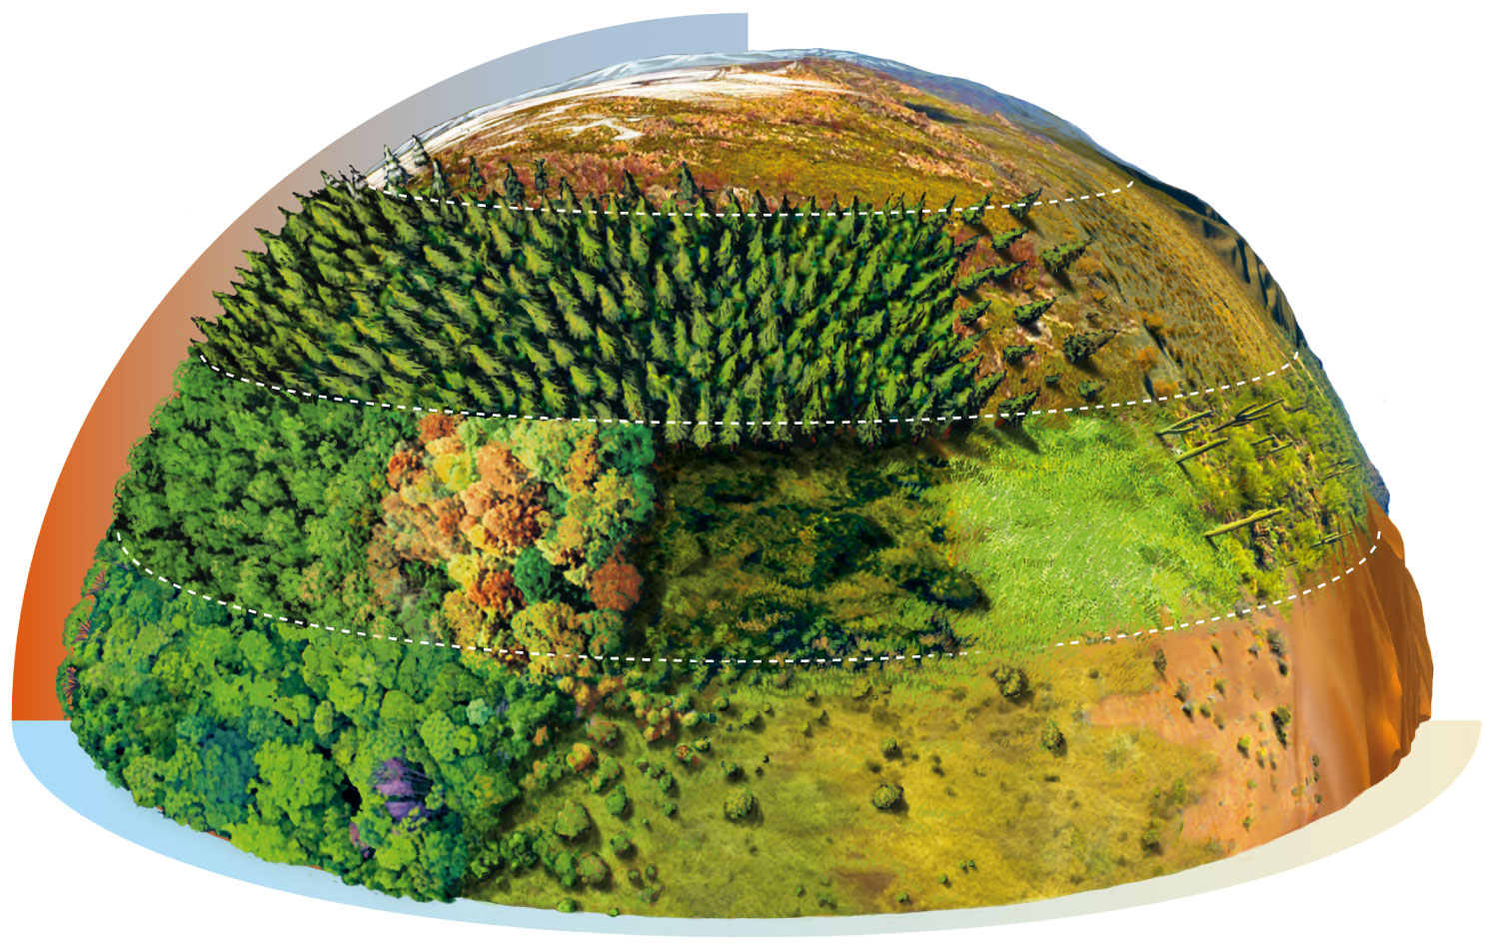
Cold
Arctic tundra
Evergreen coniferous forest
Cold desert
Temperate desert
Temperate deciduous forest
Temperate grassland
Chaparral
Hot Wet
Tropical desert
Tropical rain forest
Dry
Tropical grassland (savanna)

Slide 7
Biome Poster Gallery Walk
For this project you will be assigned to a group. Each group will be assigned one of the 9 biomes below. The number of the biome corresponds to the group # that will be completing that biome.
1. Arctic Tundra
2. Taiga/Boreal Forest/Coniferous Forest
3. Tropical Rainforest
4. Temperate Deciduous (Seasonal) Forest
5. Temperate Grassland/Woodland/Shrubland
6. Tropical Grassland/Savanna
7. Desert
8. Marine/Deep Ocean
9. Temperate Rainforest
Each member of your group is responsible for recording your poster information on the note sheet on the next page as well as your peers’ poster information.

Slide 8
Biome Groups
Emily , Jonathan , Jelissa
Ariel , Hugh , Alex, Elaina
Lauren , Tashari , Kayla
Austin , Hannah , Karen, Anthony
Winston , Destiny , Casey
Anna, Maria , Justin
Ramon, Marcus, Mary Jane, Alexa
Moises , Christian , Munir, Christopher
Olivia , KenNa' , Darren

Slide 9
Do Now
You have 10 minutes to add any finishing touches to your biome posters
Make sure you copy your group info in your packet as well
When finished, find a spot on the 2nd floor of J Hall to tape them
Visit each poster and complete your packets
You may want to grab a colored pencil to shade in the biome locations on the maps given. You are responsible for knowing their locations.
When packet is finished, continue working on Simpson Car Lab

Slide 10
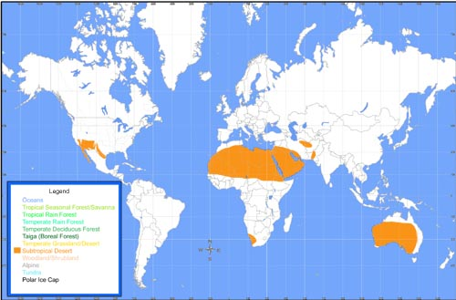
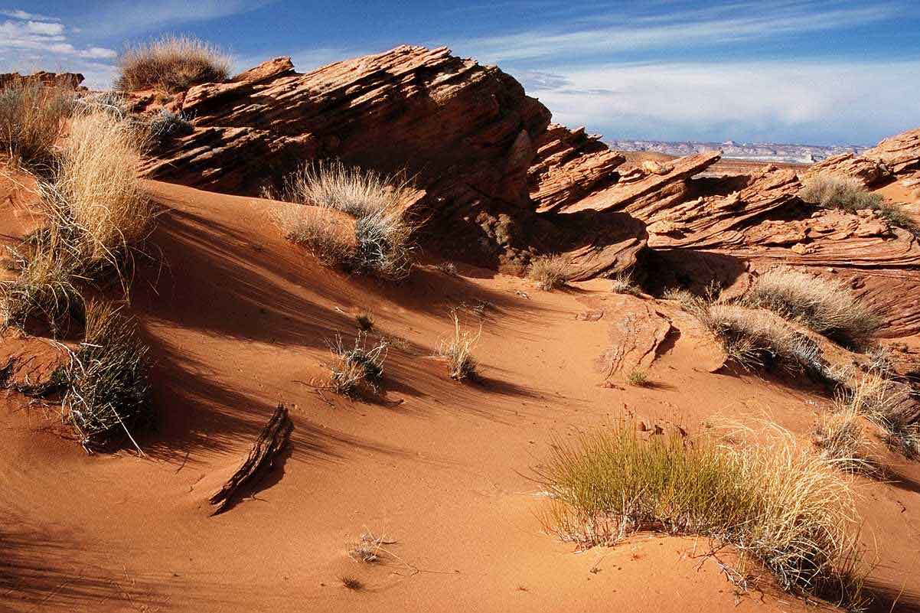
Deserts
Characteristics: Very dry, hot days and cold nights. Little to no vegetation
Temperature: 41°C During day to 0°C at night
Precipitation: Less than 250mm per year
Insolation: High
Limiting Factor: WATER

Slide 11
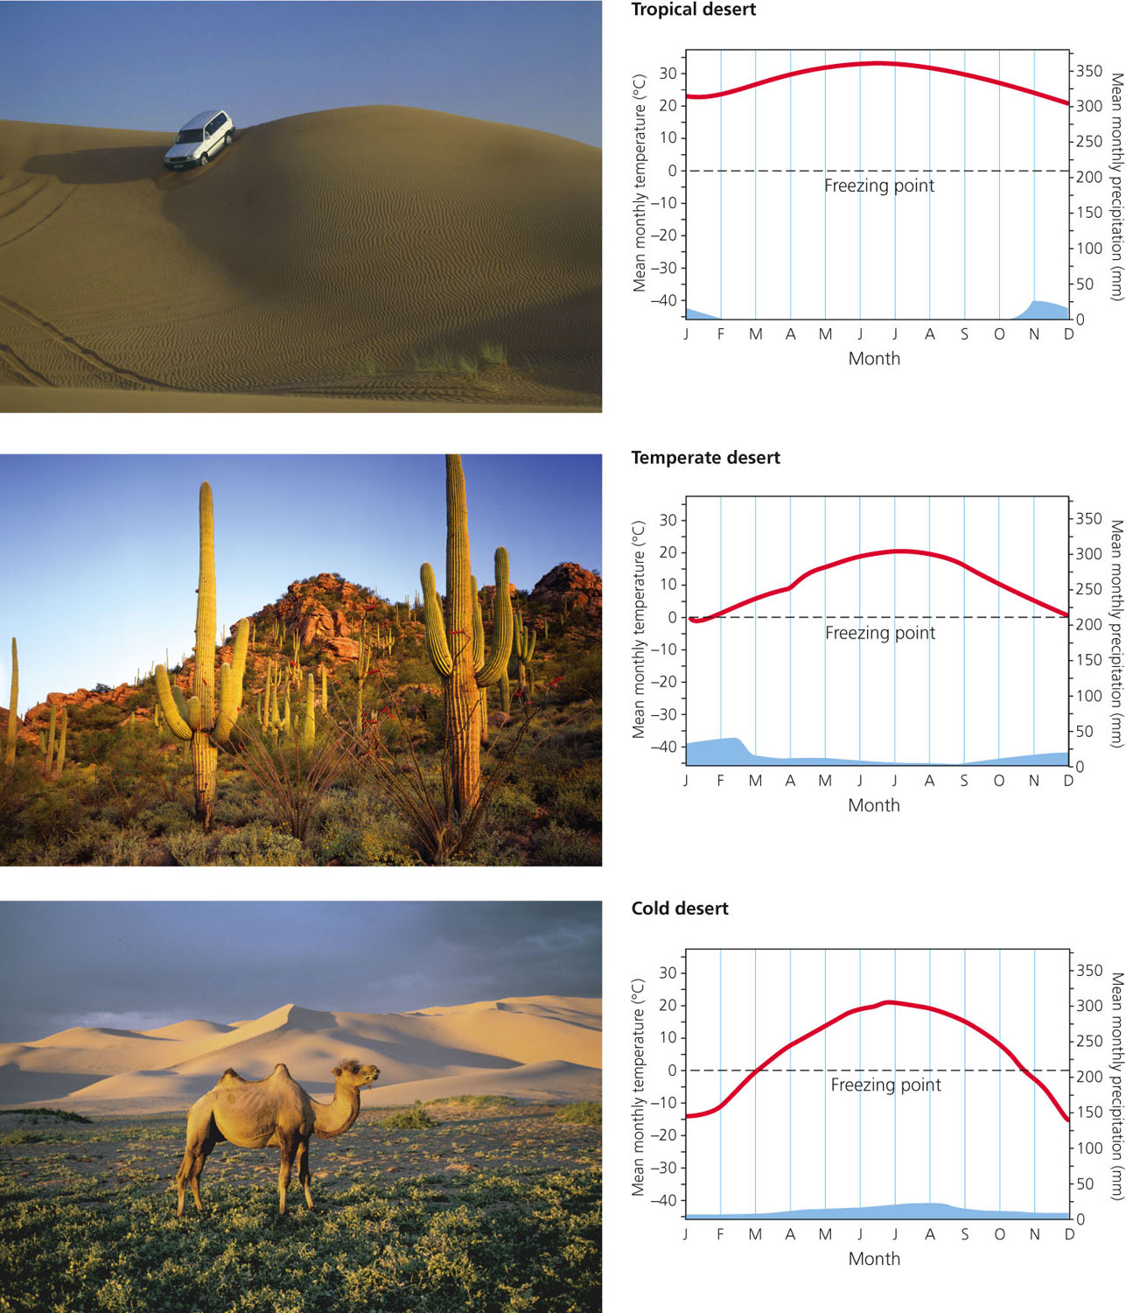

Slide 12
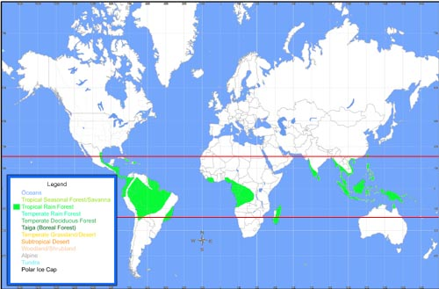
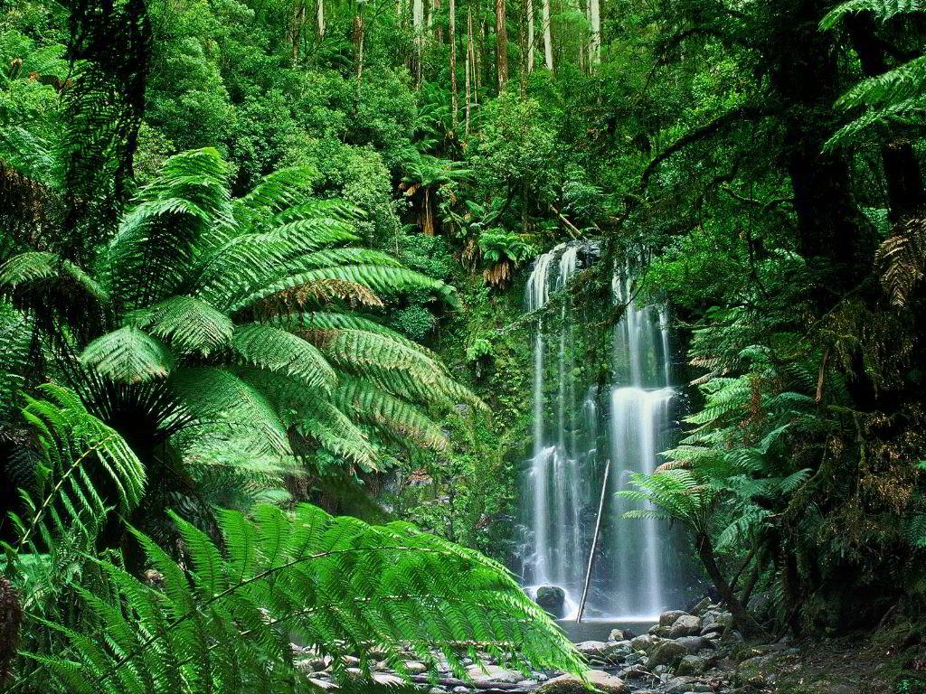
Tropical Rainforest
Characteristics: Typically hot areas, broadleaved evergreen forest
Temperature: 26-28 °C
Precipitation: High; 2000-5000mm per year
Insolation: Very High
Limiting Factor: Nutrients in soil (due to rainwater, washing it away)

Slide 13
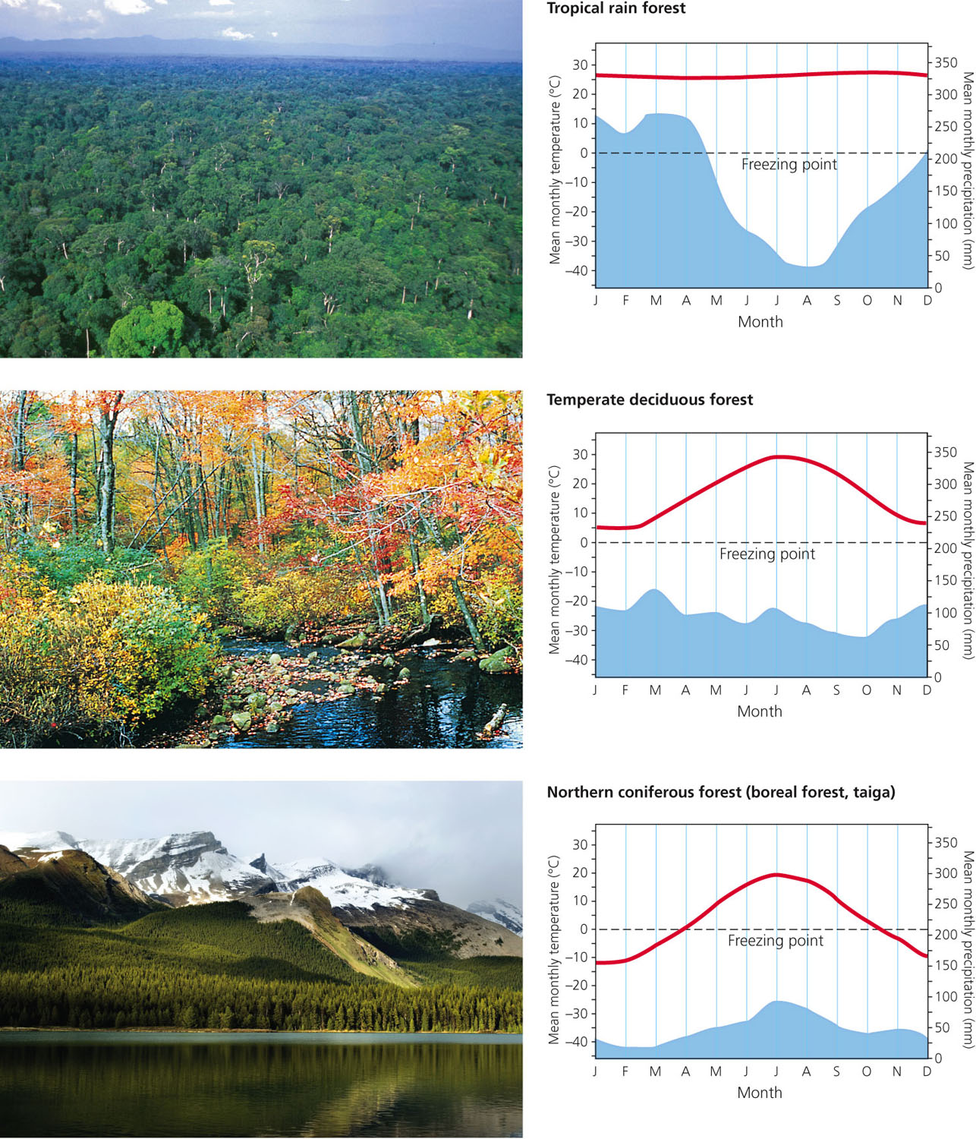

Slide 14
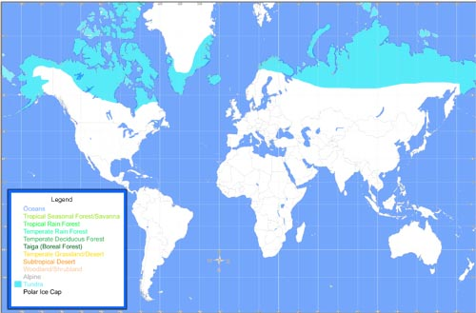
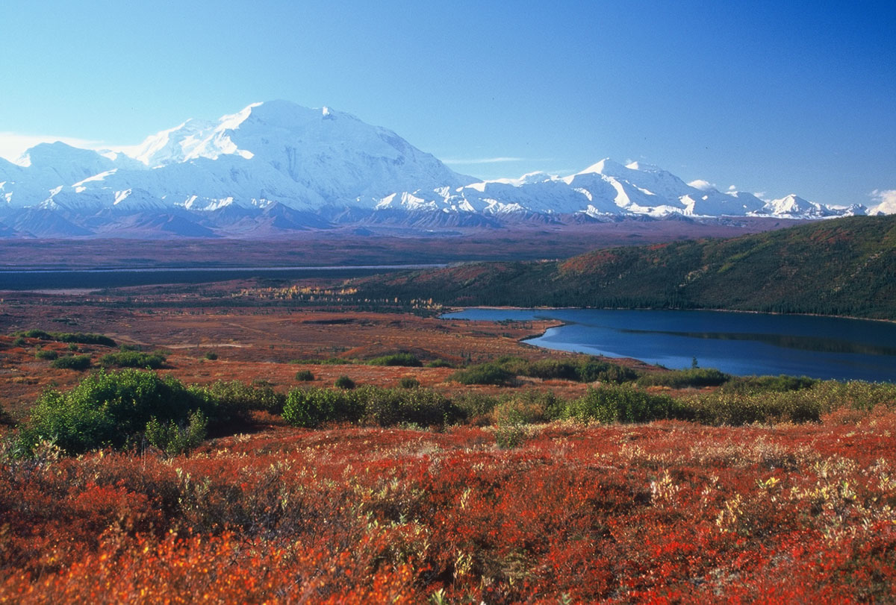
Tundra
Characteristics: Cold, low precipitation and long dark winters, covered in permafrost (frozen ground)
Temperature: -28°C in winter to 12°C in summer
Precipitation: Less than 250mm per year (most in summer)
Insolation: Low
Limiting Factor: water, temperature, insolation

Slide 15
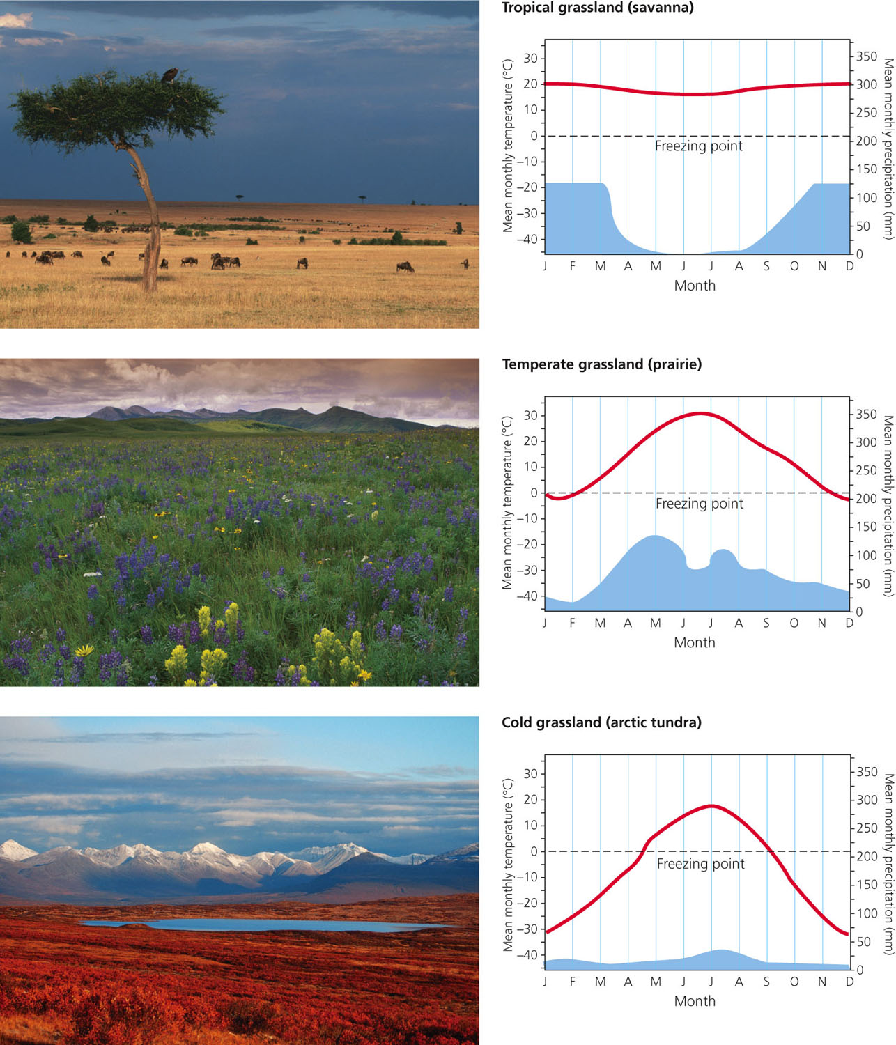

Slide 16
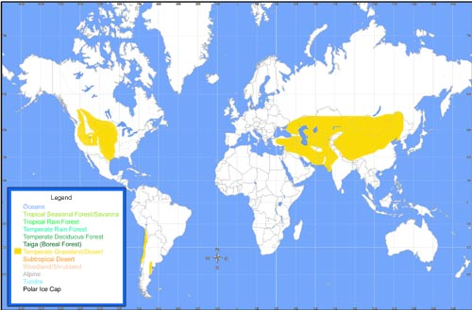
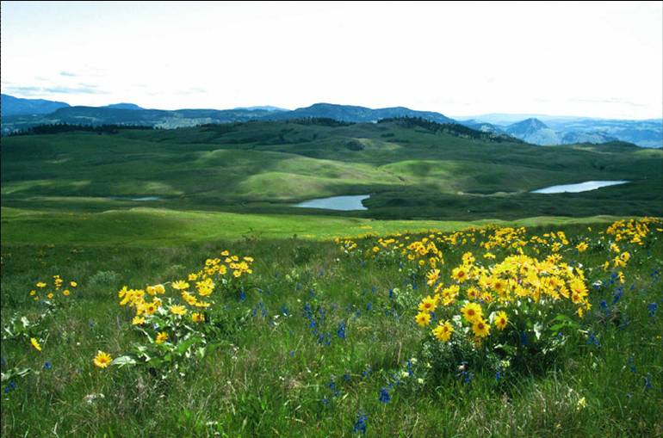
Temperate Grasslands
Characteristics: Fairly flat areas dominate by grasses and herbaceous (non-wood) plants
Temperature: -20°C in winter to 30°C in summer
Precipitation: 250mm – 1000mm
Insolation: Medium

Slide 17
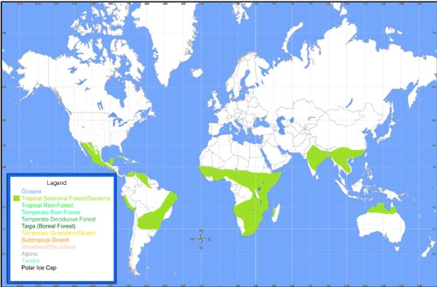
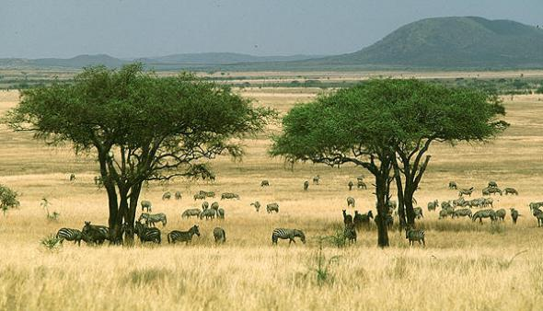
Tropical Grasslands (Savannas)
Characteristics: tropical climate zone with long periods of drought. Scattered shrubs and isolated trees, stays warm throughout the year plants adapted for drought
Temperature: ~ 27 °C
Precipitation:
235 - 1000 mm
precipitation annually
Insolation: relatively high

Slide 18
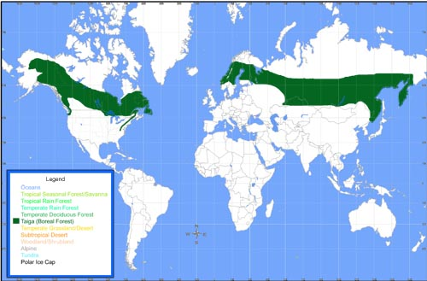
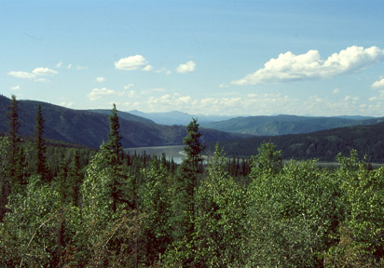
Taiga (northern coniferous forest/ boreal forest)
Characteristics: polar climate zone located south of the tundra biome. Harsh, long, cold winters; relatively cool summers
Temperature: -54 °C to 21° C
Precipitation low falls throughout the year 200-700mm / year
Insolation: relatively low

Slide 19
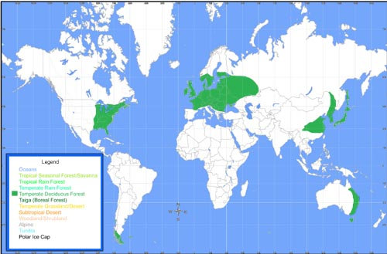
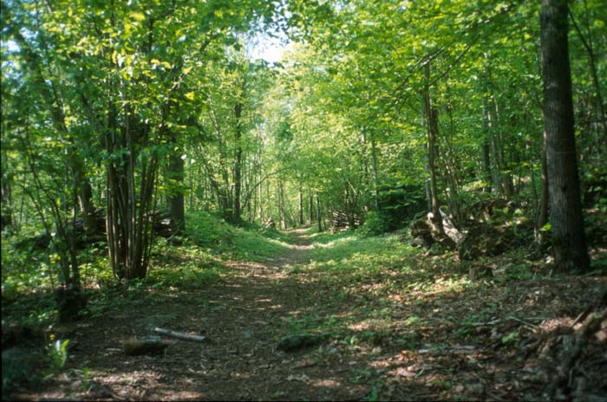
Temperate deciduous forest
Characteristics: Temperate climate zone, distinct summer and winter seasons. Leaves fall off trees in the fall
Temperature : ~10 ° C
Precipitation: 750-1500mm
Insolation: high –
2nd highest after tropical
rainforest

Slide 20
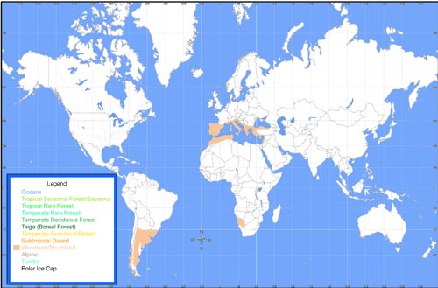
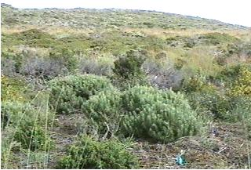
Chaparral (Scrub forest)
Characteristics: Temperate coastal zones California, Australia and Mediterranean mild wet winters, hot dry summers
Temperature: 10 to 40°C
Precipitation: 300 - 1000 mm
precipitation annually
Insolation: medium-to-low

Slide 21
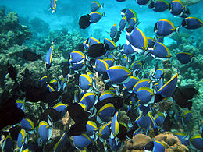
Aquatic Biomes
Coral Reefs (marine)
tropical warm, shallow water because sunlight required for photosynthesis
algae and phytoplankton are the base of food chain that is populated with many corals and fish
High Insolation called “Rainforests of the sea”
Freshwater
Lakes, Rivers, Streams

