Slide 1
Do Now
If you could clone (make a copy) of any LIVING thing – what would you clone? Why?
If you could pick your baby’s characteristics, would you?

Slide 2
Announcements!
Make sure you turned in your Unit 5 Packet and your review assignment!
New Vocabulary is due Friday!

Slide 3
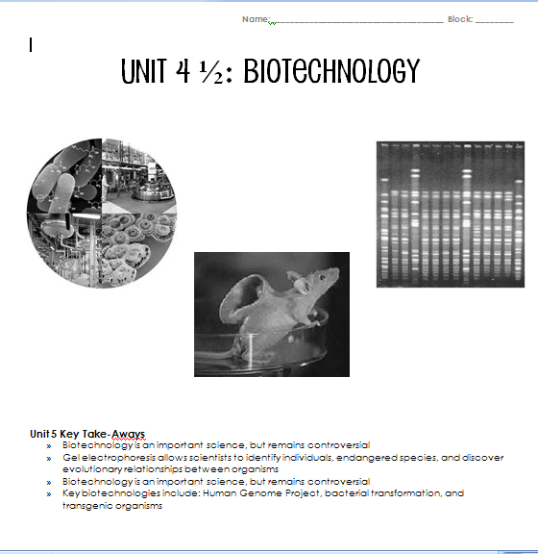

Slide 4
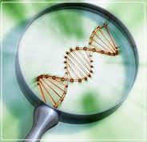
Biotechnology
5 “stations”
9 minutes each
Fill in your notes!

Slide 5
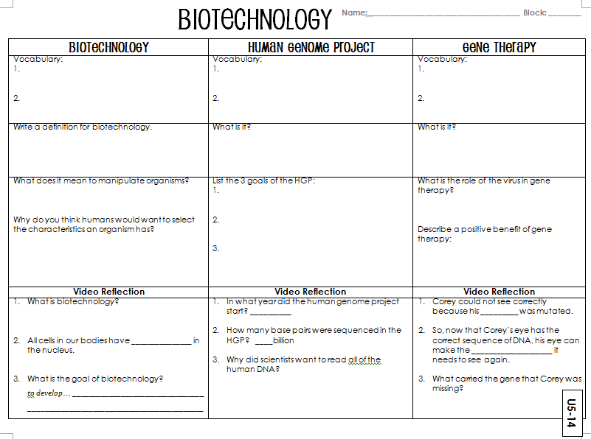

Slide 6
Ram block
Get your RAM Notebooks from the shelf
Sit quietly for instructions

Slide 7
DO Now
What is biotechnology?
What is the human genome project?
How might this project pose negative consequences? Positive?
What is gene therapy?
How could gene therapy be beneficial to medical sciences?

Slide 8
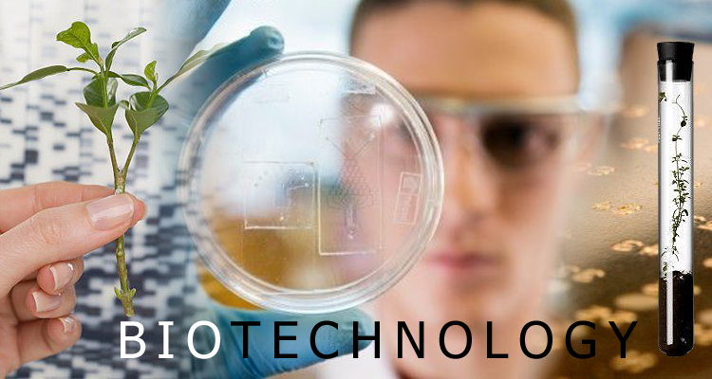

Biotechnology
http://www.youtube.com/watch?v=Wm6_BBS_KE4

Slide 9
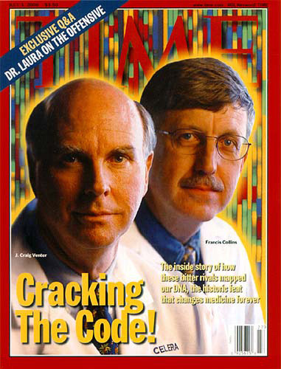
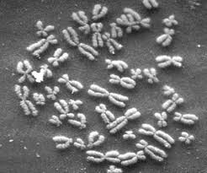
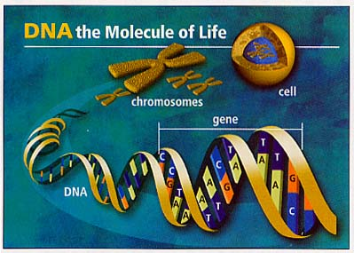
Human Genome Project
https://www.youtube.com/watch?v=N0QZDOcqyO4

Slide 10
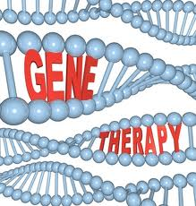
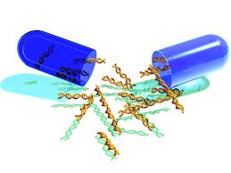
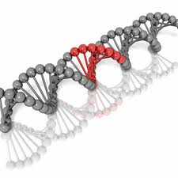
Gene Therapy
https://www.youtube.com/watch?v=H0RvTOF1fEc

Slide 11
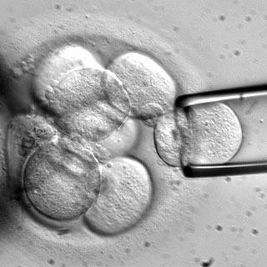
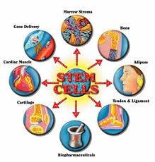
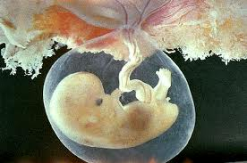
Stem Cell Research
https://www.youtube.com/watch?v=tPulEAryPO0

Slide 12
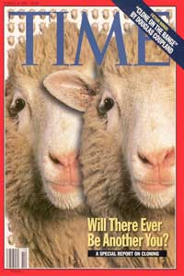
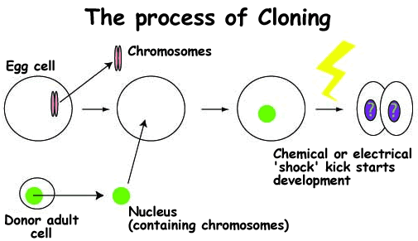
Cloning
https://www.youtube.com/watch?v=EoqBhtwgPmw

Slide 13
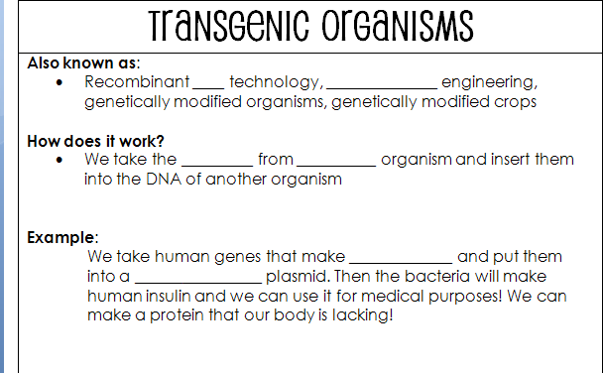
DNA
genetic
genes
one
insulin
bacterial

Slide 14
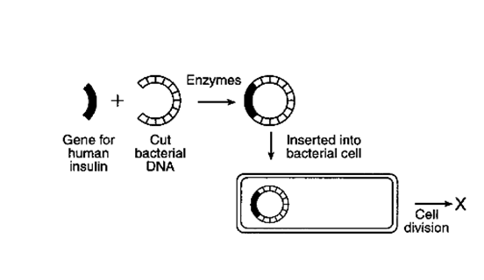
Transgenic organisms

Slide 15
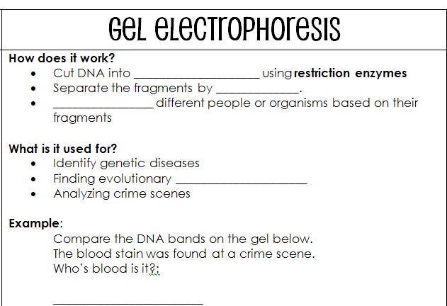
fragments
size
group
relationships

Slide 16
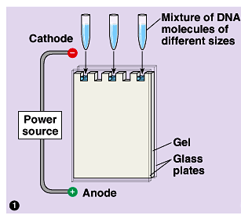
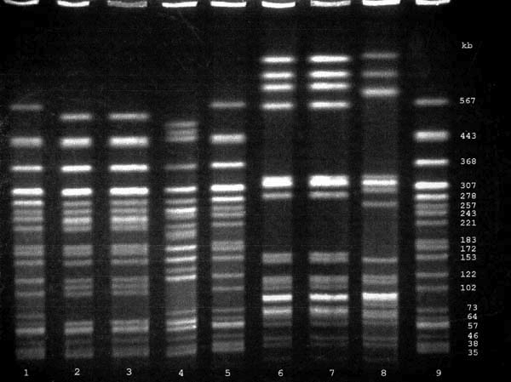

Gel electrophoresis
https://www.youtube.com/watch?v=Wwgs-FjvWlw

Slide 17
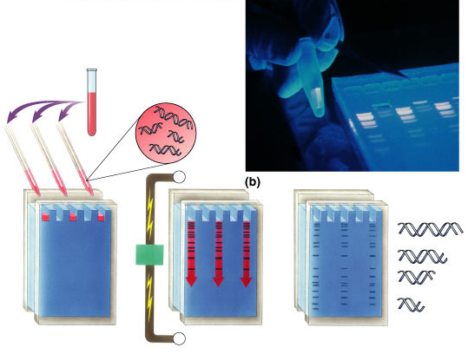
Gel electrophoresis

Slide 18
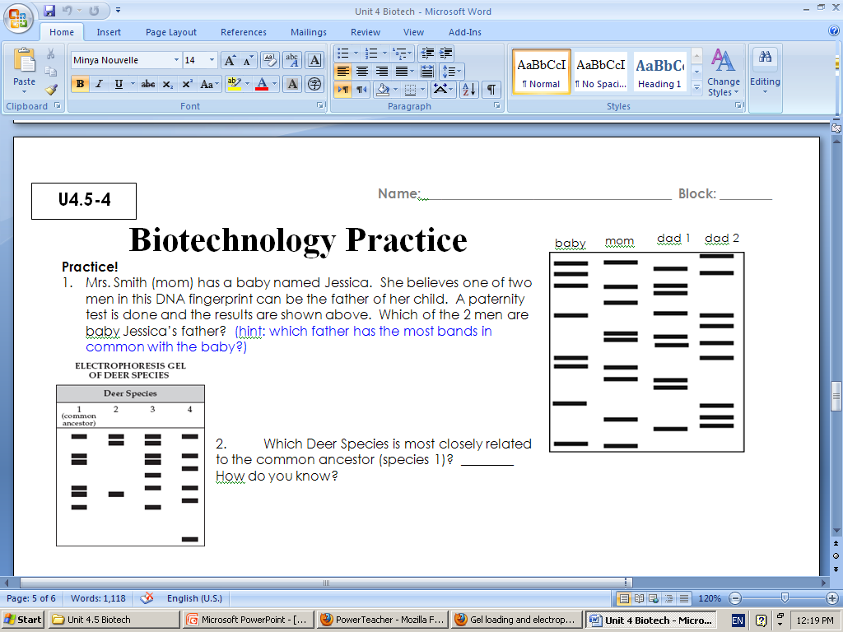
U4-26

Slide 19
Practice
Biotechnology practice
Unit 4 study guide
Unit 4 packet is due Friday
Biotechnology quiz on Friday

Slide 20
Word Wall
Choose any vocabulary word from units 1, 2, 3, or 4
Write the vocab word on a piece of computer paper or construction paper
Draw a picture to represent the word
Write the definition in your own words
Make it colorful and pretty

Slide 21
Biotechnology advertisement
Choose 1 type of biotechnology
Make an advertisement explaining your technology and why people should use it
  Poster
  Video
  Movie
  Etc.

Slide 22
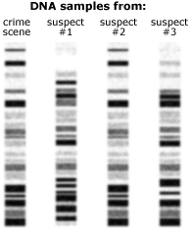
Do Now
What are transgenic organisms?
How are transgenic organisms used in modern medicine? (Hint: think of diabetics)
According to the DNA samples below, which suspect was at the crime scene?
What type of biotechnology
is this?

Slide 23
Announcement
Biotechnology quiz will be tomorrow NOT Friday
Unit 4 packets will be due on Friday

Slide 24
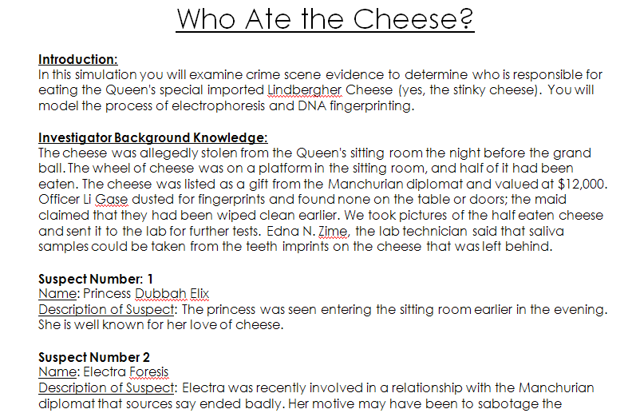
Who at the Cheese

Slide 25
Materials
Handout
Scissors
5 DNA patterns
  Crime scene DNA
  Suspect 1
  Suspect 2
  Suspect 3
  Suspect 4

Slide 26
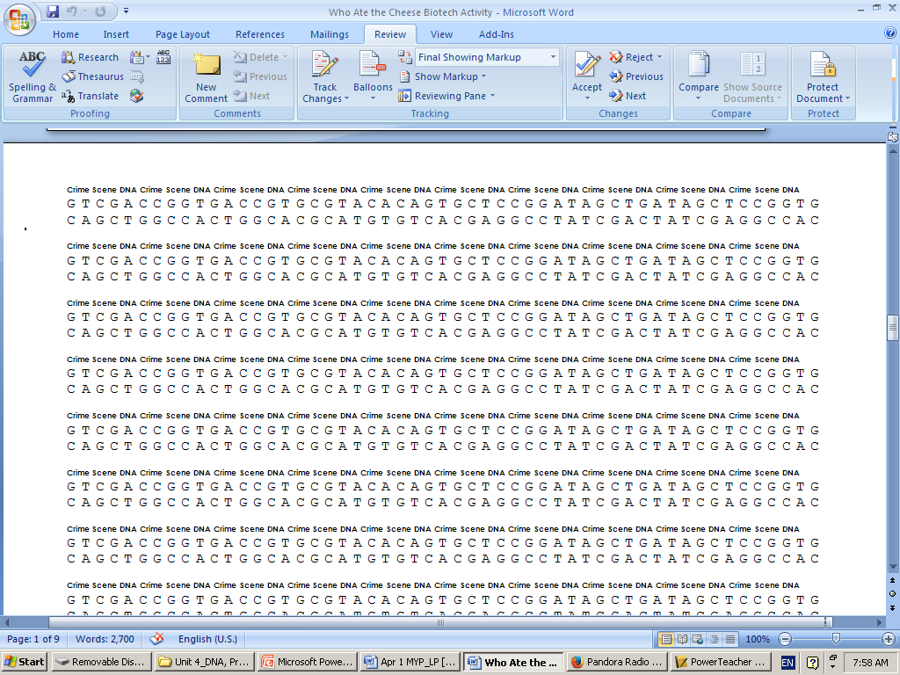

Slide 27
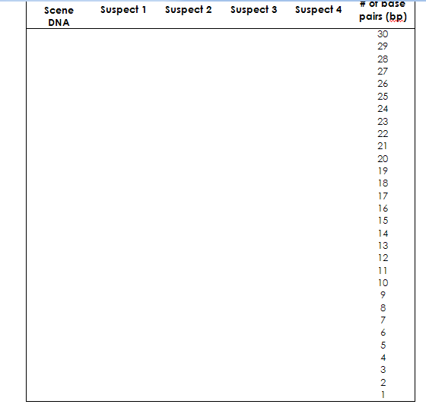

Slide 28
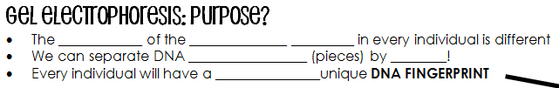
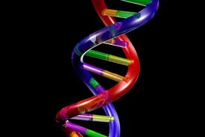
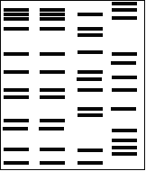
Purpose
order
nitrogenous bases
fragments
size
completely
sperm
S1
S2
S3

Slide 29
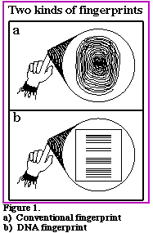

Slide 30
How?
cut
________: cut DNA into fragments using ______________ _____________ (molecular scissors!)
__________: put the DNA fragments into wells of a gel
_______ ____: connect a power source. __________________ charged DNA moves to the positive (+) end!
    “swimming through __________”
    Larger fragments move slower
    _______________ fragments move faster (& farther!)
restriction enzymes
load
run it!
negatively
jello
smaller

Slide 31
How?
read it!
4. _______ ____: interpret the results!
Which suspect was at the crime scene?

Slide 32

Gel electrophoresis

Slide 33
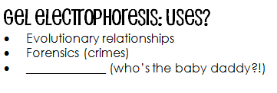
Uses?
paternity

Slide 34
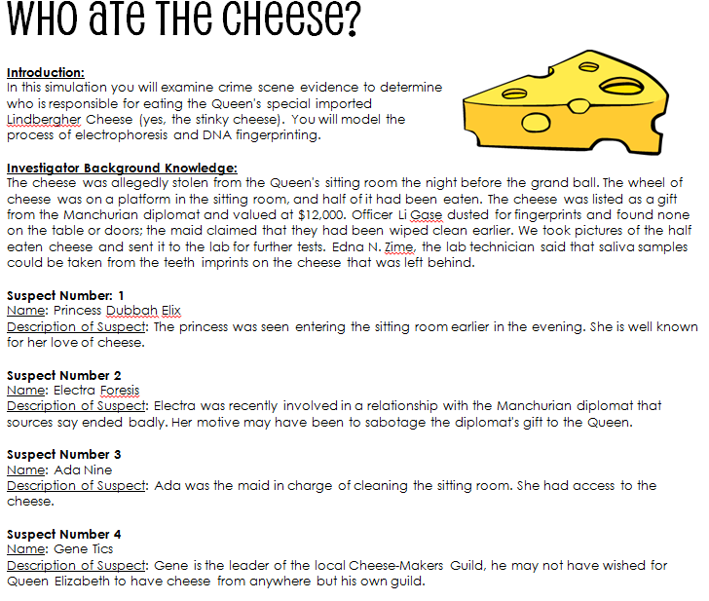
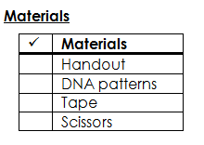

Slide 35
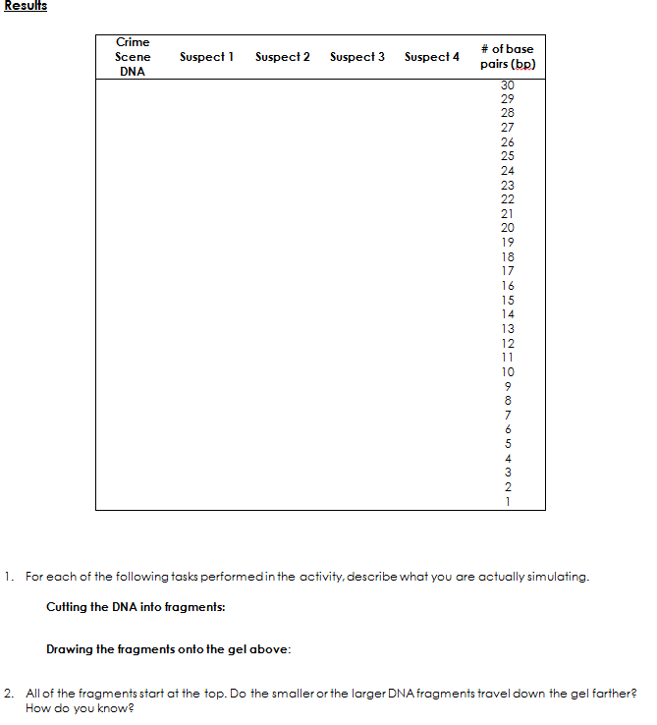
U5-4 & U5-5
20 min.

Slide 36
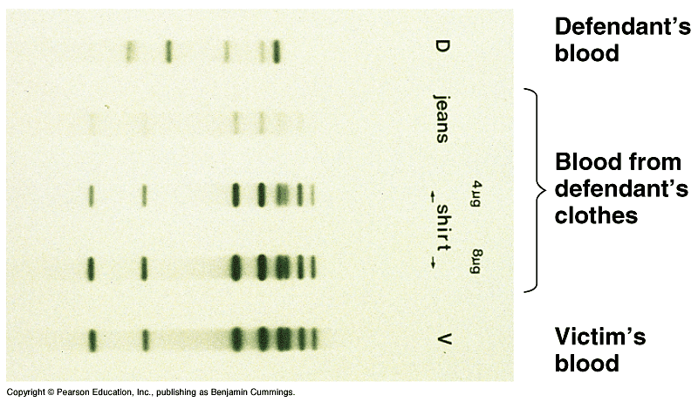
Do Now
Whose blood is on the defendant’s clothes?
Would you say that the defendant is innocent or guilty? Why

Slide 37

Do Now
What type of enzyme acts like “molecular scissors” to cut DNA?
List the 5 biotechnologies that we learned about yesterday

Slide 38
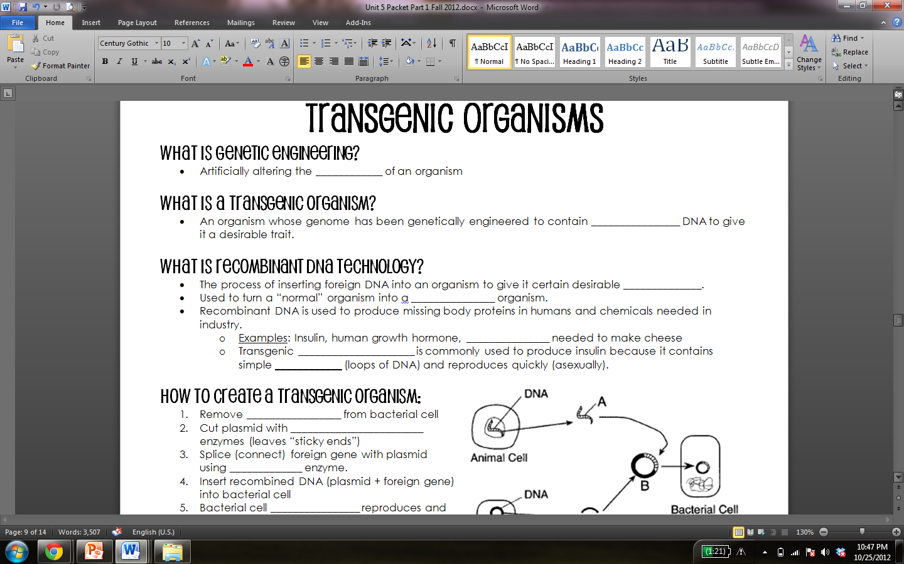
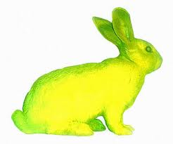
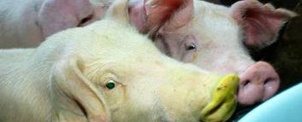
DNA
different

Slide 39
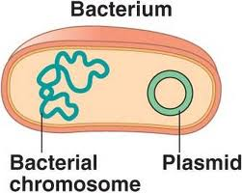
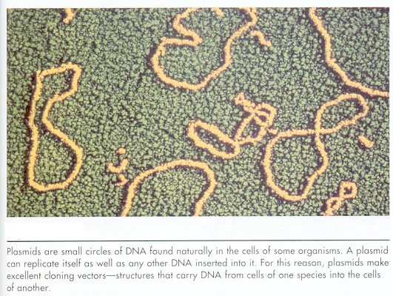
traits
transgenic
proteins
bacteria
plasmid

Slide 40
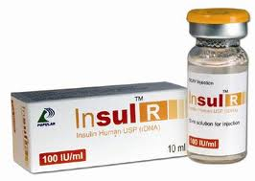
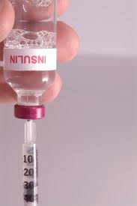
PROBLEM: People have diabetes and cannot make insulin
SOLUTION: use recombinant DNA to force bacteria to make insulin for us!

Slide 41
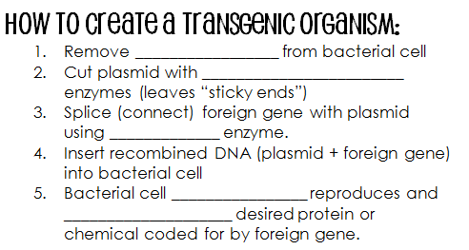

plasmid
restriction
plasmid

Slide 42
plasmid
restriction
lipase
asexually
synthesizes
plasmid
human
DNA

Slide 43
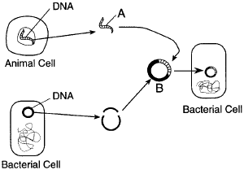

Slide 44
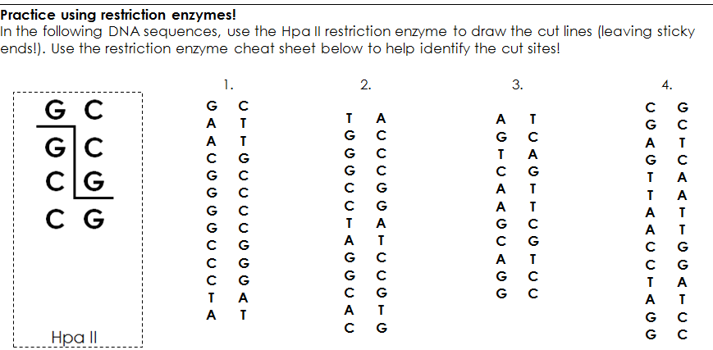

Slide 45
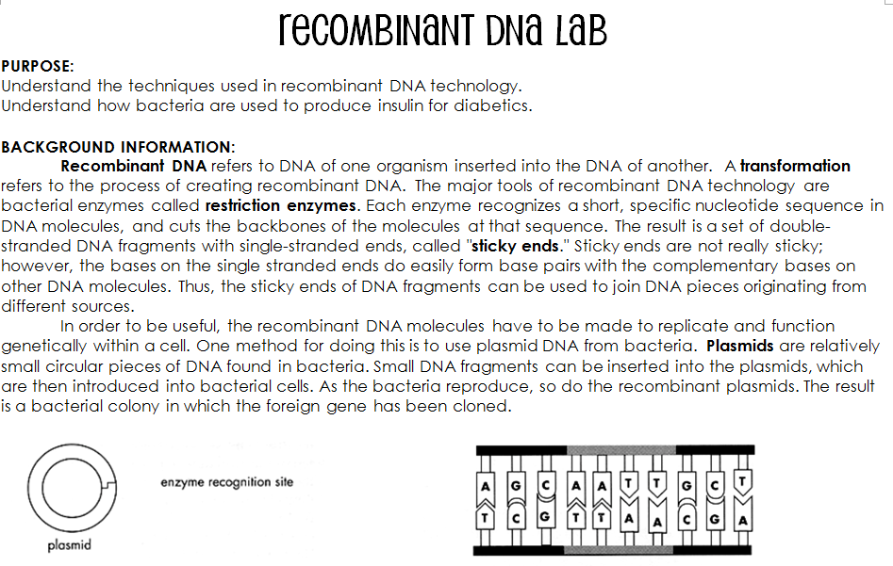

Slide 46
Recombinant DNA Lab
READ CAREFULLY
Working with your partner
Once you have read ALL of the instructions through one time, you may raise your hand for materials

Slide 47
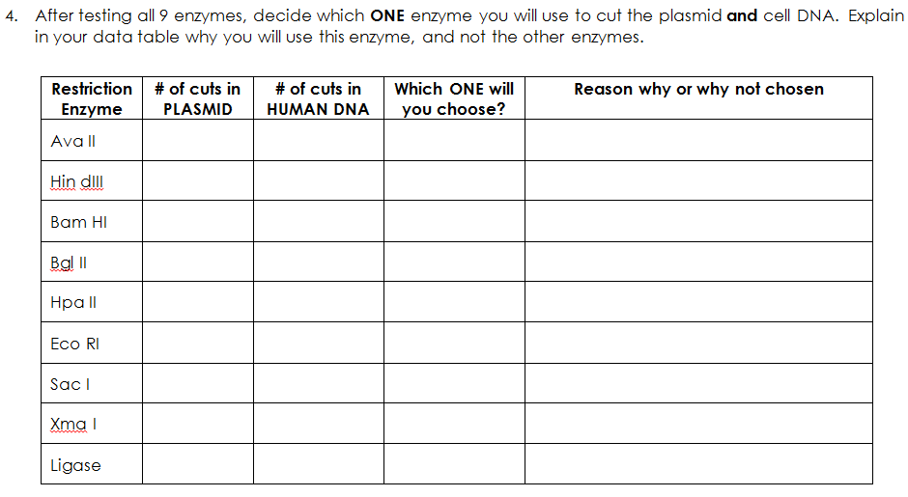

Slide 48
Practice
Pg U5-12 & U5-13

Slide 49
Do Now
STUDY biotechnology notes. You have a quiz today!

