Slide 1
Do Now
What is weather?
What is climate?
Describe the difference between short term and long term patterns.
What is global warming?

Slide 2
Definition: Climate
Describes the average conditions expected at a specific place at a given time. A region's climate is generated by the climate system, which has five components: atmosphere, hydrosphere, cryosphere, land surface, and biosphere.

Slide 3
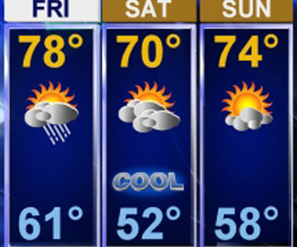
Definition: Weather
Describes the atmospheric conditions at a specific place at a specific point in time. Weather generally refers to day-to-day temperature and precipitation activity

Slide 4
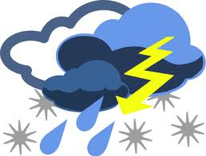
Components
CLIMATE
Climate may include precipitation, temperature, humidity, sunshine, wind velocity, phenomena such as fog, frost, and hail storms over a long period of time.
WEATHER
Weather includes sunshine, rain, cloud cover, winds, hail, snow, sleet, freezing rain, flooding, blizzards, ice storms, thunderstorms, steady rains from a cold front or warm front, excessive heat, heat waves and more

Slide 5
Forecast: Climate
By aggregates of weather statistics over periods of 30 years

Slide 6
Forecast: Weather
By collecting meteorological data, like air temperature, pressure, humidity, solar radiation, wind speeds and direction etc.

Slide 7
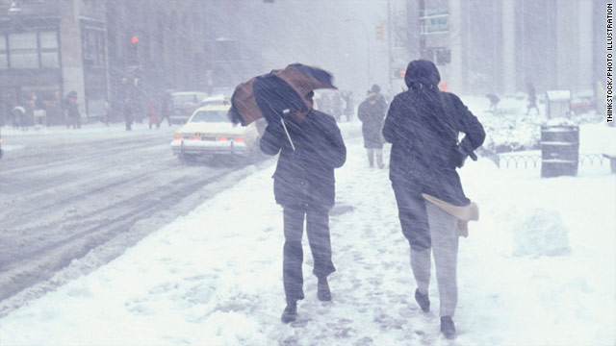
Determining Factors
Climate
Weather
Aggregating weather statistics over periods of 30 years ("climate normals").
Real-time measurements of atmospheric pressure, temperature, wind speed and direction, humidity, precipitation, cloud cover, and other variables

Slide 8
About: Climate
Climate is defined as statistical weather information that describes the variation of weather at a given place for a specified interval.

Slide 9
About: Weather
Weather is the day-to-day state of the atmosphere, and its short-term (minutes to weeks) variation

Slide 10
Time Period
Climate
Weather
Measured over a long period
Measured for short term

Slide 11
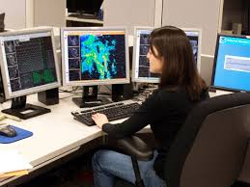
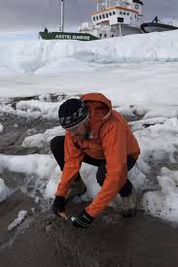
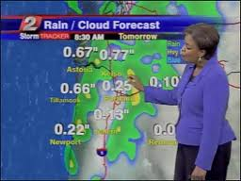
Study
Climate
Climatology
Weather
Meteorology

Slide 12
Koppen Classification Groups
Group 1: Humid tropical
Group 2: Humid mid latitude (mild winters)
Group 3: Humid mid latitude (severe winters)
Group 4: Dry
Group 5: Polar
Group 6: Highland
Poster/visual to present to class
One page notes (guided or unguided) that summarizes key points of your climate including:
What? (explanation)
Where? (specific locations on Earth)
Why? (factors that influence your climate)
Use pages 592-599 in your textbook as a reference. You may also use your device to research your climate on the internet.
This is a GROUP GRADE so EVERYONE must PARTICIPATE!

