Slide 1
Human Genome Project – collaborative effort to map out every human gene location
Used to identify locations of all disease causing genes
~ Better treatment
~ Gene therapy

Slide 2
Gel Electrophoresis also called DNA fingerprint

Slide 3
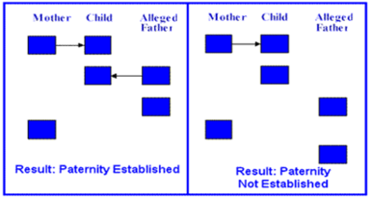
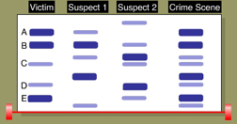
Used for
Paternity – HALF of the bands must match
Forensics (crime scene analysis) – ALL must match

Slide 4
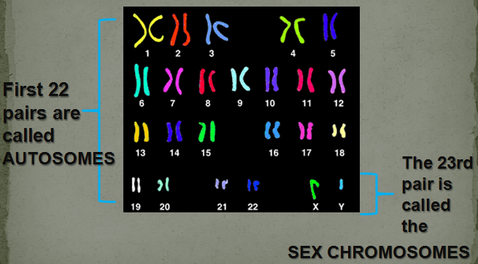
Karyotypes
~ picture of an individuals chromosomes
~ used to diagnose chromosomal disorders/abnormalities
~ humans should have 46

Slide 5
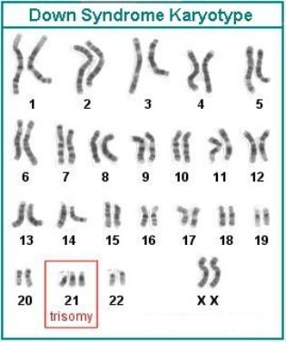
~ Most common error is TRISOMY 21
~ 3 copies of chromosome 21
~ Down Syndrome
~Other chromosomal disorders you need to know:
Klinefelter’s Syndrome XXY
Turner’s Syndrome XO
~You will need to be able to recognize disorder & gender
XX – female XY - male

Slide 6
Evolution
Charles Darwin – Father of evolution Studies finches & tortoises on the Galapagos Islands
O – Overproduction of Offspring - species produce LOTS of offspring to make sure enough survive to keep population going
V – Variation – individuals are all different (different strengths & weaknesses) caused by mutations & SEXUAL reproduction
C – Competition – variations cause some to be better competitors for limited resources (space, food, protection, mates, etc.)
S – Survival of the fittest
Fit means BEST ADAPTED TO THEIR ENVIRONMENT
Those that succeed reproduce & pass on their ‘GOOD’ genes

Slide 7
Evolution
All evolution is driven by RANDOM MUTATION
If that mutation causes you to be better fit to your environment, you will survive and pass that mutation to your offspring

Slide 8
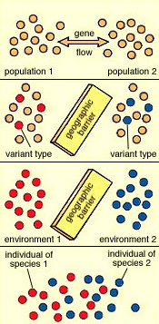
Speciation – a barrier separates a species
~over time both halves evolve
differently & form enough genetic difference to be 2 different species

Slide 9
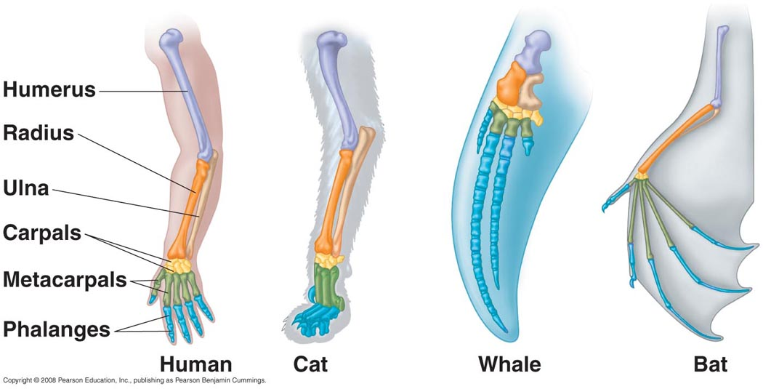
Evidence for evolution
Fossils – remains of past life forms
Homologous Structures – SAME basic structure in different species
Shows COMMON ANCESTRY

Slide 10
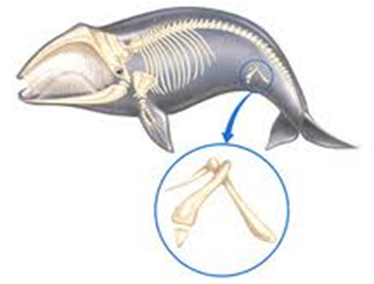
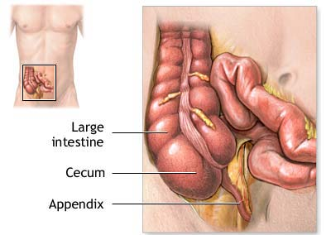
3. Vestigial Structures – structures no longer used by organism
Ex. Leg bones in whale skeleton, human tailbone & appendix

Slide 11
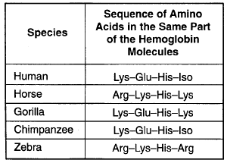
4. Biochemical Evidence – Comparison of DNA sequences in different species
~ The more similarity, the more recent the common ancestor
Humans & chimps = 99% identical
Humans & bananas = 70% identical

Slide 12
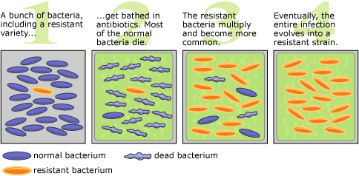
Antibiotic Resistance in Bacteria
Because of quick generation time, we can witness evolution in action.
Some bacteria are stronger than medicine (because of RANDOM MUTATION).
These bacteria will survive & reproduce, leading to antibiotic resistance

Slide 13
Classification
Binomial Nomenclature – TWO name system
Scientific name is GENUS & SPECIES
Ex. Homo sapien – human Canis familiaris – dog
7 Taxons from largest to smallest
Kingdom
Phylum
Class
Order
Family
Genus
Species
Two
Name

Slide 14
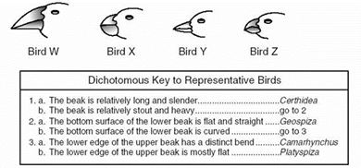
Dichotomous Key
Bird W -
Bird X -
Bird Y -
Bird Z -
Geospiza
Platyspiza
Certhidea
Camarhynchus

Slide 15
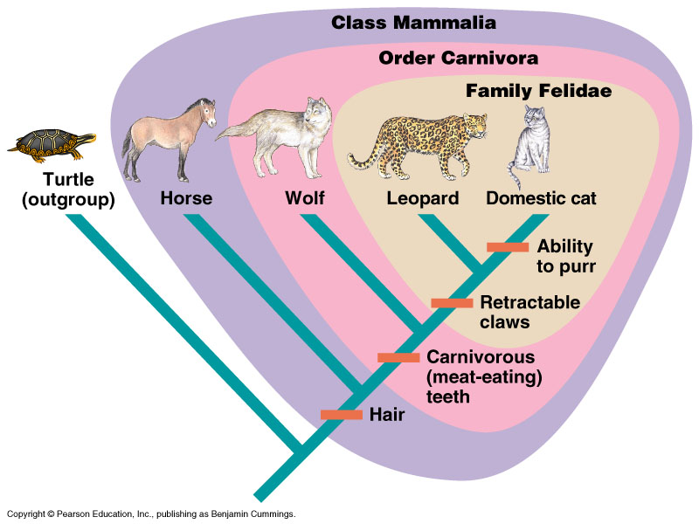
Cladograms
The closer they are on the cladogram, the closer the evolutionary link.

Slide 16
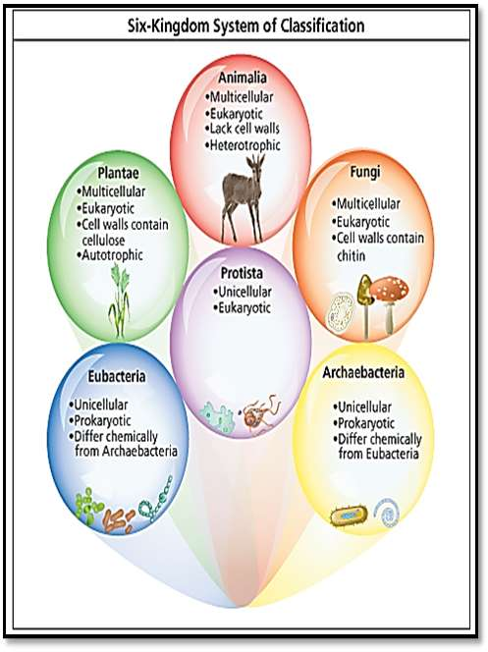
Six Kingdoms of Life
Archaebacteria – OLDEST, Prokaryotic, CELL WALL
Eubacteria – NEWER, Prokaryotic, CELL WALL
Protist – Unicellular, Photosynthetic, Eukaryotic, CELL WALL
Fungi – Multicellular, Heterotrophic, Eukaryotic, CELL WALL
Plant – Multicellular, Photosynthetic, Eukaryotic, CELL WALL
Animal – Multicellular, Heterotrophic, Eukaryotic, NO CELL WALL

Slide 17
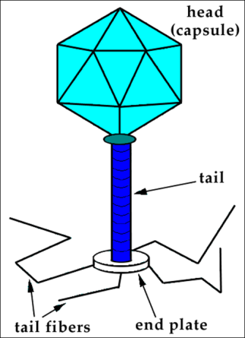
Six Kingdoms of Life
Viruses – NOT LIVING
2 reasons:
NOT made of cells
Can’t reproduce on their own
MUST use a host cell

Slide 18
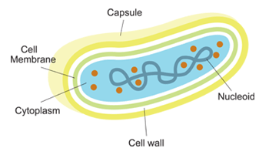
Six Kingdoms of Life
Archaebacteria – OLDEST forms of life
Live in harsh environments
Prokaryotic
Cell Walls
Means old

Slide 19
Six Kingdoms of Life
Eubacteria – Common bacteria
MOST are beneficial
Some are pathogenic (cause disease)
Cell Walls

Slide 20
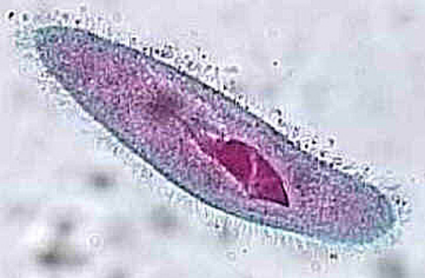
Six Kingdoms of Life
Protists – Mostly UNICELLULAR
Cell Walls
Ex. Paramecium, Euglena, Amoeba

Slide 21
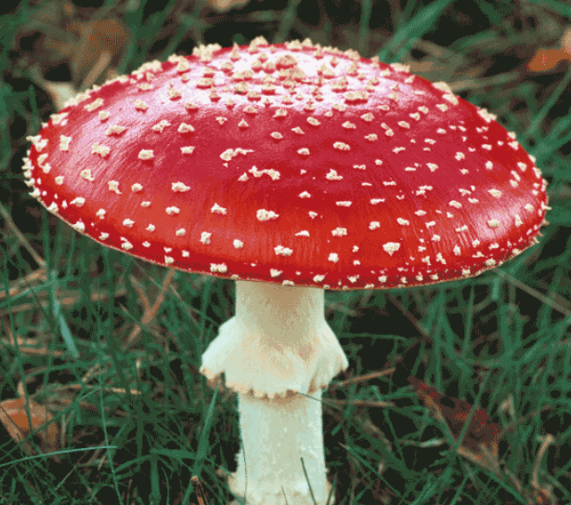
Six Kingdoms of Life
Fungi – Mostly MULTICELLULAR (mushrooms)
Yeasts are unicellular
Heterotrophic
Decomposers
Cell Walls

Slide 22
Six Kingdoms of Life
Plants – Multicellular, autotrophic (photosynthetic), Cell Walls
Vascular or Non-vascular
Gymnosperms Angiosperms

Slide 23
Vascular vs. Non-vascular
TUBES
Xylem – carry H2O
Phloem – carry food
NO TUBES
Absorb H2O and nutrients by diffusion
Ex. Mosses

Slide 24
Gymnosperm vs. Angiosperm
NAKED SEED
No fruits or flowers
Ex. Pinecones
Gym = Cones
Jim likes cones
COVERED SEED
Seeds protected by flowers or fruits
Angie = Flowers
Angie loves flowers

Slide 25
Plant Tropisms/Taxis
Movement TOWARD or AWAY from a stimulus
Positive = toward Negative = away from
Photo = light geo = gravity hydro = H2O thigmo = touch
Ex. Positive phototropism (phototaxis) means leaves of a plant grow toward sun

Slide 26
Plant Regulating Hormones
Auxins – elongation of cells allows plants to bend
Cytokinens – rapid cell division roots
Ethylene – gas for fruit ripening/spoilage
Ex. Bananas go from green to yellow to brown

Slide 27
Animals
Multicellular, heterotrophic, NO Cell Walls
Invertebrate – NO backbone ex. sponge
Vertebrate – Backbone ex. human

Slide 28
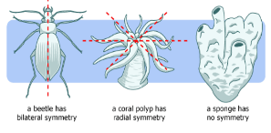
Symmetry
Radial Bilateral Asymmetry
Symmetry from
one central point
Symmetry by halves
NO symmetry
Ex. sponge
Ex. pizza
Ex. human

Slide 29
Animal Behavior
Instinct/Innate Behavior – behavior you are born already knowing ex. nursing, suckling, migration, estivation, hibernation, taxis, tropism
1. Flight or Fight – a rush of adrenaline to allow you to stay and defend or run away
2. Reflex – AUTOMATIC response to a stimuli ex. Blinking, flinching
3. Courtship – behavior done in order to mate ex. Bird calls, peacock showing feathers

Slide 30
Animal Behavior
4. Territoriality – behavior done to defend your resources (space, food, mates, etc.)
5. Aggression – behavior done to show your power ex. lion growling, dog barking, etc.
6. Dominance Hierarchy – behavior in a population to show social ranking ex. Bees in a hive (queen, workers)
7. Taxis – movement toward or away from a stimulus same a tropisms for plants
Cockroaches run away from light = negative phototaxis

Slide 31
Animal Behavior
Behavior Cycles
1. Circadian rhythm – happens every 24 hours
2. Hibernation – lower metabolism in winter
3. Estivation – lower metabolism in hot weather
4. Migration – movement to a different location during different seasons

Slide 32
Animal Behavior
Learned Behavior – behavior learned during your lifetime
1. Habituation – ignoring constant harmless stimuli ex. Perfume, living next to airport
2. Classical Conditioning – associating one stimuli to a NON-related stimuli ex. Pavlov’s dogs
3. Trail and Error/Operant Conditioning – reward/punishment for good/bad behavior

Slide 33
Animal Behavior
4. Imprinting – happens immediately after birth ex. Babies with mothers scent, ducks following mom
5. Communicating – relaying information to other members of your population (verbal, visual, scent)
6. Social Behavior – behavior done to increase your chance of survival ex. Pack animals, schools of fish

Slide 34
Ecology
Biosphere – any part of Earth that can sustain life ex. ocean, land, air
Population – all the members of same species in same place at same time
Community – all of the interacting species in one area
Biotic factors – LIVING factors that affect other species ex. Food, predators, symbiotic partners
Abiotic factors – NON-LIVING factors that affect other species
ex. H2O, temperature, sunlight, etc.

Slide 35
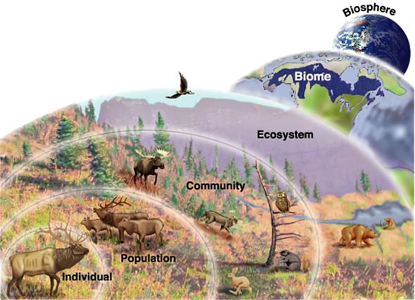

Slide 36
Producer – can make their own food
Also called AUTOTROPHS
Consumer – CANNOT make their own food
Also called HETEROTROPHS
Herbivores – eat plants only
Carnivore – eat meat only
Omnivore – eat both plants and animals
Decomposer – break down dead material and return the nutrients to the soil
Main Decomposers – bacteria & fungi

Slide 37
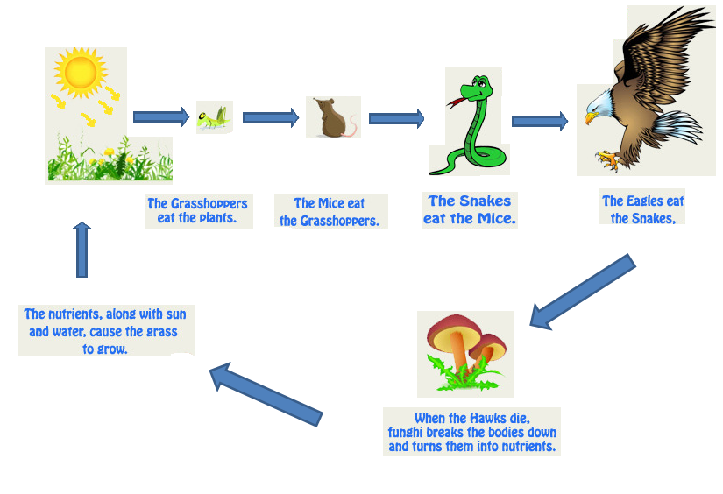
Food chain/Web – links of energy transfer
Only 10% of energy travels from link to link, the rest is lost as heat !!

Slide 38
Mutualism BOTH benefit examples: humans & bacteria, clownfish & anemone, birds/bees & flowers | Commensalism One benefits, other UNAFFECTED examples: shark & remora, tree & birds
Parasitism One benefits, other HARMED examples: dog & fleas, humans & tapeworms | Predator/Prey One KILLS and EATS the other examples: lion & gazelle, bear & salmon

Slide 39
Parasitism
Predator/Prey
Commensalism
Mutualism
Mutualism
Predator/Prey
Commensalism
Parasitism

Slide 40
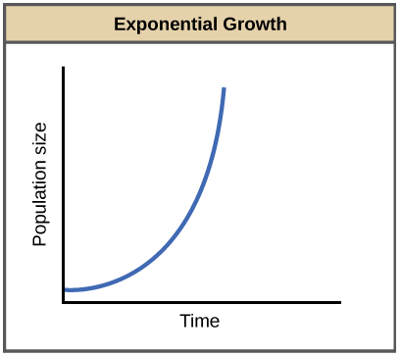
Population Growth
Exponential Growth – MUST have UNLIMITED resources (space, food, mates, etc.)

Slide 41
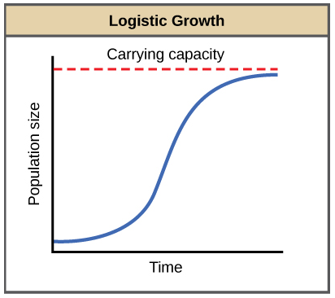
Population Growth
Logistic Growth – as population reaches CARRYING CAPACITY (the maximum number of individuals a place can support), the growth rate SLOWS DOWN and hovers around the carrying capacity.

Slide 42
Predator/Prey Curves – two species dependent on each other. A change in one of them will cause a change in the other.

Slide 43
Limiting Factors
Density-Dependent – will limit population growth MORE as the population gets bigger
Examples – sickness, predator/prey, competition
Density-Independent – will limit population growth THE SAME regardless of how big or small the population gets
Examples – natural disasters, pollution

Slide 44
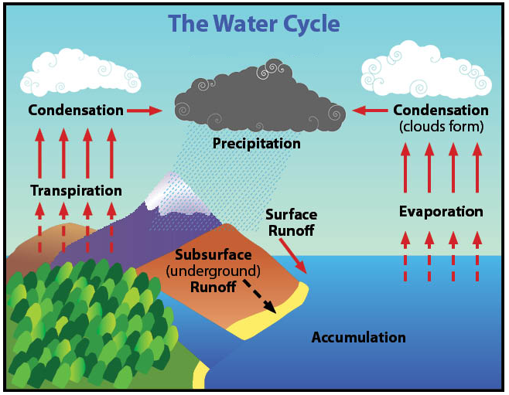
Nutrient Cycles
Water Cycle – EVAPORATION &
TRANSPIRATION take H2O UP
into the atmosphere
CONDENSATION &
PRECIPITATION bring H2O back
to the land/sea

Slide 45
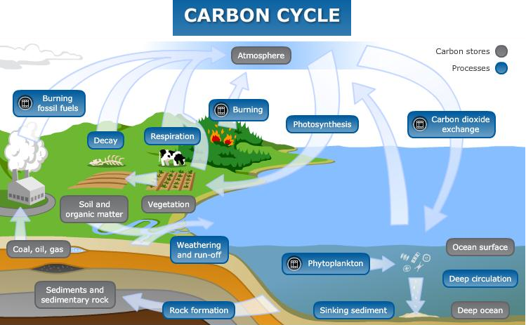
Nutrient Cycles
Carbon Cycle – PHOTOSYNTHESIS takes CO2 out of the atmosphere
CELL RESPIRATION & DECOMPOSITION put CO2 back into the atmosphere
Burning FOSSIL FUELS increases atmospheric CO2 levels
NOT natural

Slide 46
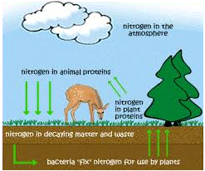
Nutrient Cycles
Nitrogen Cycle – Nitrogen from excretion & dead plants/animals is UNUSABLE to us
Bacteria “fix” the nitrogen & convert it into a form we can use

