Slide 2
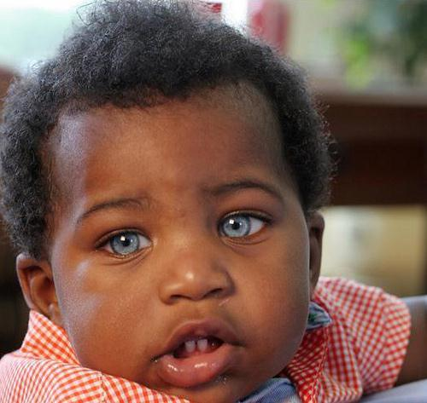
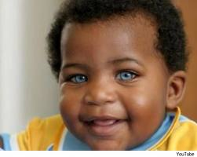
Do Now
What is the relationship between a chromosome, a gene, and DNA?
2. If this baby’s parents both had brown eyes, how did he get blue eyes?

Slide 3
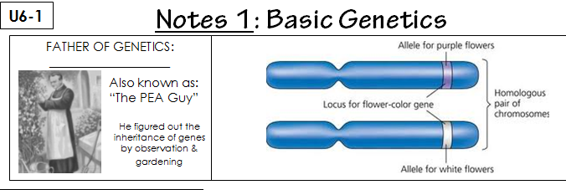
Gregor Mendel

Slide 4
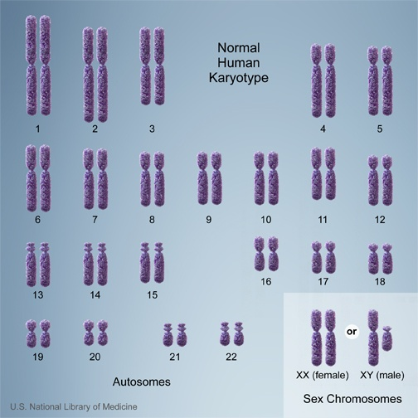

Slide 5
Mendel Video
http://www.youtube.com/watch?v=GTiOETaZg4w
https://www.youtube.com/watch?v=aoVeSncKFAY

Slide 6
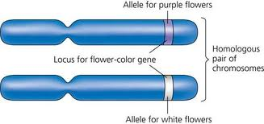
A
a
A a

Slide 7
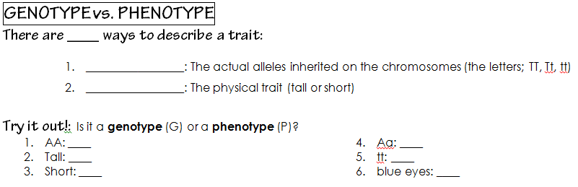
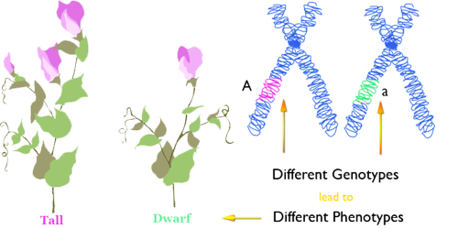
genotype
phenotype

Slide 8
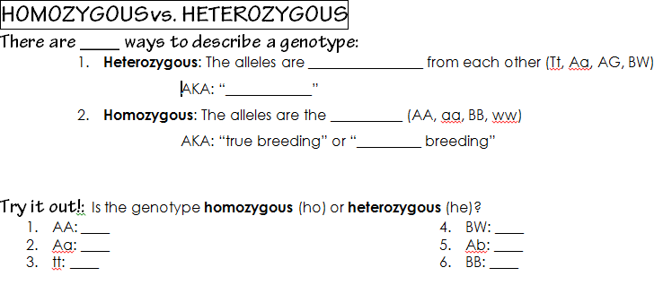
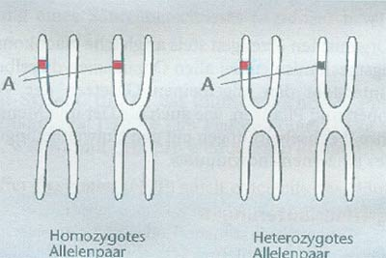
2
different
hybrid
same
pure

Slide 9
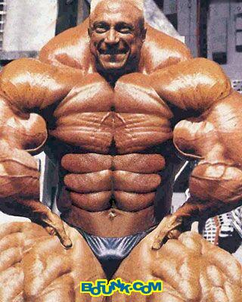
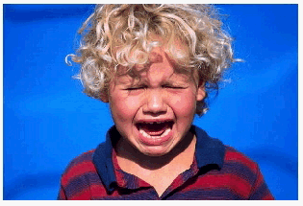
B
b
Dominant – bossy
Recessive – wimp
Alleles

Slide 10
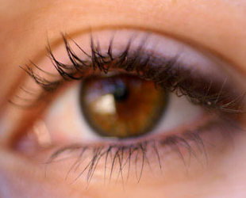
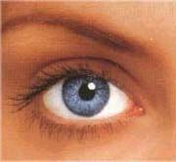
Genotype | Strongest | Phenotype
BB
bb
Bb
B
b
B

Slide 11

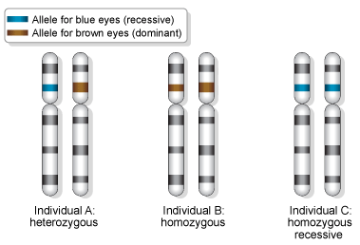
recessive
dominant
recessive
green

Slide 12
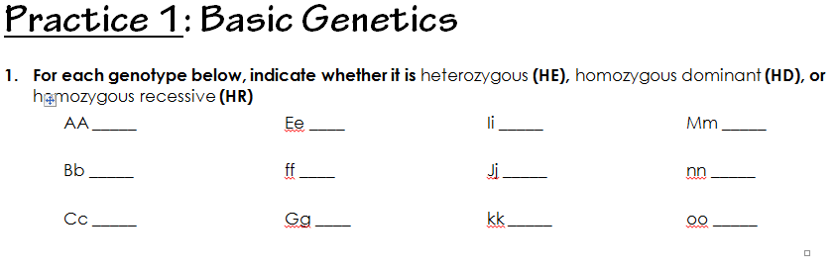

Slide 13
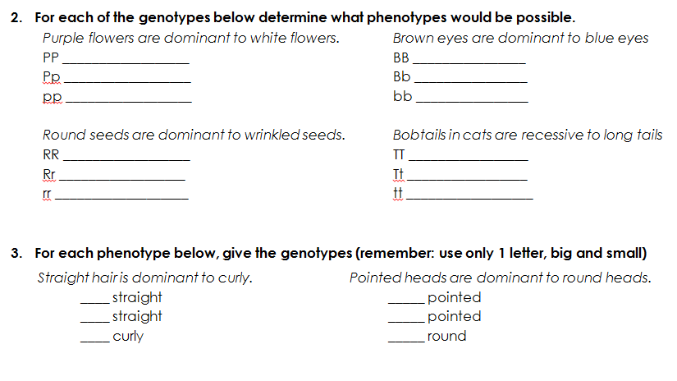
3 min

Slide 14
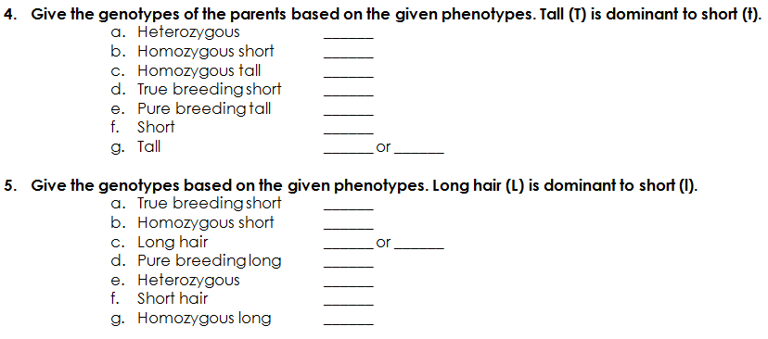
on your own

Slide 15
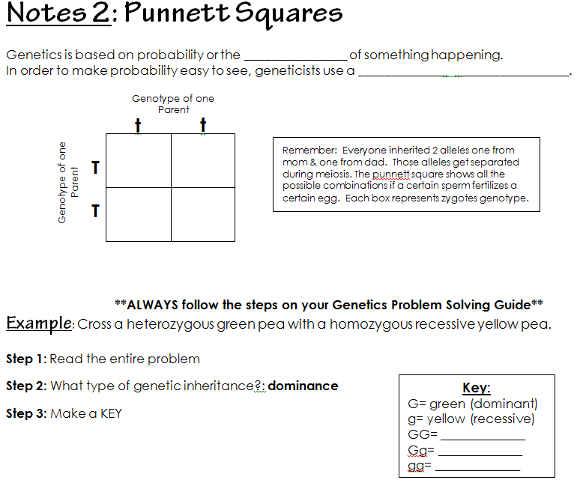
chance
Punnett squares

Slide 16
What are the possible gametes that could be made from the following genes?
Mom:
Aa
Dad:
Aa
X
A
a
a
A
a
A
A
a

Slide 17
chance
Punnett squares

Slide 18
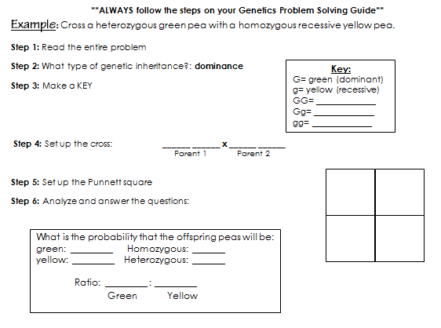

Slide 19
Practice
U5-10
U5-11
U5-12
U5-14: Working Backwards Only
Flip Flop on page U5-19

Slide 20
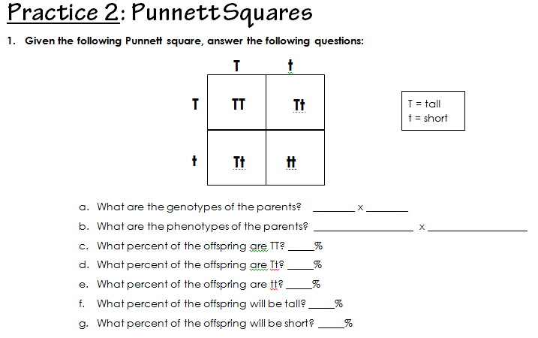

Slide 21
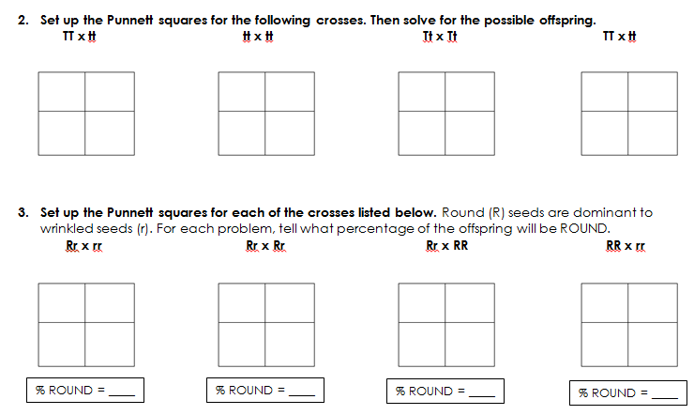
5 min.

Slide 22
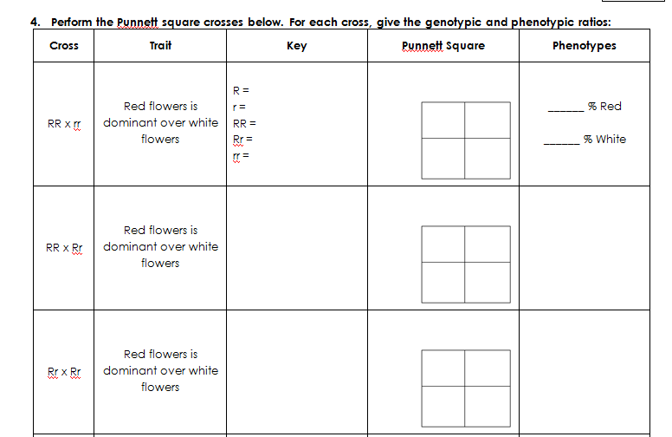

Slide 23
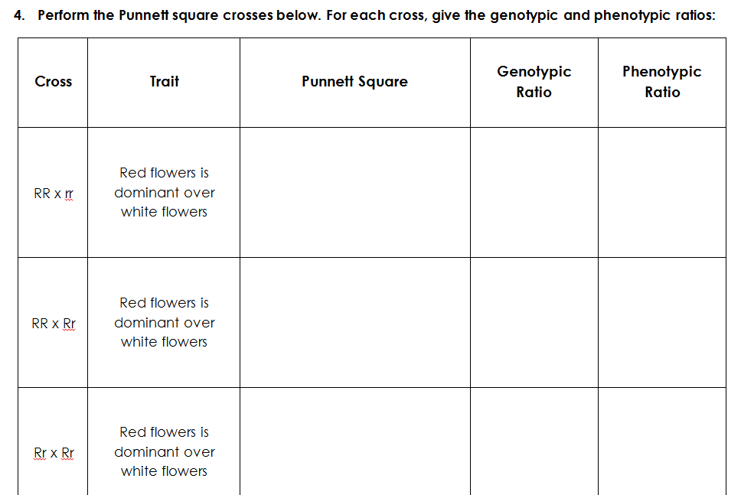
Practice

Slide 24
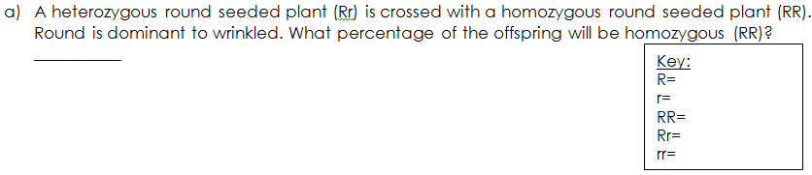
Let’s Try it
U5-12

Slide 25
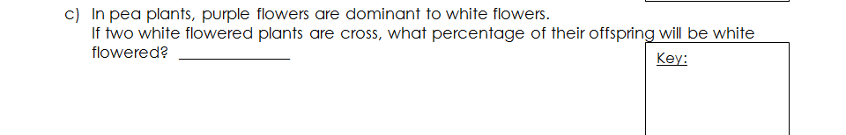
You Try it (8 min)
U5-12
Finish through F!
If you finish early raise your hand for the next assignment.

Slide 26
Do Now
Label as Homozygous Dominant, Homozygous Recessive, or Heterozygous
  AA
  Aa
  GH
  ff
Blue eyes are recessive to brown eyes. Determine the phenotypes of the genotypes below:
  TT
  Tt
  tt
What is the genotype of a true breeding short haired horse? (short=a, long =A)
What are the 2 possible genotypes for a long haired horse? (short=a, long =A)

Slide 27
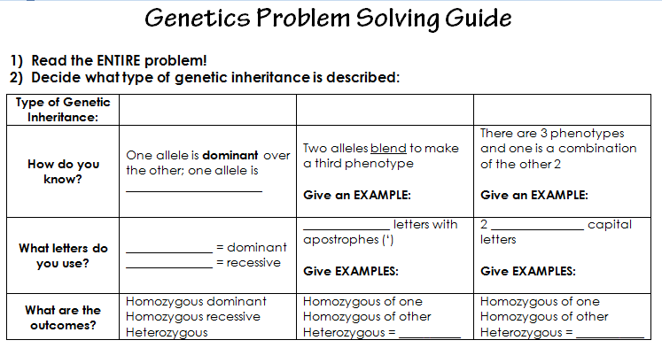
complete dominance
recessive
capital letter
lowercase
DON’T LOSE THIS

Slide 28
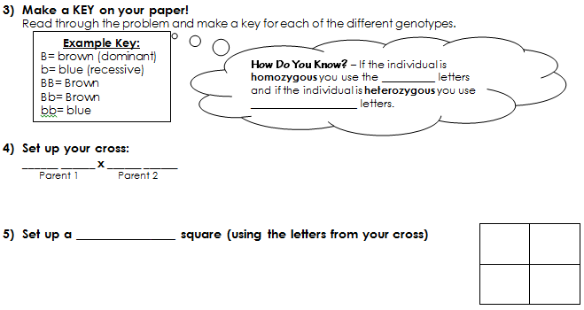
same
different
Punnett
Parent 1
Parent 2

Slide 29
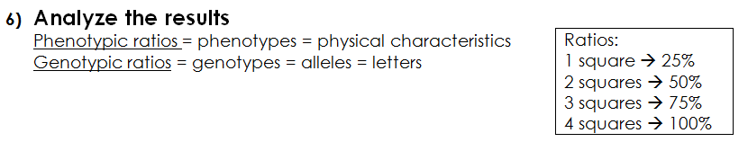
25%
25%
50%
75%
100%
25%
25%

Slide 30
Do Now
What is the purpose of sexual reproduction?
What is the result of meiosis? (How many cells? What kind?)
Brown eyes are dominant to blue. (What is the phenotype)
  Bb
  BB
  bb
What is the genotype of a hybrid long haired horse? (short=r, long =R)

Slide 31
Do Now
If this baby’s parents both had brown eyes, how did he get blue eyes?
A = Big ears a= small ears
heterozygous: ______
homozygous dominant: _____
homozygous recessive: _____
true breeding big ears: _____

Slide 32
Do Now
Complete on a half sheet of line paper.
Tall is dominant to short. Show a cross between a heterozygous mom and a homozygous dominant dad. YOU MUST MAKE A KEY AND SHOW WORK!!
What is the probability that their child will be tall?
What is the probability that their child will be short?
3. What is the genotypic and phenotypic ratio?

Slide 33
On Your Desk solve:
*FOLLOW STEPS*
Blue is recessive to brown. Cross a heterozygous brown eyed mom and a blue eyed dad.
What are the genotypic
and phenotypic
ratio?

Slide 34
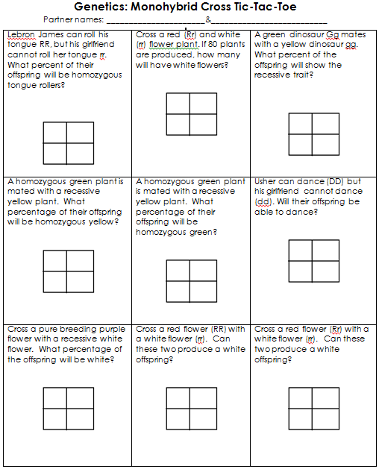
Genetics Tic-Tac-Toe (15)
You MUST answer the question before placing your symbol (X or O).
There are 2 boards (front and back)

Slide 35
FUN FRIDAY
http://www.youtube.com/watch?v=qnydFmqHuVo
http://www.youtube.com/watch?v=xVrJ8DxECbg

Slide 36
“Carrier”
Heterozygous
Bb
Hh
Dd
Rr
Tt
Ll
Ff
Aa

Slide 37
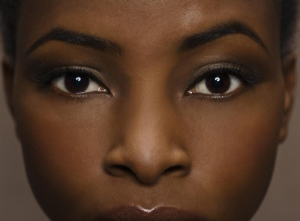
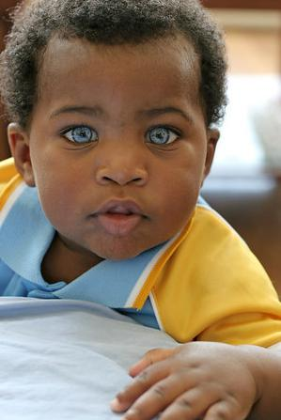
Carrier
Bb x Bb

Slide 38
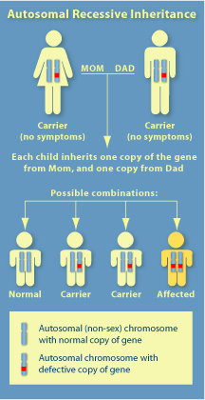
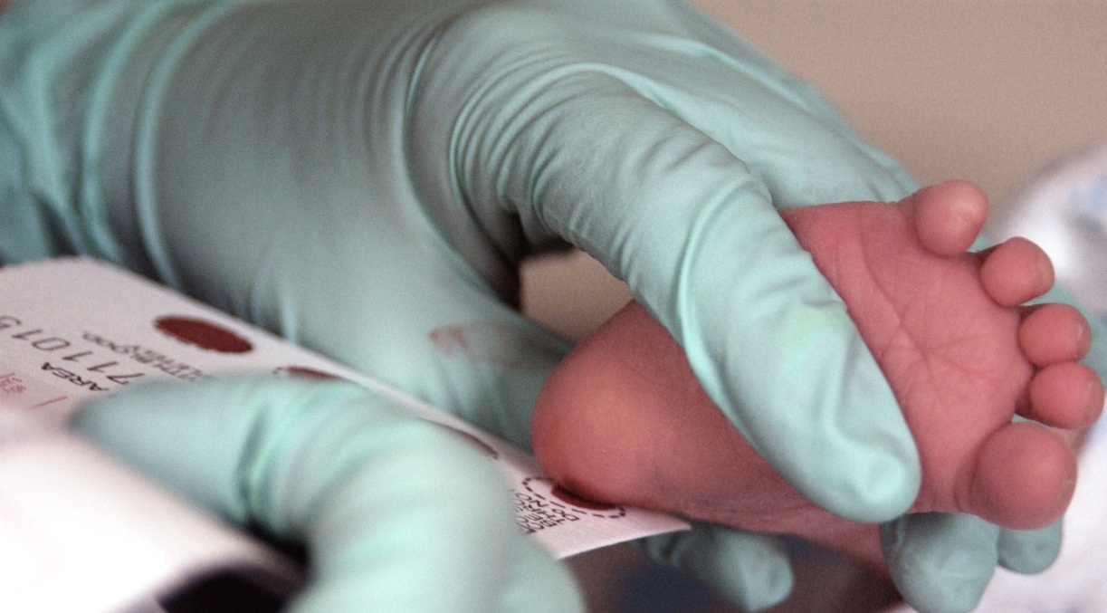
PKU phenylketonuria

Slide 39
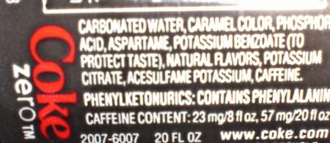
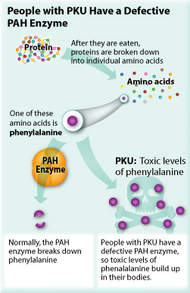
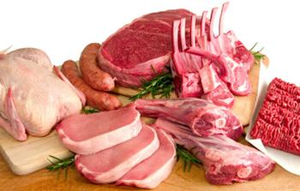

Slide 40
Cross a homozygous dominant mother with a father who has PKU. What percent of their children will be carriers?
Key

Slide 41
Notes 3: Working Backward
U5-13
Given: parents
Find: offspring
Given: OFFSPRING
Find: PARENTS
Two brown eyed people are crossed several times. Out of their 10 children, 3 of them have blue eyes. What are the probable genotypes of the parents?
3/10 ≈ 25%
Blue = bb
_______ X _______

Slide 42
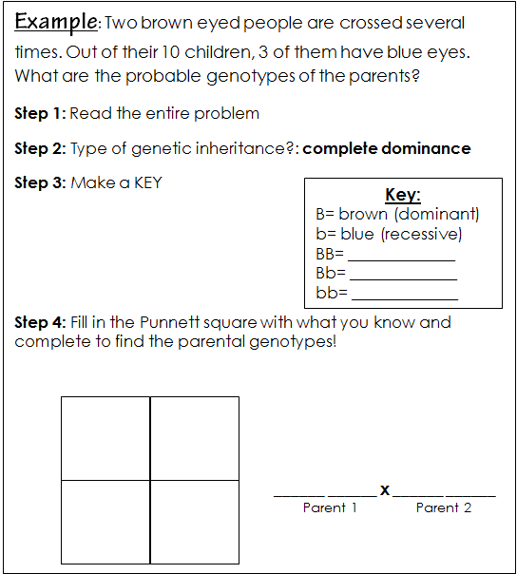

Slide 43
U5-14
You try it!
Practice 3: working backward
Two short haired guinea pigs are mated several times. Out of 50 offspring, 12 of them have long hair. What are the probable genotypes of the parents?

Slide 44
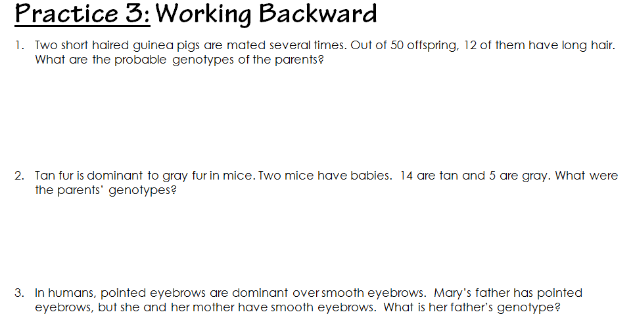

Slide 45
Do Now
In dragons, horns are dominant (H) and no horns are recessive (h). A heterozygous dragon was crossed with a homozygous recessive dragon. What percent of the offspring have horns?!
parents: _____ x _____
___HH : ___Hh : ___hh

Slide 46
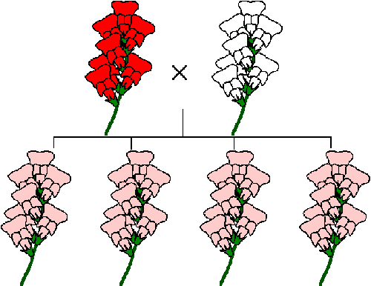
Incomplete dominance
Can we get pink flowers from crossing a red & white flower?!

Slide 47
Incomplete Dominance
Incomplete Dominance: Neither allele is dominant nor recessive - The traits BLEND together - Use all capital letters with apostrophes (') to show the different alleles (ex. RR, R'R, R'R') Steps: * Determine the possible genotypes * Set up the cross * Calculate the ratios

Slide 48
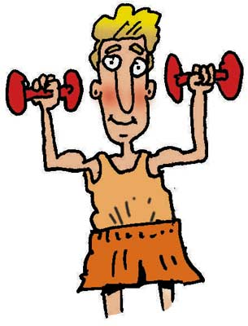
Incomplete Dominance
Incomplete Dominance: Neither allele is dominant nor recessive The traits BLEND together - Use all capital letters with apostrophes (') to show the different alleles (ex. RR, R'R, R'R') Steps: * Determine the possible genotypes * Set up the cross * Calculate the ratios
T T
T’ T’

Slide 49
Incomplete Dominance
LIGERS!
http://www.youtube.com/watch?v=JE8Z5Es-M0E

Slide 50
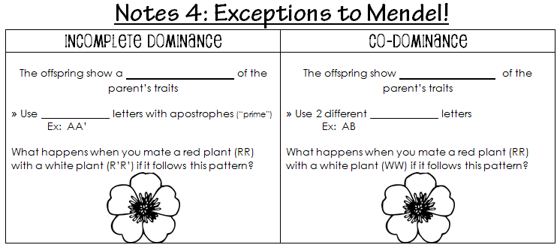
U5-14
BLEND
capital

Slide 51
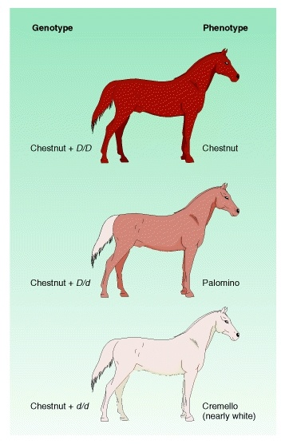

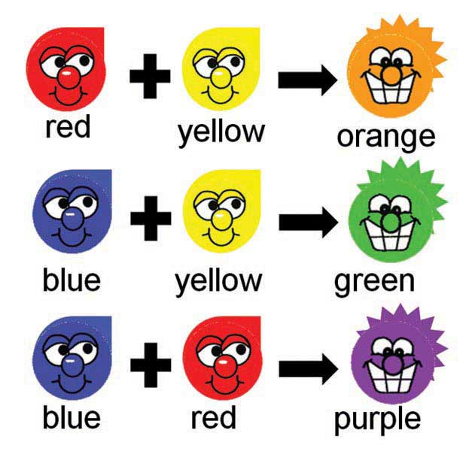
Blending colors

Slide 52
Incomplete
dominance
complete dominance
recessive
Black, white, gray
capital
capital letter
lowercase
ex: R’R’ or A’A’
BLEND

Slide 53
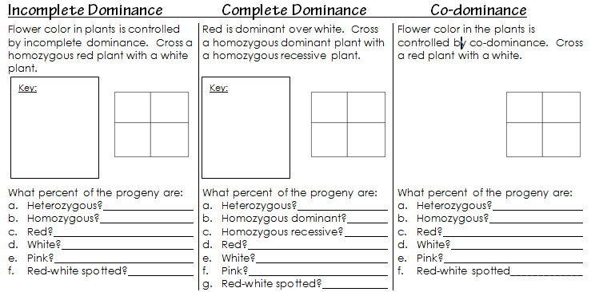
U5-11

Slide 54
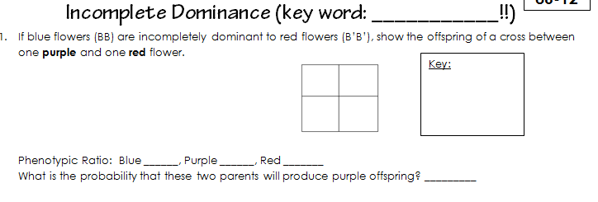
You try it! (12 min)
U5-15

Slide 55
Incomplete dominance practice
Complete page U5-15
12 min

Slide 56
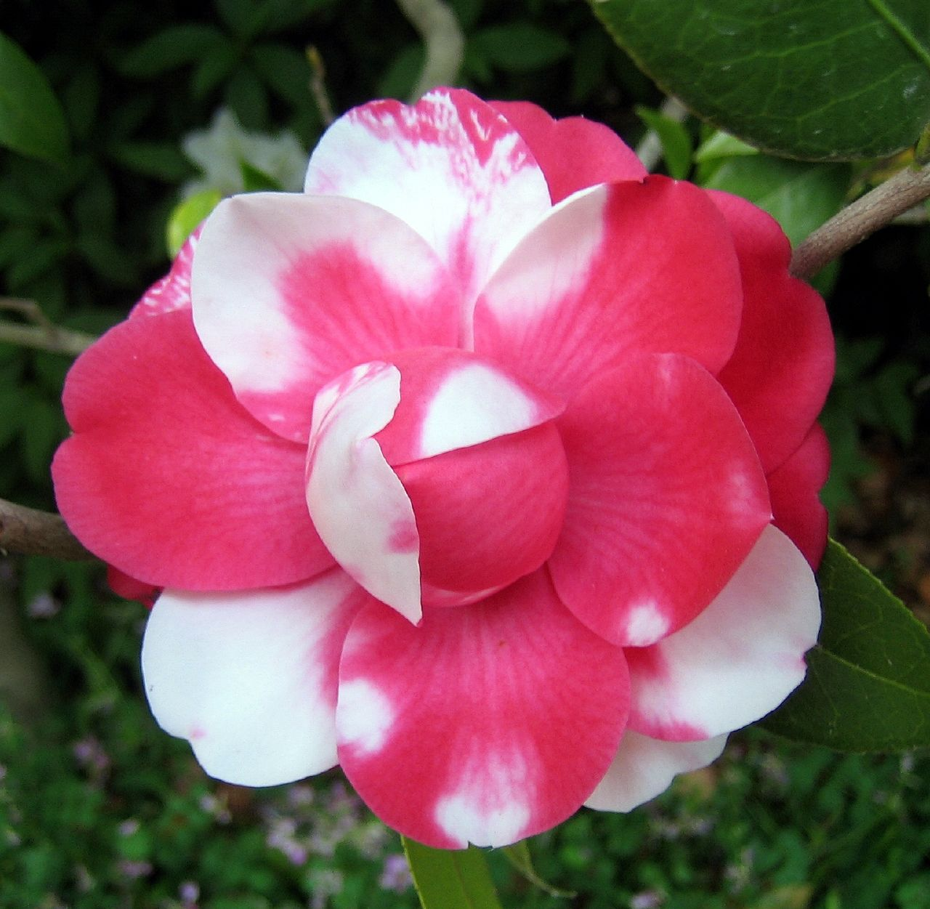
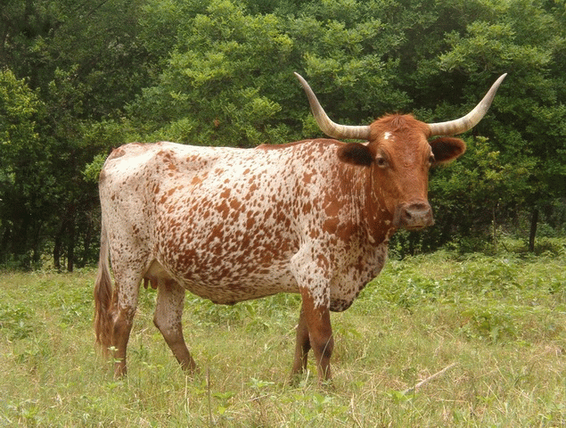
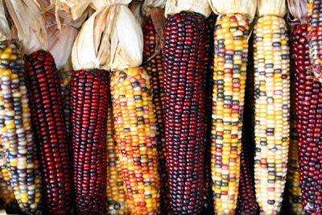
Co-Dominance

Slide 57
Co-Dominance
Co-Dominance: Both alleles are dominant – so BOTH show up - When heterozygous, a third phenotype appears - The traits BLEND together - Use all capital letters with apostrophes (') to show the different alleles (ex. RR, R'R, R'R') Steps: * Determine the possible genotypes * Set up the cross * Calculate the ratios

Slide 58
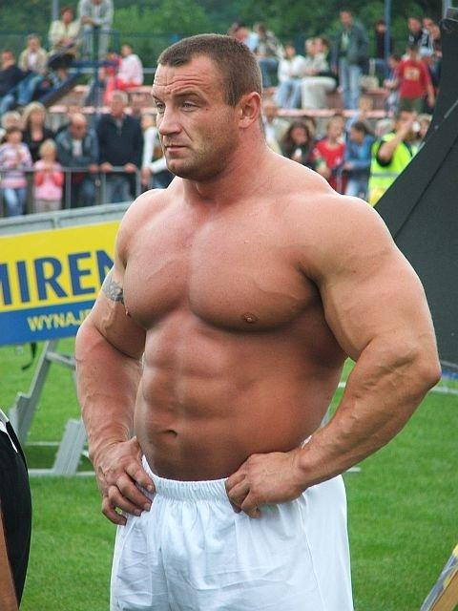
Co-Dominance
Co-Dominance: Both alleles are dominant – so BOTH show up - When heterozygous, a third phenotype appears - The traits BLEND together - Use all capital letters with apostrophes (') to show the different alleles (ex. RR, R'R, R'R') Steps: * Determine the possible genotypes * Set up the cross * Calculate the ratios
BW

Slide 59
U5-3
BLEND
BOTH
capital
capital

Slide 60
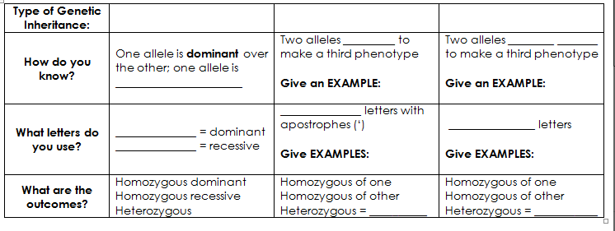
Incomplete
dominance
complete dominance
Co-dominance
Both show
recessive
Black, white, gray
Black, white, b&w spots
capital
Capital
capital letter
lowercase
ex: R’R’ or A’A’
RW, AB
BLEND
BOTH

Slide 61
U5-11

Slide 62

You try it! (12 minutes)
U5-16

Slide 63
Co-dominance practice
Complete page U5-16
12 min

Slide 64
Do Now
Label each as either complete dominance, incomplete dominance, or co-dominance.
Pink flowers
Genotype: Aa
This roan cow →
Genotype: AA’
Phenotype: gray
Complete pages!
U5-15 thru U5-21

Slide 65
Review
Pg. U5-14 & U5-15
Use color!
15 minutes

Slide 66
Review
Pg. U5-16 & U5-17 (top 18
15 minutes

Slide 67
Review
Pg. U5-18 - U5-20
15 minutes

Slide 68
Do Now
1. A woman who is heterozygous for blood type A marries a man who has blood type B. They have a son who is blood type AB. What is the father’s genotype? Show work!
2. Label each as either complete dominance, incomplete dominance, or co-dominance.
Pink flowers
Genotype: Aa
This roan cow →
Genotype: AA’
Phenotype: gray

Slide 69
Do Now
You see the following crosses set up on a piece of paper – but there’s no description of the problem!
What type of inheritance problem is the student solving – dominance, incomplete dominance, co-dominance?
On the paper: | What kind of inheritance?
Aa x AA
A’A x A’A
AB x AA
BW x BW
PP x PP’

