Slide 1
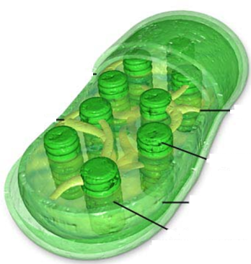
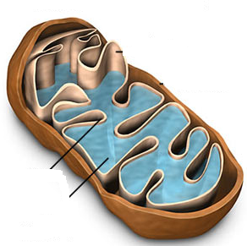

Slide 2
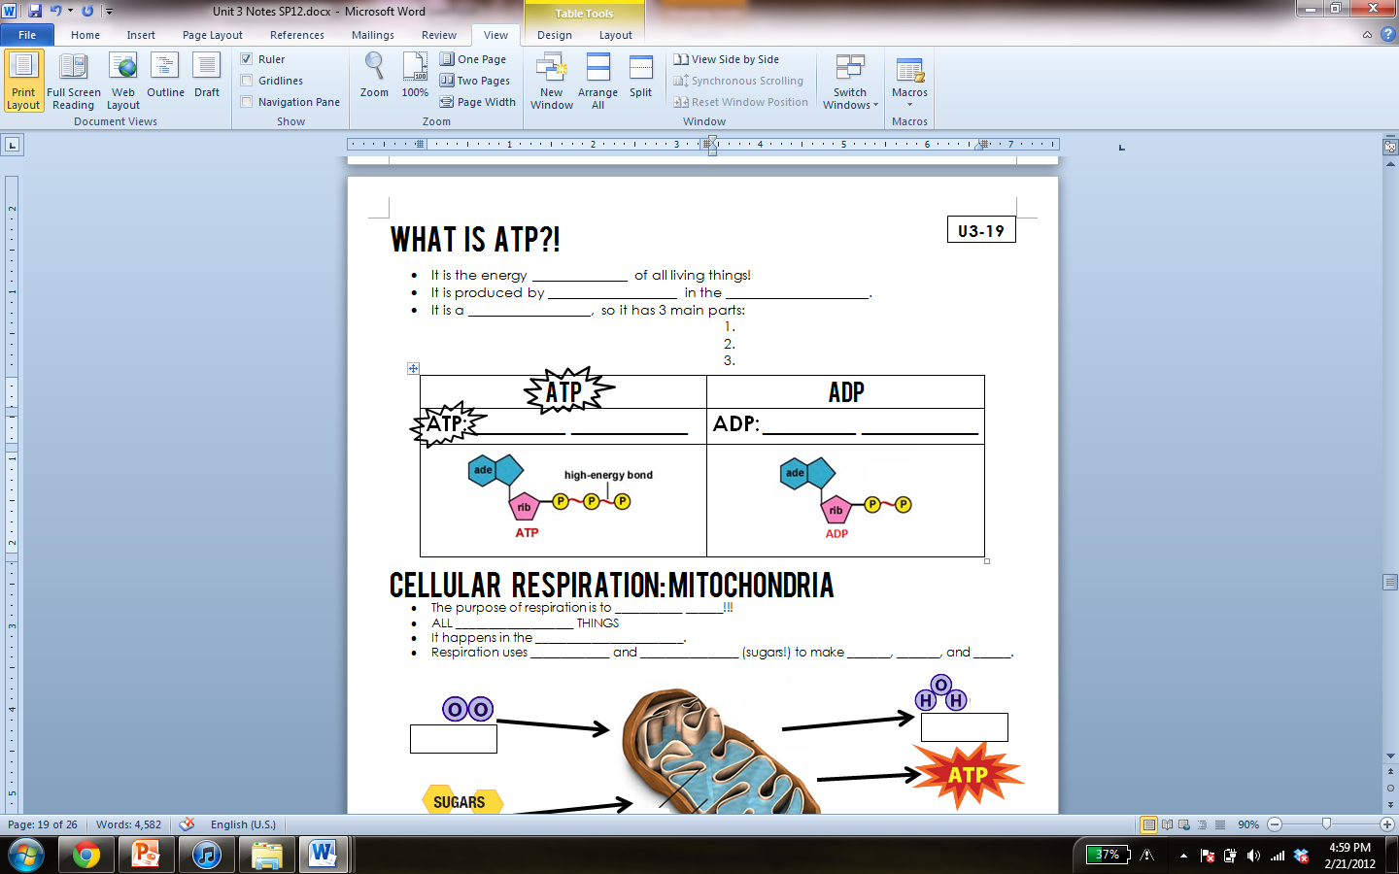
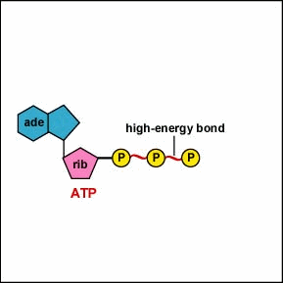
What is ATP?!
currency
respiration
mitochondria
nucleotide
phosphate
sugar
adenosine

Slide 3
PAGE U3-21
adenosine triphosphate
adenosine diphosphate

Slide 4
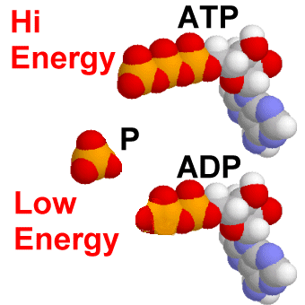

Slide 5
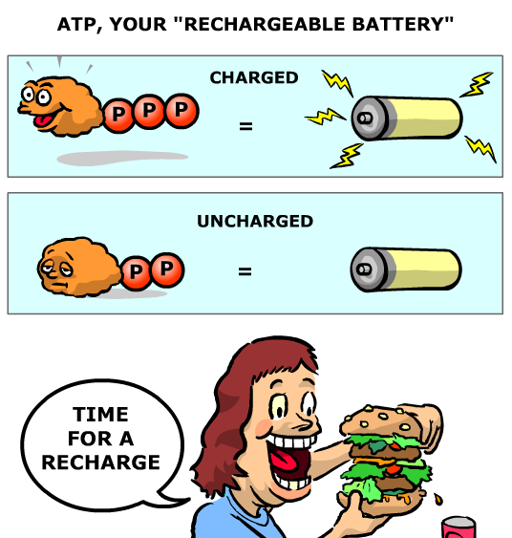
ATP

Slide 6

Draw an ATP molecule! (3 min)
Draw in notes.
Labeled & glued on pg. 23
Station #1: phosphates
Station #2: ribose (sugar)
Station #3: nitrogenous base
Label: phosphate, ribose, adenosine, ATP, nucleotide
Picture on pg. 203

Slide 7
Cellular respiration
Where do you get energy?!

Slide 8
Do Now
What is the energy currency of ALL living things?
Where in the cell is energy produced?
What is this process called?
What does ATP stand for?

Slide 9
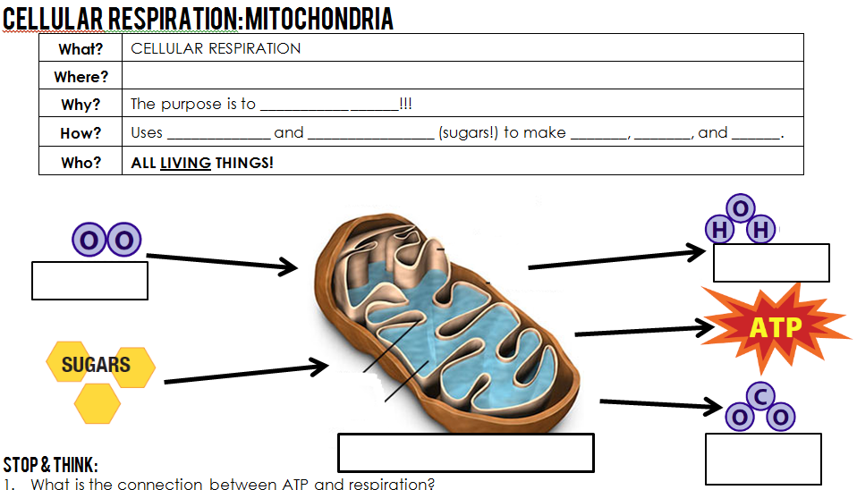
mitochondria
make ATP
oxygen glucose H2O CO₂ ATP
H₂O
O₂
mitochondria
CO₂

Slide 10
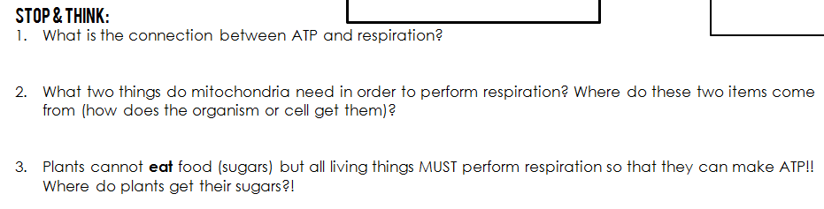
4 min

Slide 11
Photosynthesis
What does a plant need in order to stay alive?

Slide 12
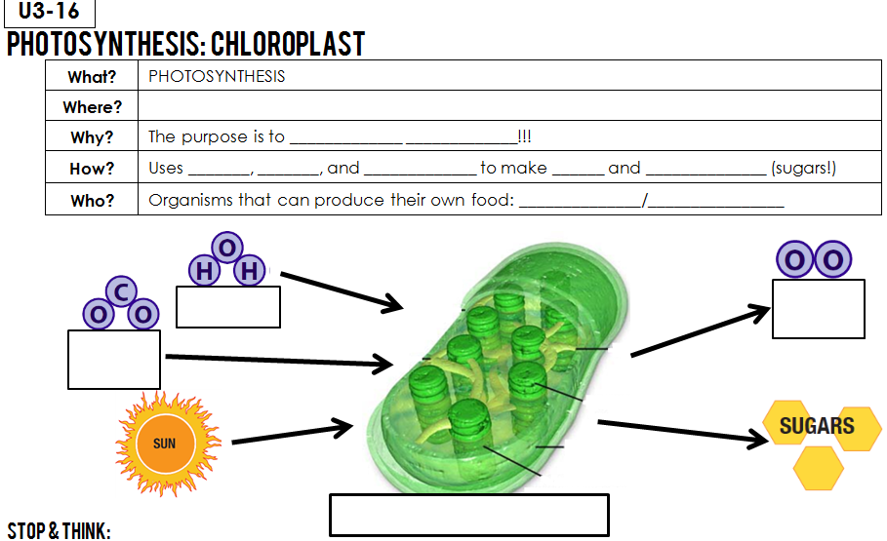
chloroplasts in plant cells in leaves
make glucose
H₂O CO₂ sunlight O₂ glucose
autotroph producer
H₂O
O₂
CO₂
chloroplast

Slide 13
Autotroph vs. heterotroph
Makes their own food. EATS their food.

Slide 14
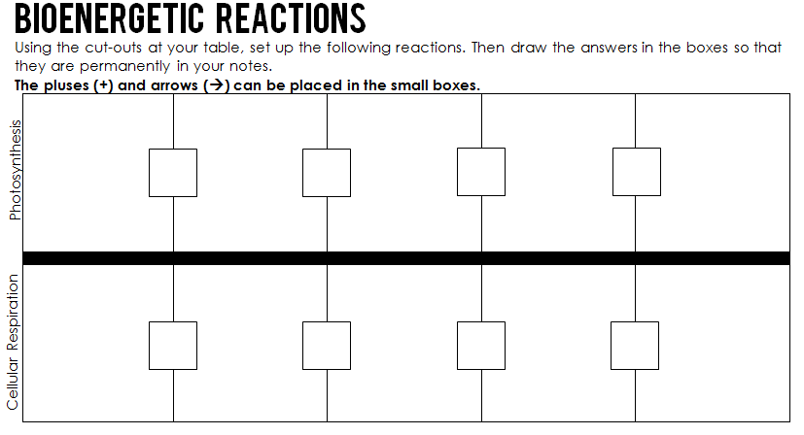
Practice

Slide 15
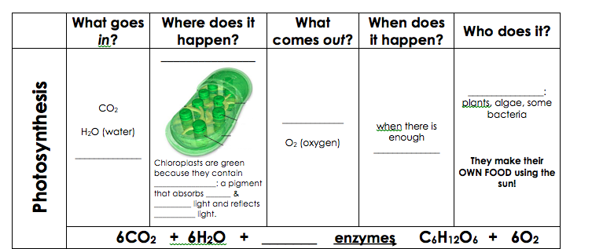
Chloroplast
Autotrophs
Glucose
Sunlight
Sunlight
chlorophyll
red
blue
green
Sunlight

Slide 16

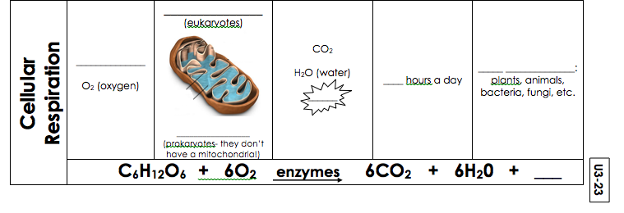
Mitochondria
Glucose
Heterotrophs
24
ATP
Cytoplasm
ATP

Slide 17
Exit Ticket
Complete a 5 question quiz on cell organelles.
NO TALKING!

Slide 18
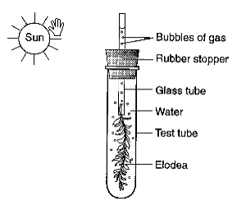
Do Now
What is the equation for photosynthesis?
2. What is the equation for cellular respiration?
3. The green aquatic plant
represented in the diagram
to the right was exposed
to sunlight for several hours.
Which gas would most likely
be found in the greatest
amount in the bubbles?

Slide 19
Gummy Bear Lab
Part 3 and Part 4 you must finish for homework. Due Friday!

Slide 20
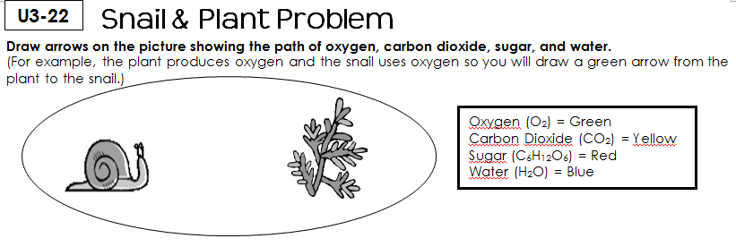

Slide 21
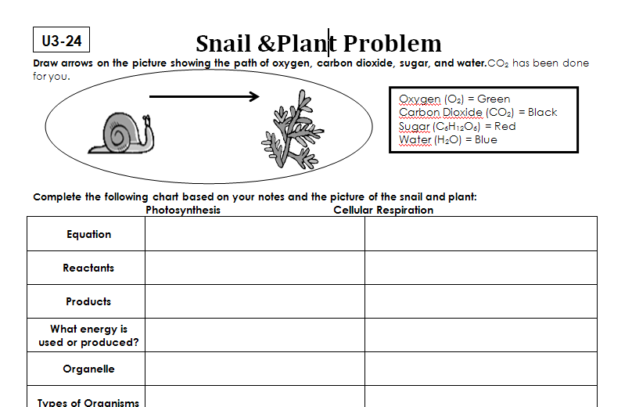

Slide 22
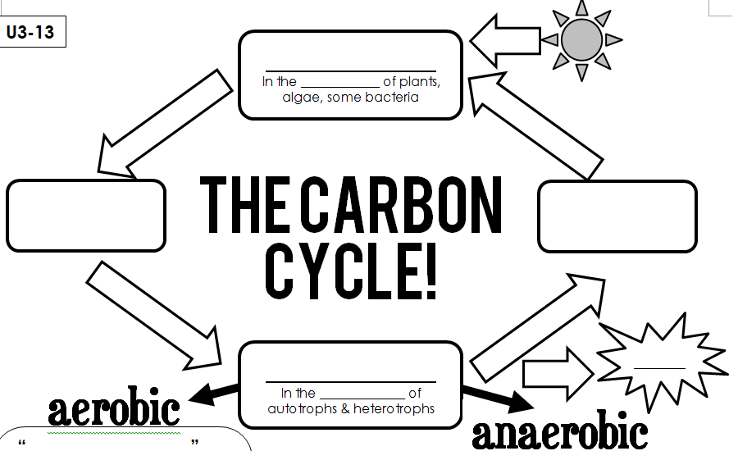
photosynthesis
chloroplast
Oxygen
Glucose
CO₂
Water
ATP
respiration
mitochondria

Slide 23
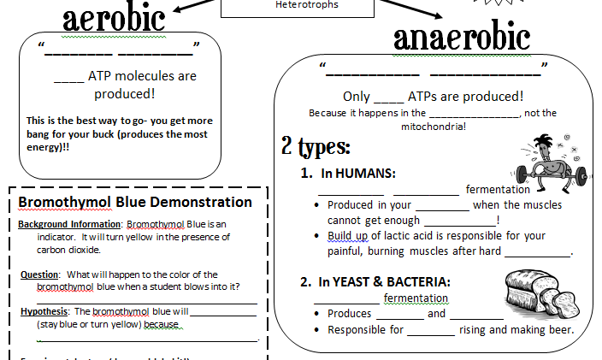
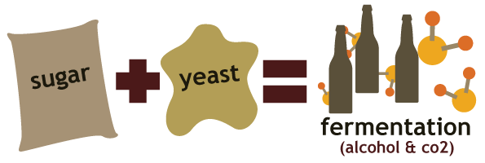
2 types of cellular respiration
With oxygen
Without oxygen
38
2
cytoplasm
lactic acid
muscles
oxygen
exercise
alcohol
CO₂
alcohol
bread

Slide 24
Do Now
What are the 2 types of respiration?
Which of these types requires oxygen?
Which of these types requires NO oxygen?
Why do your muscles burn after intense exercise?

Slide 25
Review Stations
6 stations
7 minutes at each station
Need your Unit 3 packets!
All of your work from the stations 1, 2, 3, and 4 goes into your packets
The page numbers are on the station instruction sheets

Slide 26
Practice Problems on Pages…
U3-24
U3-27
U3-19
U3-13 through U3-16
U3-28
U3-29
ALL PROBLEMS MUST BE COMPLETED!!!!!

Slide 27
Do Now
For #1-3, Which statement below is a lie and EXPLAIN why that statement is NOT true:
1. Plant use cellular respiration to make energy
2. Plants use photosynthesis to make energy
3. Animals use cellular respiration to make energy
4. Think back to yesterday’s lab. What are factors that affect the rate of photosynthesis?

Slide 28
2 Truths 1 Lie
With your groups using information from Unit 3, come up with 2 true statements and 1 false statement
DO NOT mark which one is false on your paper
Number your statements

Slide 29
Do Now
Study unit 3! Test will begin at 7:40!

Slide 30
Due Today
Gummy Bear Lab
Unit 3 Packet
Unit 3 Crossword Puzzle

