Slide 1
Sound to Sea
IB/MYP Biology Field Trip
Wed May 11- Fri May 13

Slide 2
What is Sound to Sea?
The only residential environmental education program on the Outer Banks
Offers school groups a habitat-based program which includes:
Multi-disciplinary hands-on activities
Challenge Course
Special evening programs
Last year, 110 school groups (over 6000 students grades 2-12, teachers and chaperons) explored our barrier island and it's five habitats in Sound to Sea programs

Slide 3
Where is Sound to Sea?
All Sound to Sea programs are held on site at Trinity Center, located on Rt 58, 7 miles west of Atlantic Beach, on Bogue Banks.
Trinity encompasses 62 acres of salt marsh, maritime forest, freshwater pond, sand dunes and 1/3 mile each of sound and beach front.

Slide 4
Why Sound to Sea?
To increase awareness of the human community
To introduce students and teachers to a variety of habitats typical of a North Carolina Barrier Island
To apply classroom learning in a practical way
To enhance relationships between adults and students
To stimulate personal growth--students develop a sense of independence and responsibility
IT’S A FIELD TRIP YOU’LL NEVER FORGET!!

Slide 5
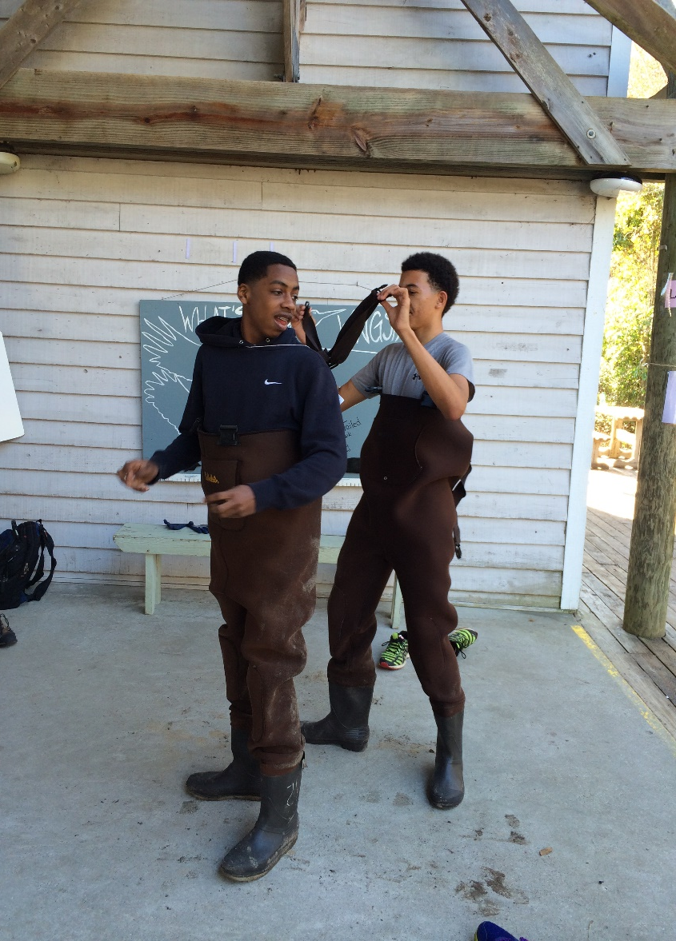
If you’re still not convinced…look at the fun you’ll have

Slide 6
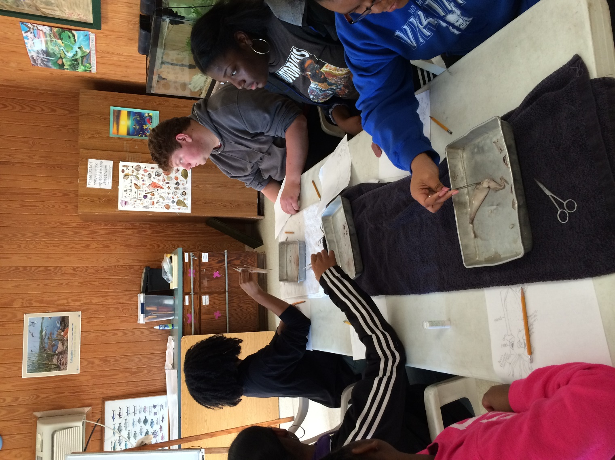
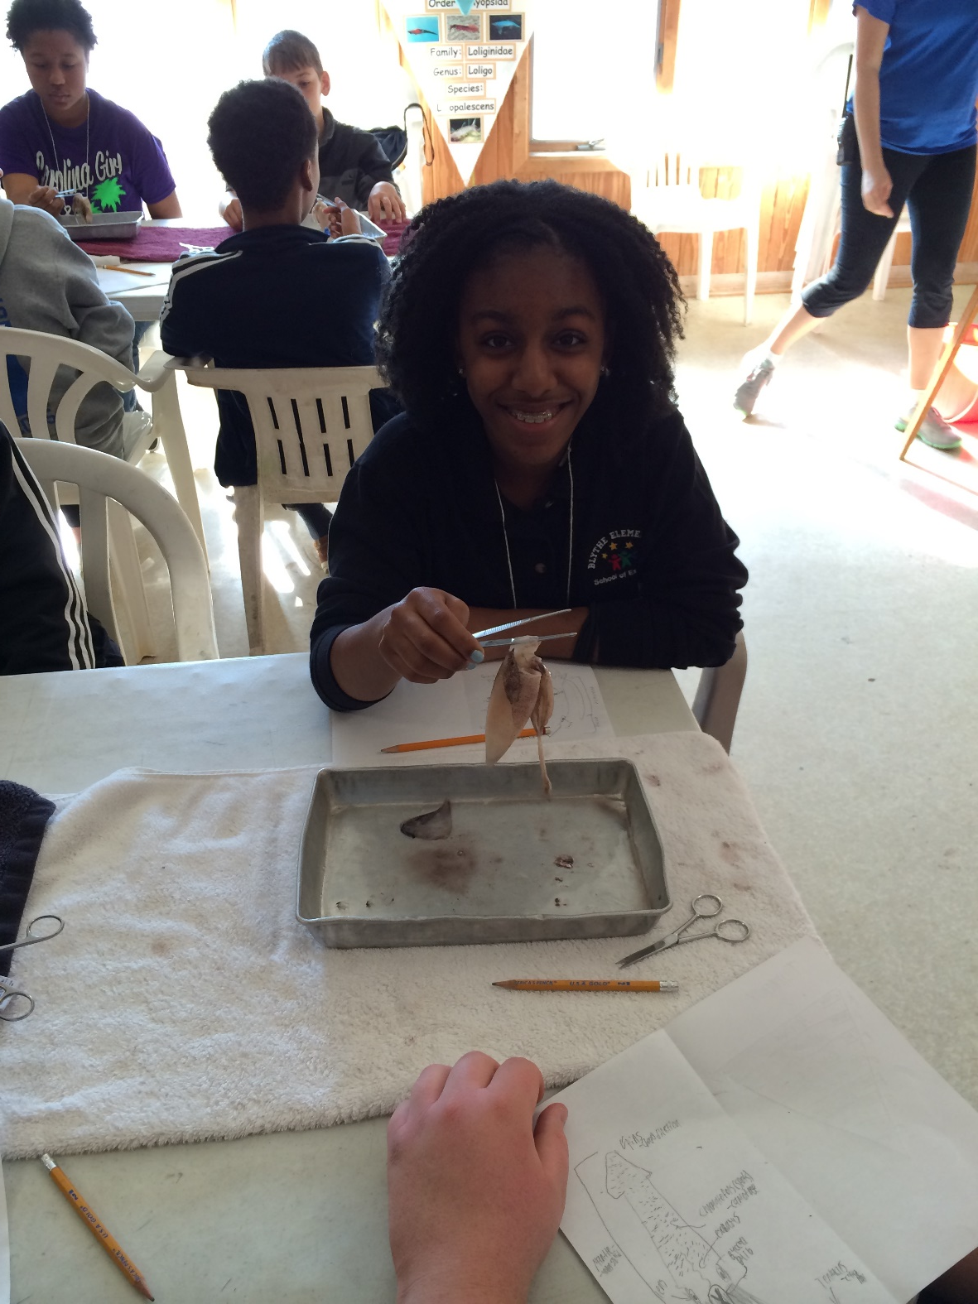
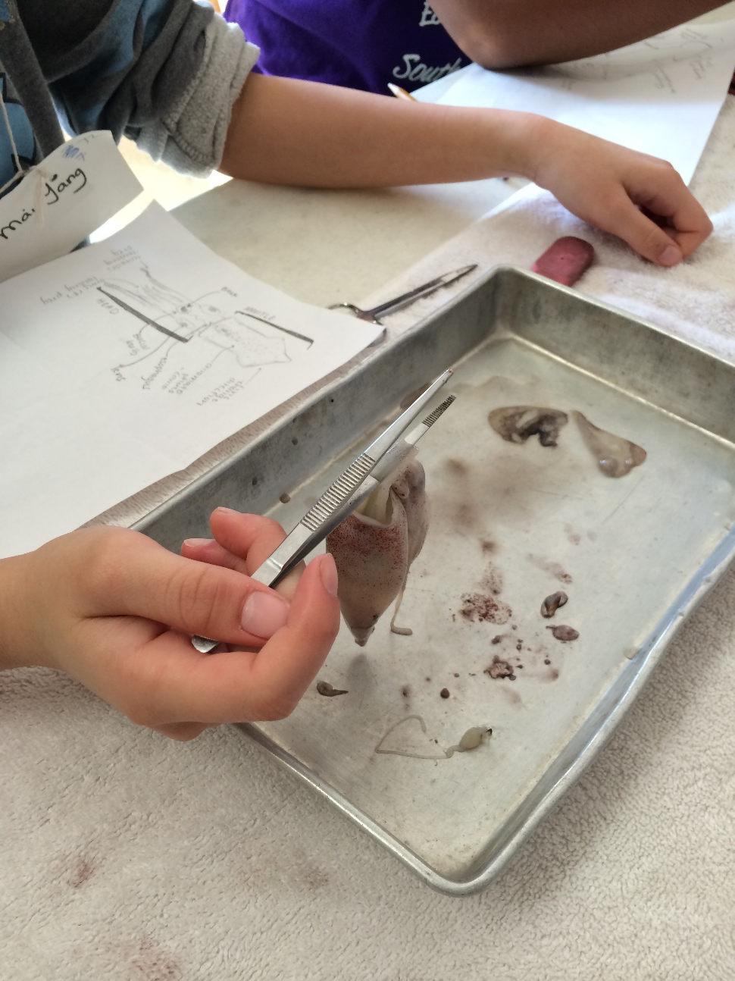

Slide 7
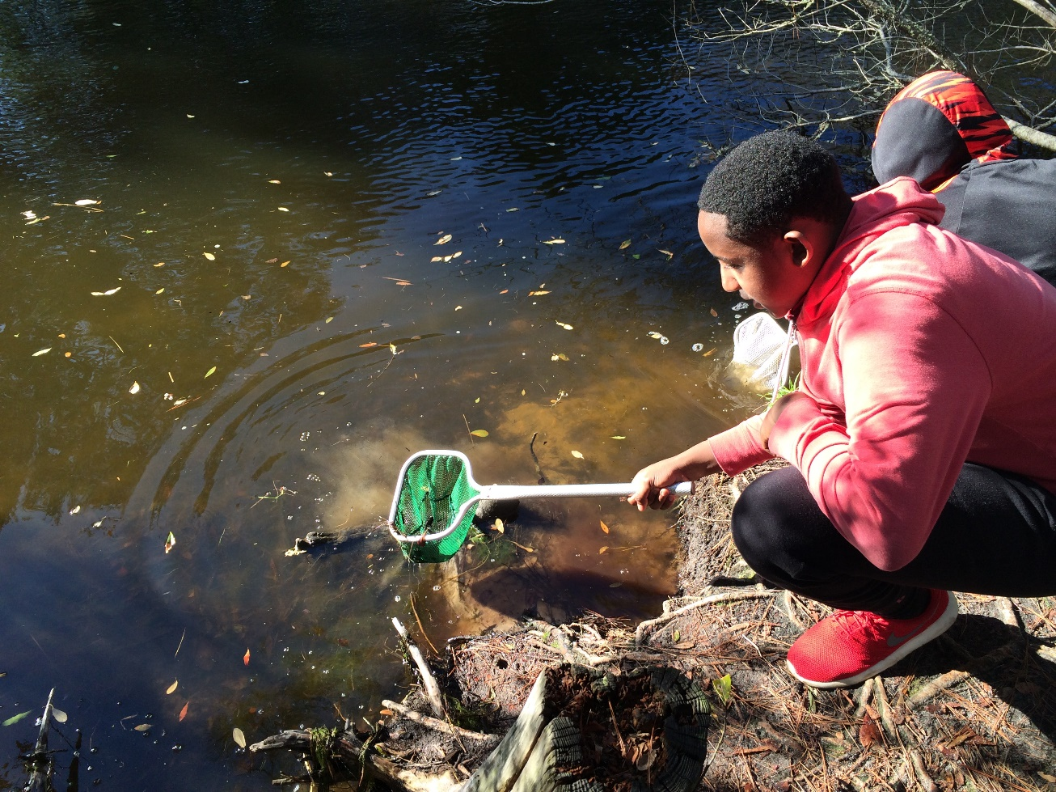
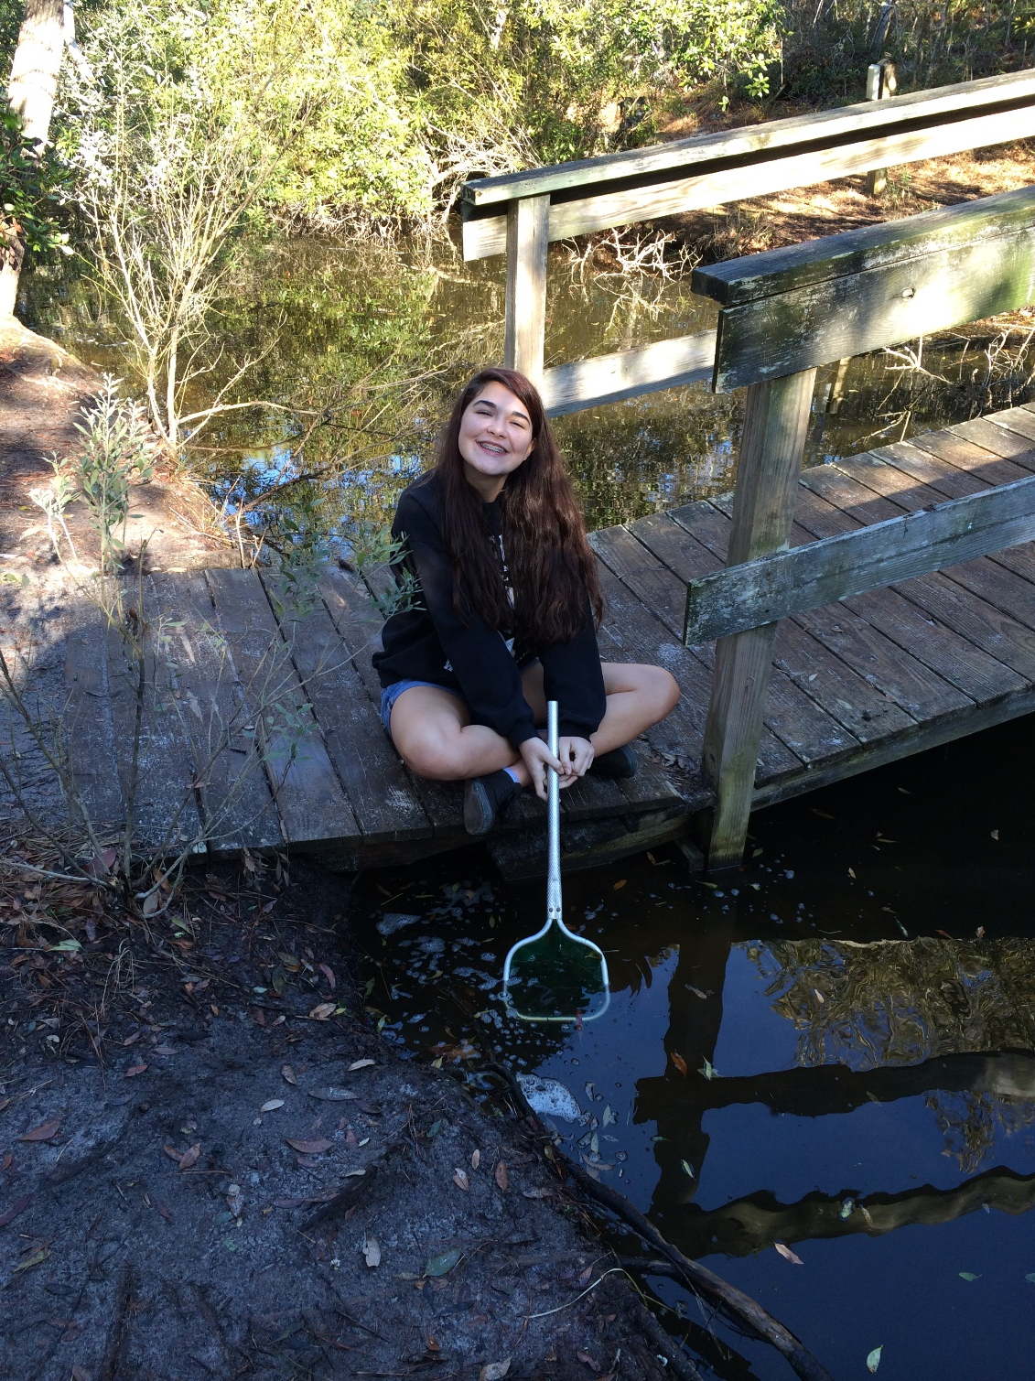

Slide 8
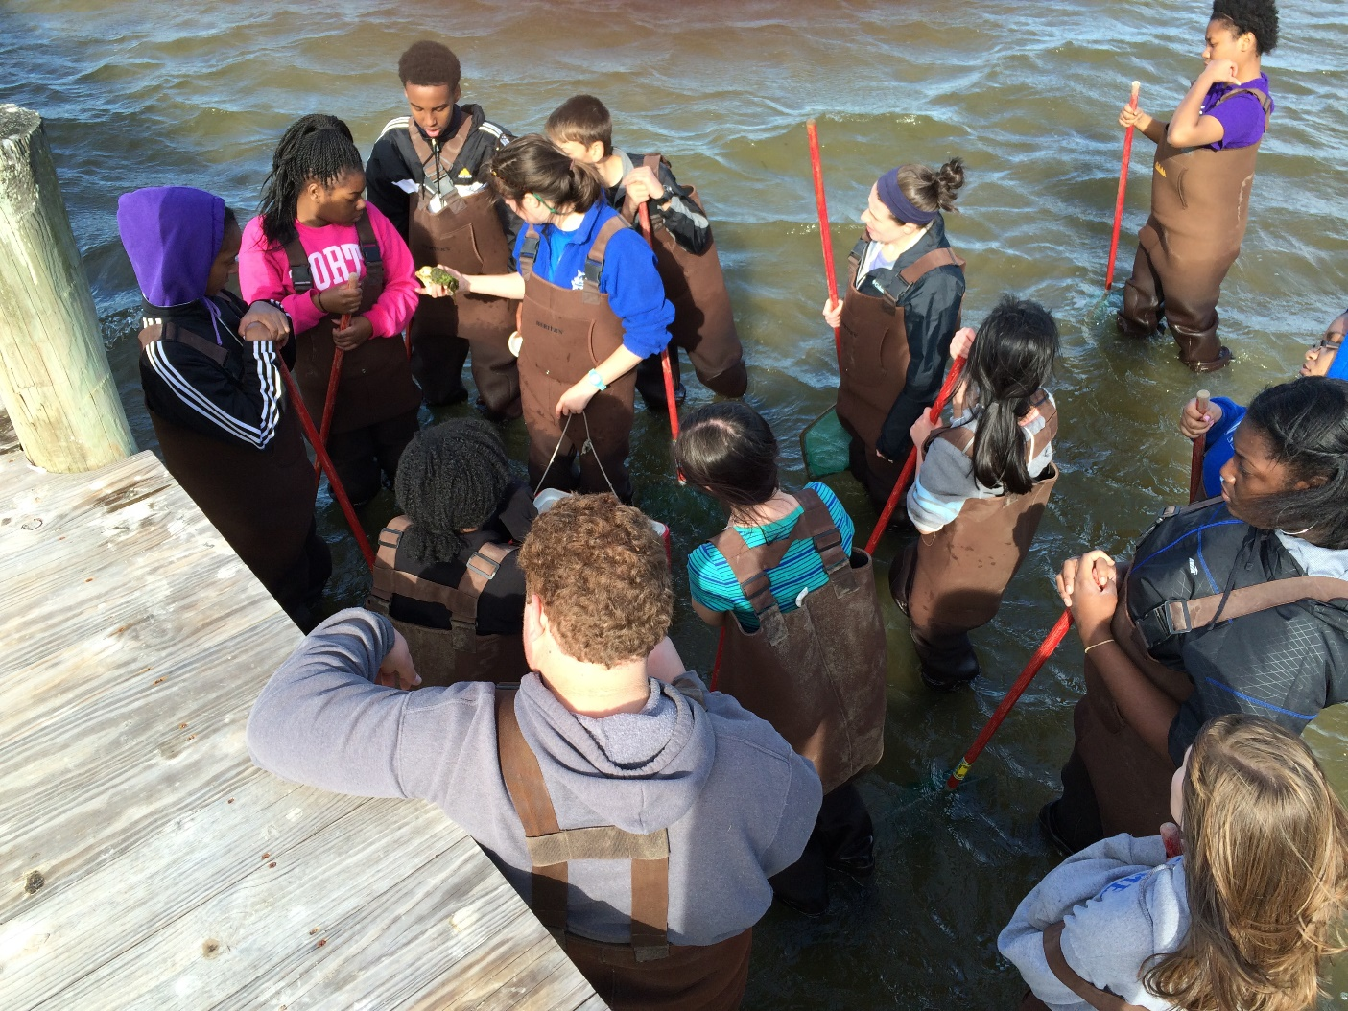
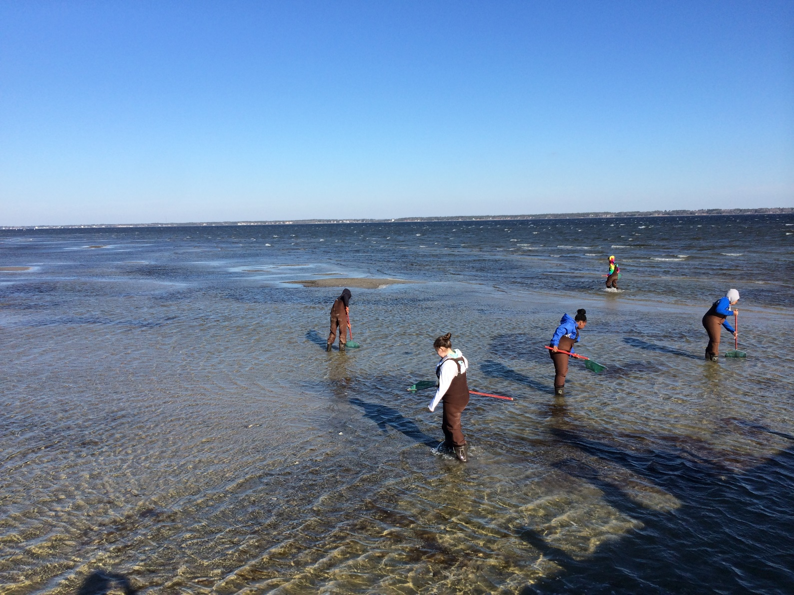

Slide 9
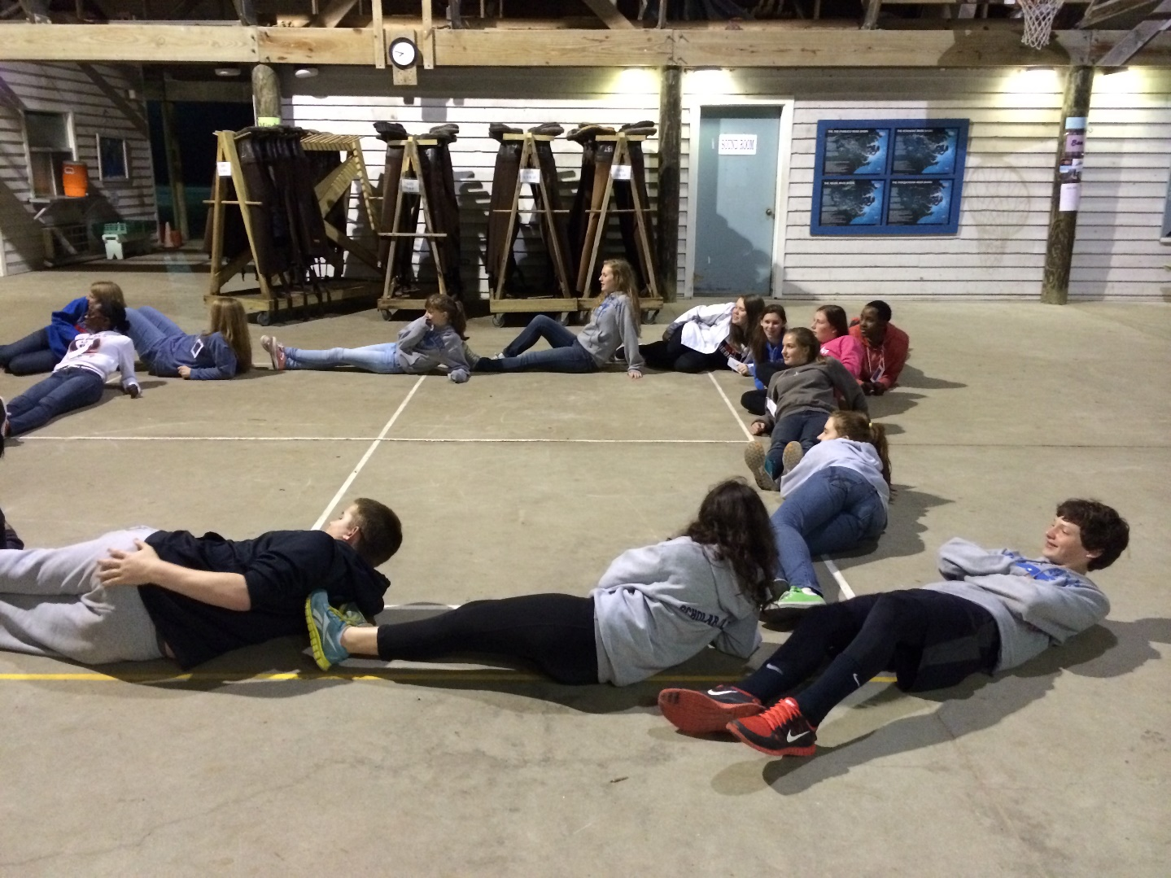
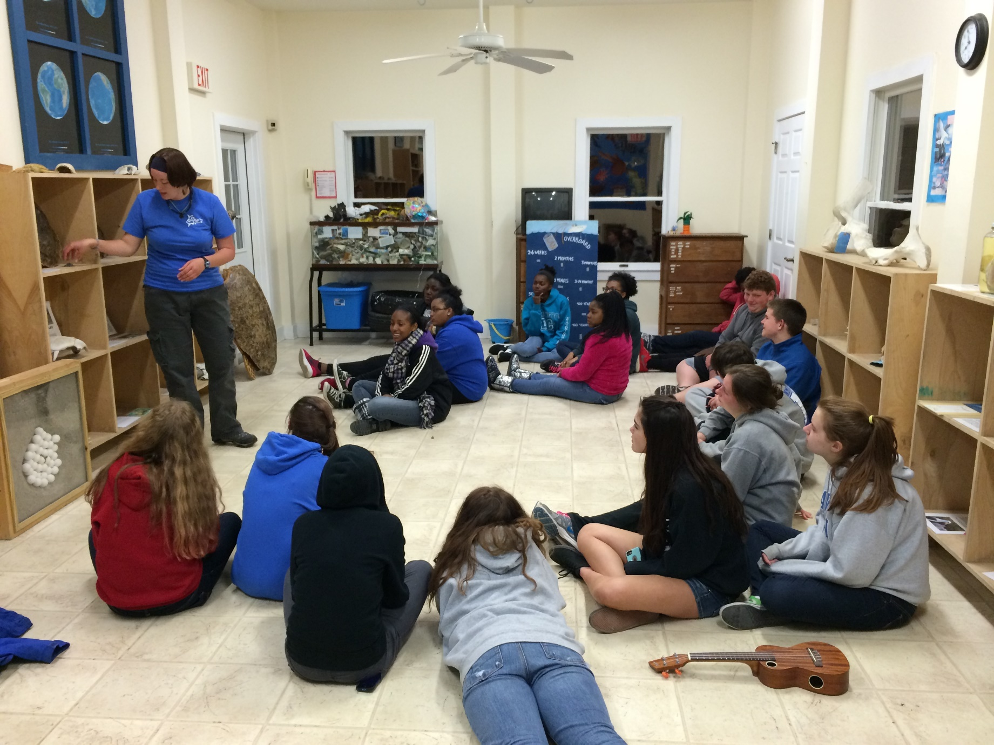

Slide 11
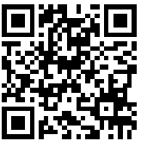
More Information
Visit Trinity Center’s Website
http://trinityctr.com/soundtosea/soundtosea.html
Or
email Ms. Simmons at
brooke1.simmons@cms.k12.nc.us
Only 35 students can attend!! This is a first come, first served opportunity!!

