Slide 1
Do Now
Enter silently
Find your assigned seats. Your names are on the desks. Top left is A day, top right is B day.
Fill out the student information sheet on your desks
  There is a front and a back!

Slide 2
Let’s Get to Know Each Other
Tell us you name
Where you are from
One fact or something interesting about yourself

Slide 3
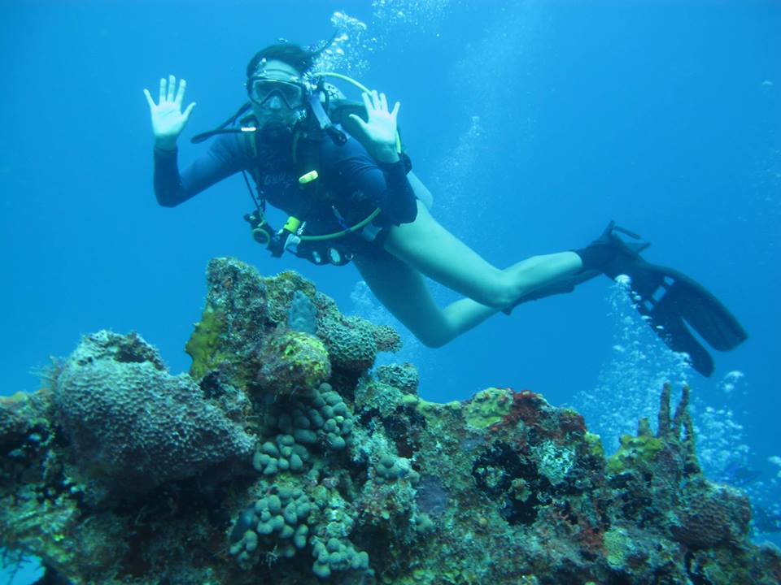


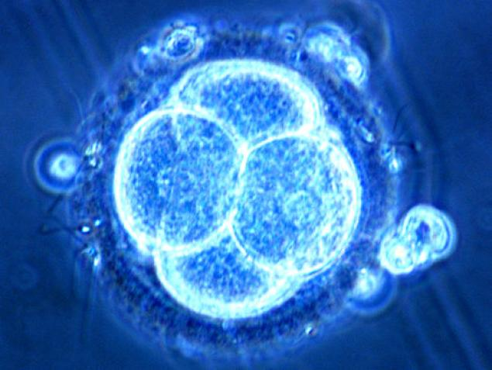
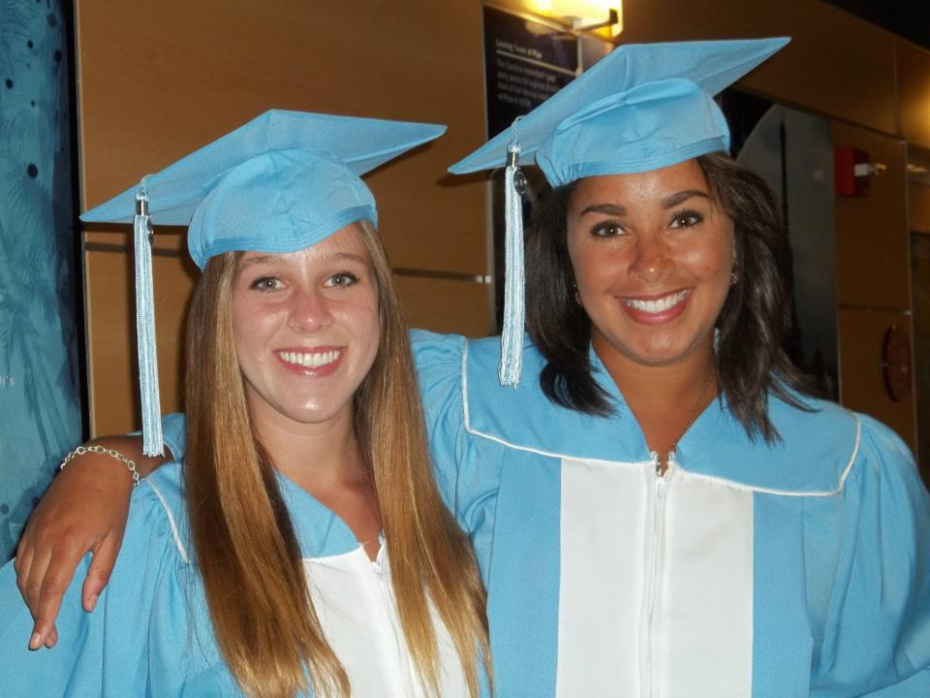

Who is Ms. Simmons?

Slide 4
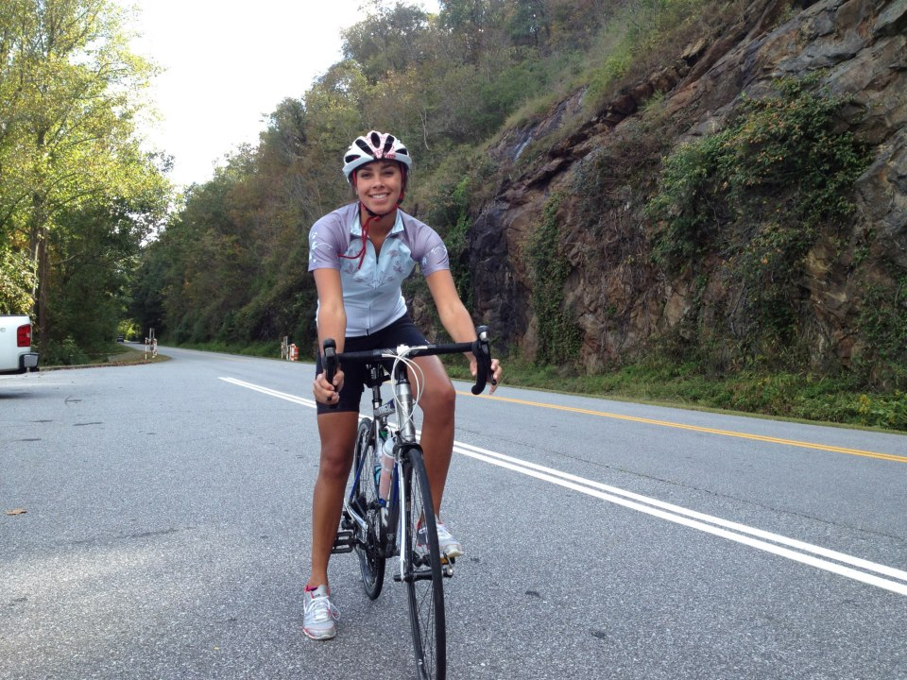
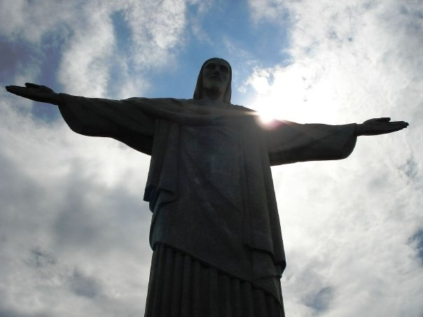
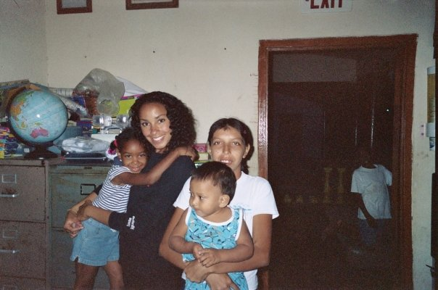
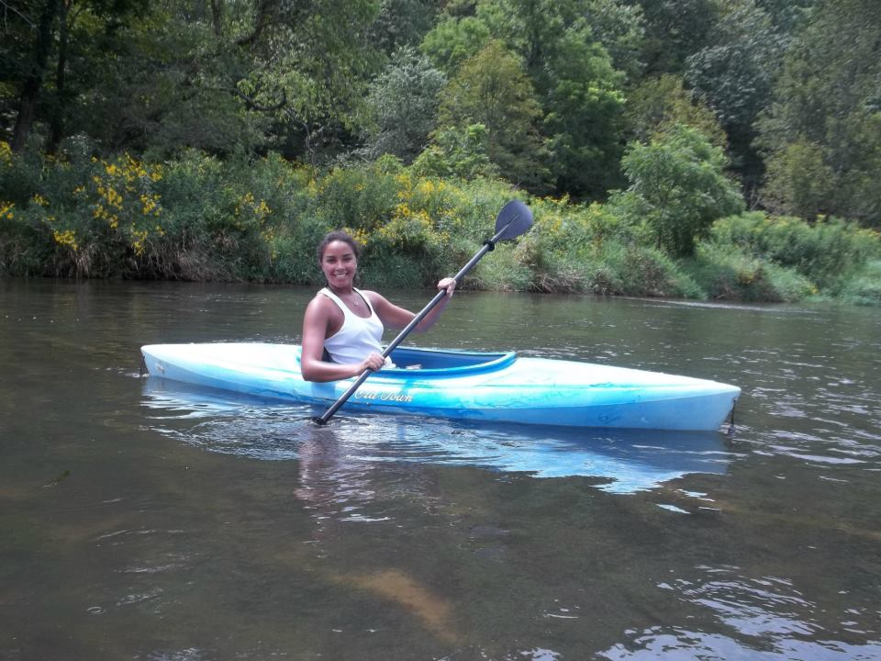
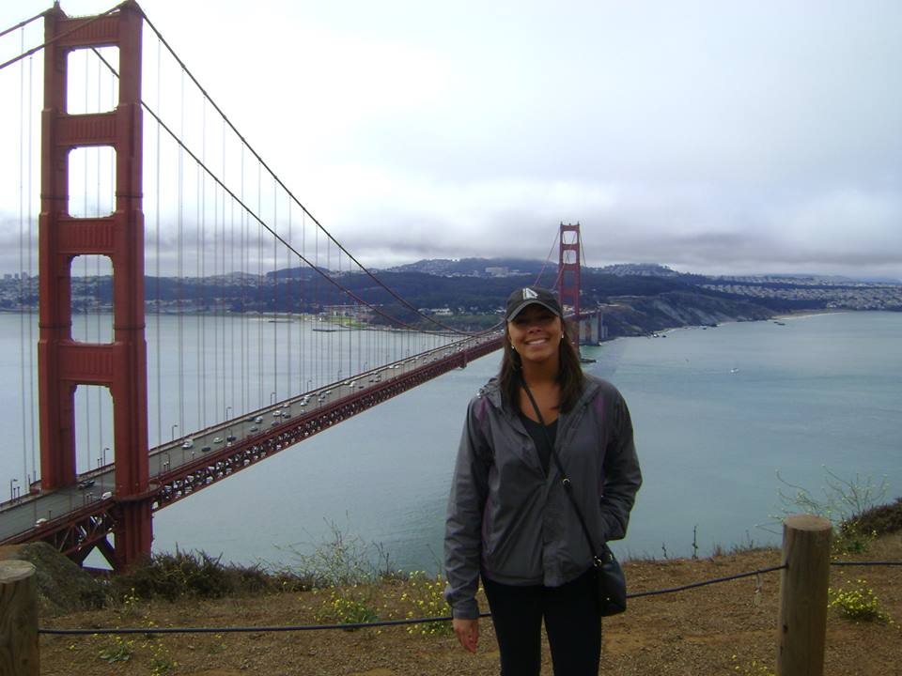

Slide 5
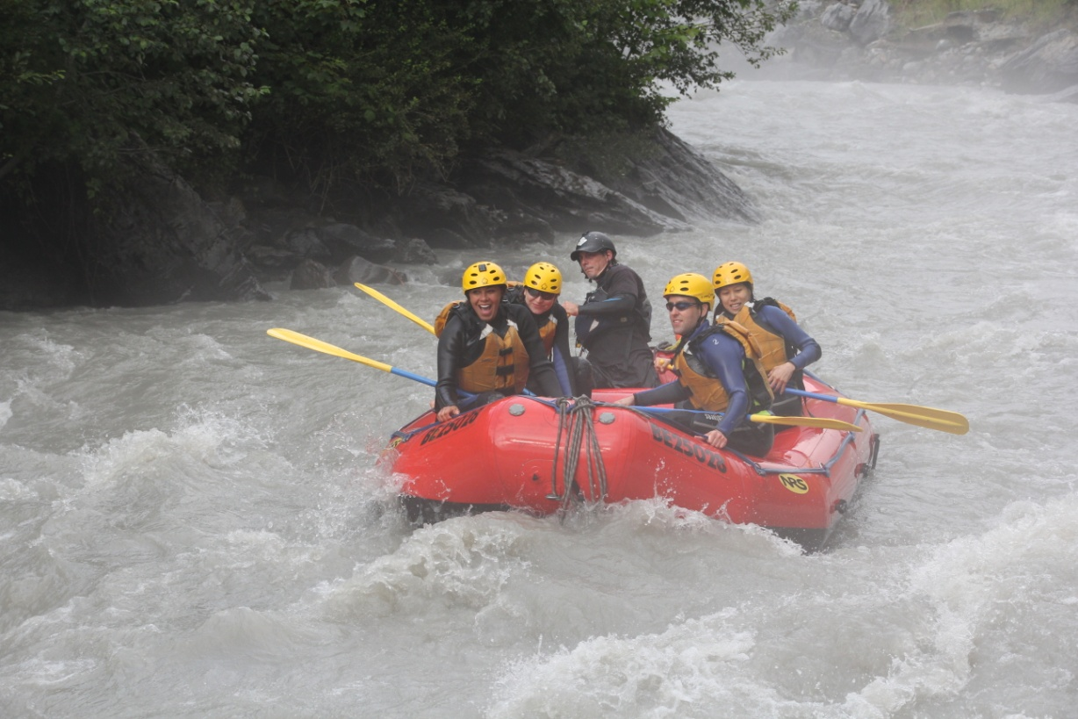
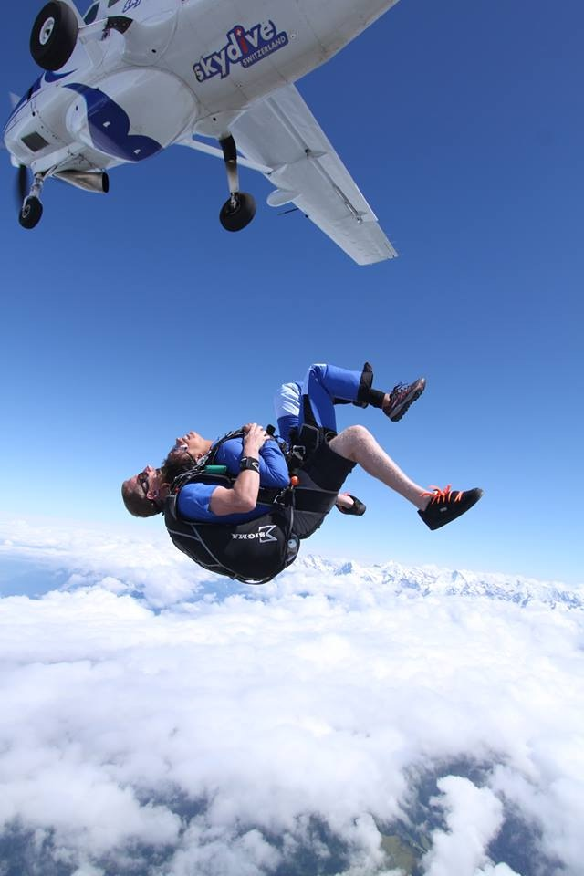
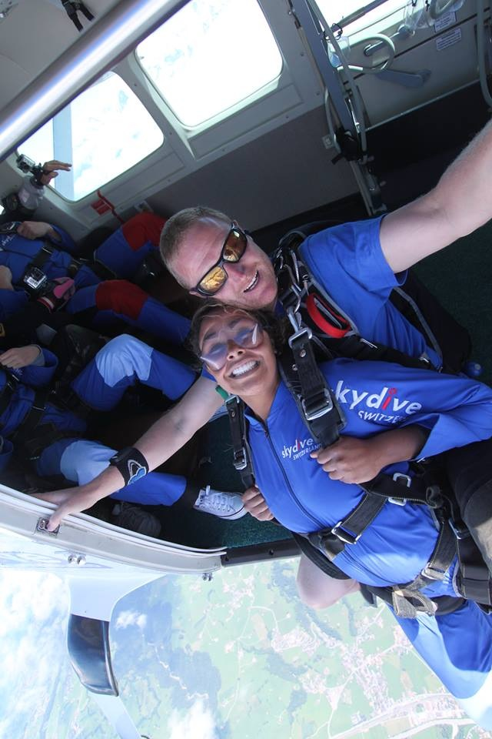
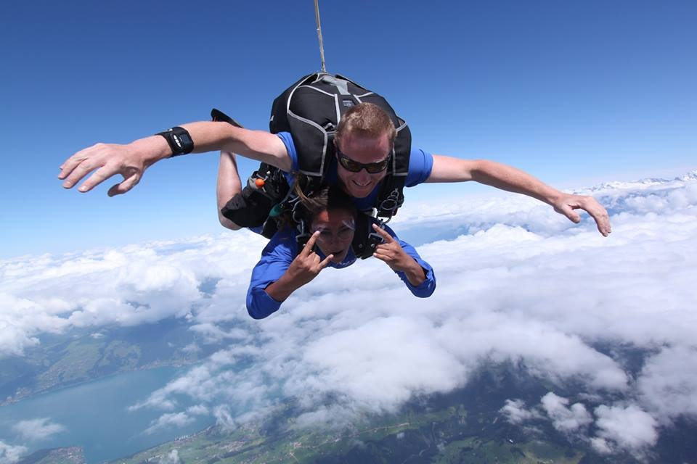

Slide 6
What are we doing?
Brief overview of procedures
Class Tour
Questions?

Slide 7
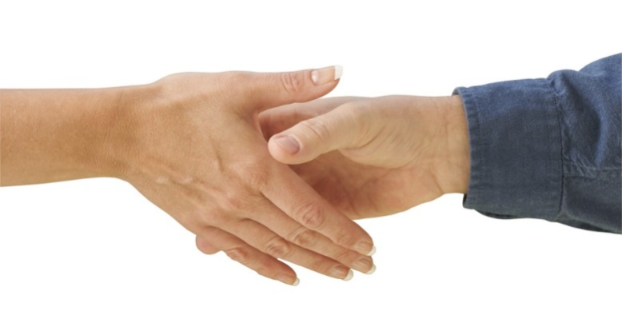
Daily Classroom Entry Routine
Shake Ms. Simmons’ hand
Look her in the eye and appropriately greet her
3. Enter silently
4. Take out weekly Do Now logs
5. Begin working on your Do Now silently

Slide 8
PRACTICE!!

Slide 9
Syllabus Introduction
Take a minute to look at your syllabus
  Required class materials (Binder, composition notebook, dividers, pens/pencils)
  BYOT
  Tardy policy
  Late Work
  Big Goals
  Re-testing
Sign and Return

Slide 10
BINDERS
Every student needs a binder to organize all of your notes and assignments
There will be random binder checks for a grade!
IT IS ESSENTIAL TO KEEP UP WITH YOUR BINDER!
Reference the class example binder to ensure you have everything
If you foresee a problem with obtaining your own binder see me after class.

Slide 11
Announcements!
You MUST have a binder and a notebook by next week Tuesday, September 2nd
If you have me for both biology and EES, you must have separate binders for each class!

Slide 12
Classroom Rules

Slide 13
Positive Consequences

Slide 14
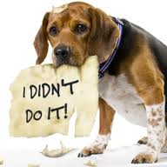
Negative Consequences

Slide 15
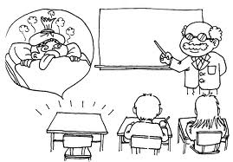
Absent????
While you were out…
You have 5 days!
Receiving this work is YOUR responsibility!

Slide 16
Procedure: Late Work
Make sure name is on your work
You must attach a pink slip to your late work in order to receive credit
All late work will be turned into the late work tray on table by the door
DO NOT HAND IT TO MS. Simmons

Slide 17
Class Website
www.brookesimmonsbio.weebly.com
Updated weekly with class notes, PowerPoints, worksheets, resources, helpful links, etc
If you are absent, please use this website to see what you’ve missed

Slide 18
Class Tour

Slide 19
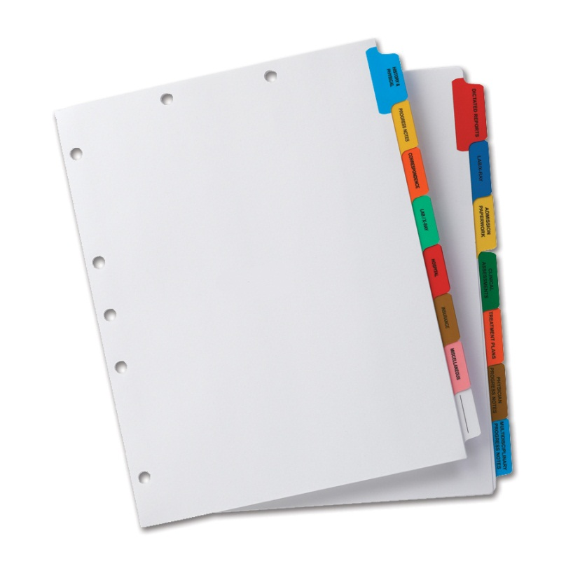

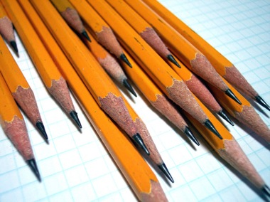
Have materials by Tuesday Sep. 2nd

Slide 20
Homework
1. YOU and YOUR Parent/Guardian READ & SIGN the Syllabus
BRING SYLLABUS SIGNED TO CLASS TOMORROW!!!!!

Slide 21

Questions???

Slide 22
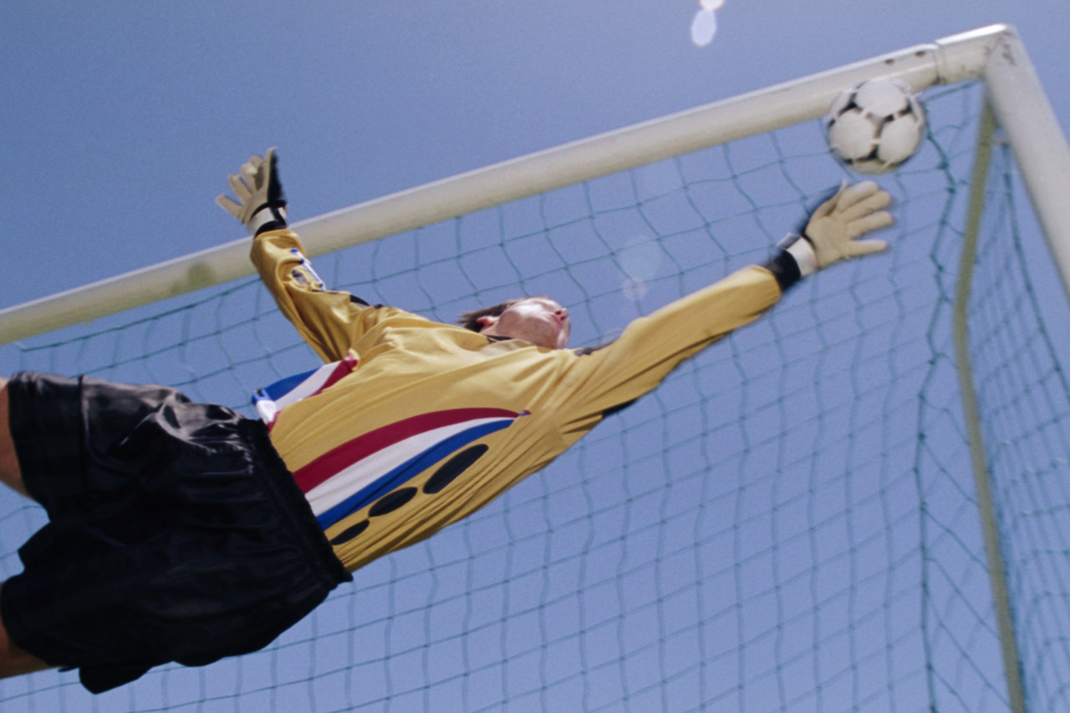
Big Goal!!

Slide 23
How will we know?
TRACKING TRACKING TRACKING!!!!!!
Individual and class data tracking!
More on this later!

Slide 24
Letter to You
Write a letter to yourself for the final week of the semester.
Include:
  A goal you want to have accomplished.
  Motivation for your EOC / Final Exam.
  (10 min)

Slide 25
Marshmallow Challenge
You and your lab groups will build the
Tallest Freestanding Tower with the marshmallow on top

Slide 26
Marshmallow Challenge
Tens of thousands of people in every continent, from the CFOs of the Fortune 500 companies to students at all levels have completed this challenge.

Slide 27
Marshmallow Challenge
You will have the following materials:
20 pieces of spaghetti
1 marshmallow
1 yd. of yarn
1 yd. of tape
You will have 18 minutes to complete the challenge

Slide 28
Marshmallow Challenge
Rules:
  Your team will be automatically disqualified if a member is supporting the structure when time is up
  Your structure must be FREESTANDING
  Your marshmallow must be intact and on top
Prize:
  Standing ovation

Slide 29
On your Do Now Sheets @ your tables, answer the following:
1. How do you think scientists test their ideas? What methods do they use? What steps might they do in order to come to their conclusion?
2. What steps are you going to take in this class to be successful in this class and pass the EOC in the June?

Slide 30
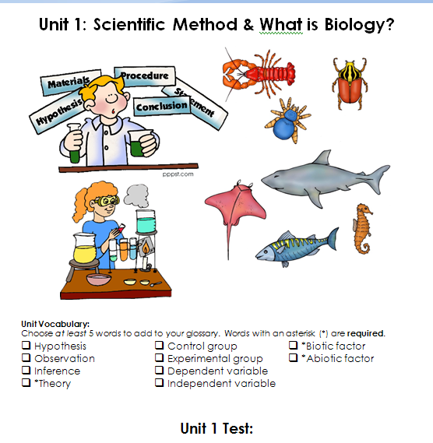

Slide 31
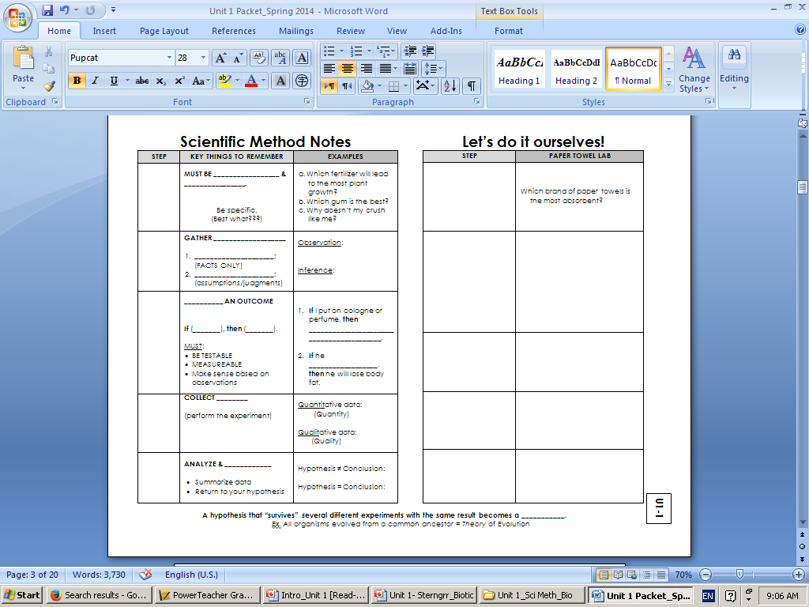

Slide 32
Do Now
Complete the graphing analysis questions on page U1-3 & U1-4 in your Unit 1packets
If you have a signed syllabus, please place it in the middle of your lab bench

Slide 33
Steps | Key Things to Remember
Ask a Question | Must be specific & clear
Background Research | Gather information Observations ( FACTS only) Inferences (assumptions based on facts)
Hypothesis | Predict an outcome If (independent), then ( dependent).
Test your Hypothesis | Collect data
Communicate your Results | Analyze & Conclude
A hypothesis that “survives” different experiments
with the same results, it becomes a Theory.

Slide 34
Let’s Do it Ourselves
  Which Brand of paper towels is the most absorbent?
Ask a question
Background Research
  Observation
  Inference

Slide 35
observation
A: Harding paper towels: $2.50/roll 65.7 ft²
B: Up & Up Target: $0.97/roll 41.5 ft²
C: U-Line: $2.12/pack

Slide 36
Let’s Do It Ourselves
Step: Ask A question
  Which Brand of paper towels is the most absorbent
Step: Background Research

Slide 37
Let’s Do It Ourselves
Step: Ask A question
  Which Brand of paper towels is the most absorbent
Step: Background Research
  Observation
  Inference
Step:
Step:
Step:

Slide 38
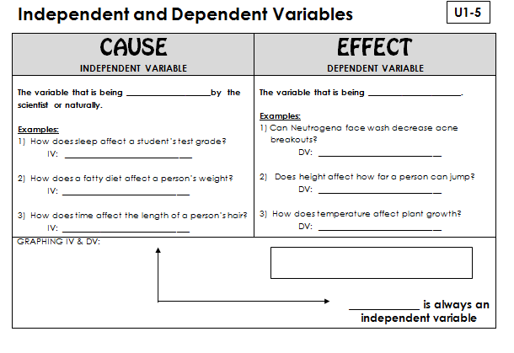
Variables
U1-2
manipulated
measured
amount of sleep
Acne breakouts
Fatty diet
How far a person can jump
time
Plant growth
DEPENDENT
“Y DEPENDS ON X”
time
INDEPENDENT

Slide 39
PRACTICE: Identify the independent and dependent variable in the examples below: How does hydration (drinking enough fluids) affect an athlete’s performance? IV: ______________ DV: _____________ Does playing an instrument improve academic performance? IV: _____________ DV: _____________ Does sex education in schools decrease the spread of sexually transmitted diseases? IV: ______________ DV: _____________ Is there a relationship between socio-economic status and obesity? IV: _______________ DV: _____________ 6 min

Slide 40
Control and Experimental Groups
Experimental: the group that gets the experimental treatment
Control: the group you do nothing to

Slide 41
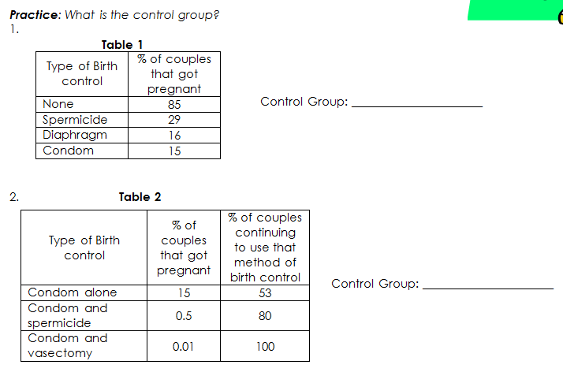
Let’s try it

Slide 42
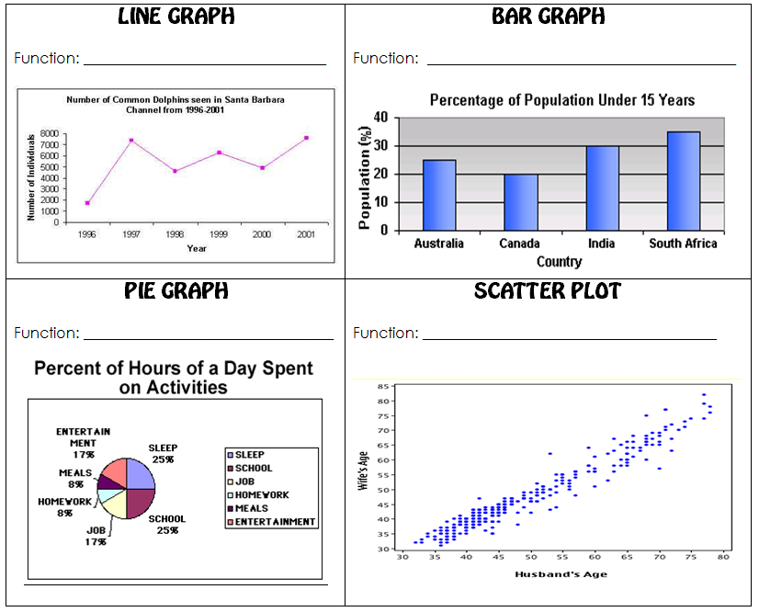
Graphing
Change over time
Comparison (single event)
% of whole
Relationship/correlation

Slide 43
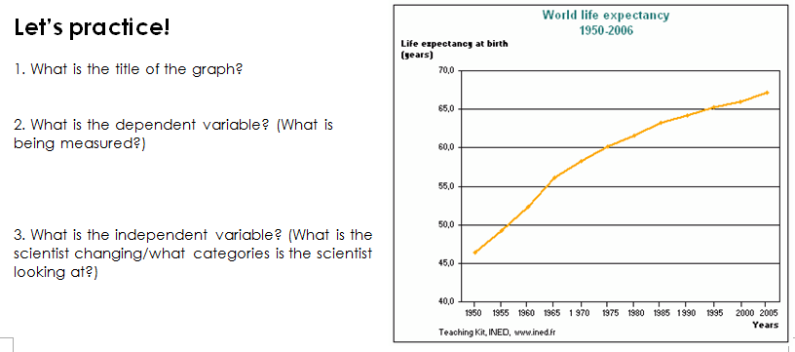

Slide 44
Graphing Analysis
Complete the graphing analysis
7 min.

Slide 45
Do Now
Place your homework on your desk:
  - Signed Syllabus
  On your Do Now Sheet:
  2. What is the difference between an independent variable and a dependent variable?
  3. What is the difference between an experimental group and a control group?
4. Classify the following items as living or non-living
  river house flower
  snail desk clouds
  dog car metal
  candle cat human

Slide 46
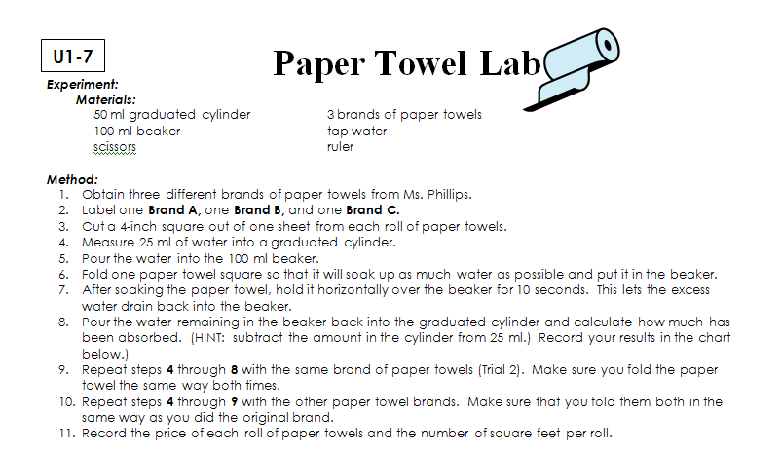
Paper Towel Absorbency Lab

Slide 47
Paper Towel Absorbency Lab
You and your lab groups will be testing the absorbency of paper towels
SCIENTIFIC METHOD:
Question: Which brand of paper towels is the most absorbent?
Observe: Some paper towel brands absorb more water than other brands.
Hypothesis: If a brand of paper towels is more expensive, then it will soak up more water.

Slide 48
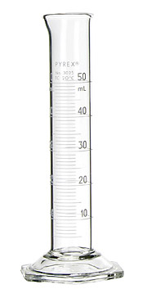
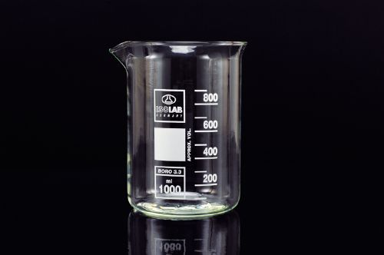
Materials
50 mL graduated cylinder
100 mL beaker
3 Brands of paper towels
Tap water
Ruler
Scissors

Slide 49
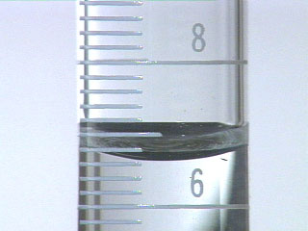
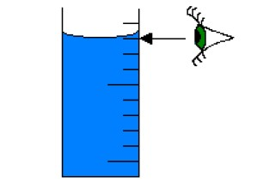
Meniscus
Get on eye level with the meniscus
Read from the bottom of the meniscus

Slide 50
Paper Towel Brands
Bounty: $2.12/roll 55.6 ft²
Great Value: $1.49/roll 41.5 ft²
Harding paper towels: $2.50/roll 65.7 ft²
Complete the lab with your group and be sure to graph your data and answer all questions in the conclusion section.

Slide 51
Lab Report
1 for each partnership
You MUST follow the template to get full credit

Slide 52
Do Now
Define abiotic factors. Give 2 examples.
Define biotic factors. Give 2 examples.
What is biology?

Slide 53
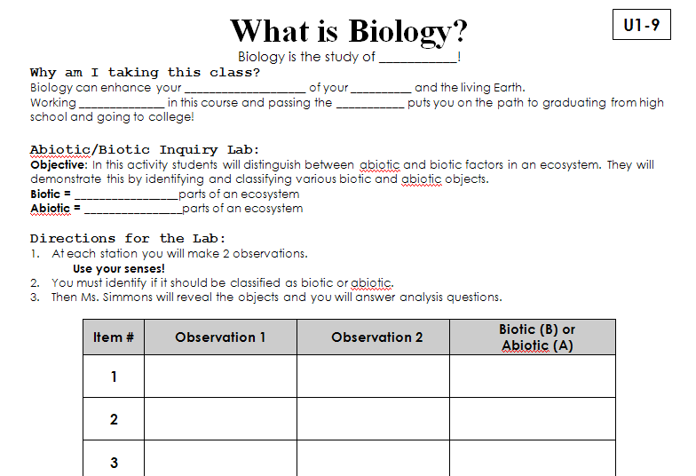
What is Biology?

Slide 54

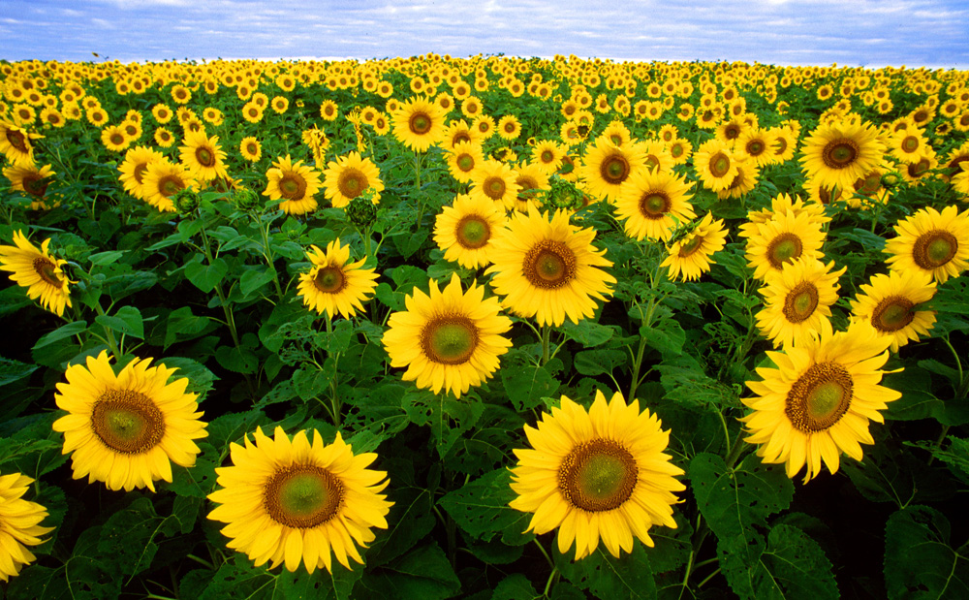
What is Biology?
Biology is the study of life!

Slide 55
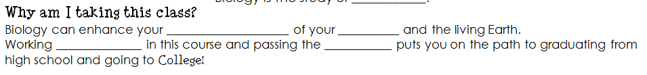
Why am I taking this class?
understanding
body
diligently
EOC

Slide 56
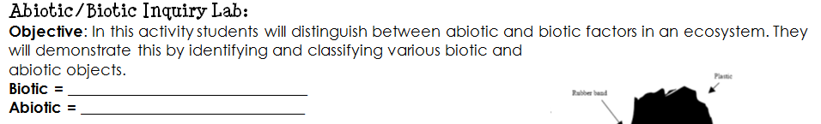
Abiotic/Biotic
LIVING
NON-LIVING

Slide 57
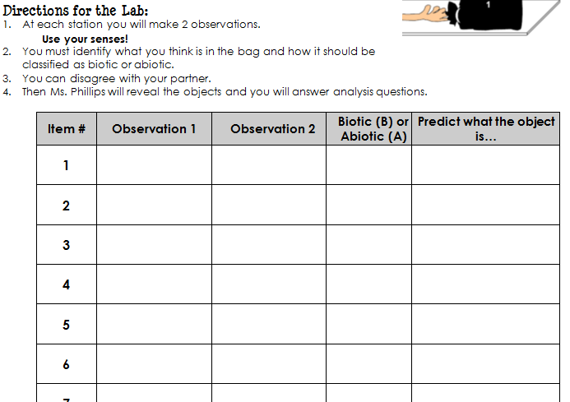
Simmons

Slide 58
Group Activity Procedure Expectations
Get Along: We will not argue
Respect All: We will listen to everyone’s opinions and not judge
On task behavior: We will do our job
Use Quiet voices: Only your group can hear you
Participate: Do your part
Stay in your group: Raise your hand and I’ll come to you
Model Volume Level

Slide 59
Simmons

Slide 60
Making Observations
What do you observe about the object?!

Slide 61
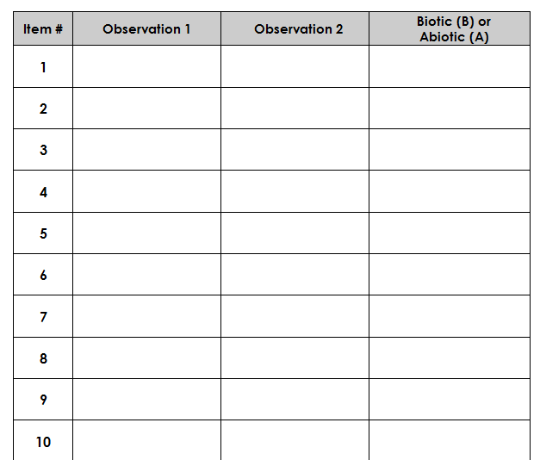
2 in. wide
round
Abiotic

Slide 62
Announcements
Class materials by Wednesday!
  1 ½” – 2” 3-ring binder
  Dividers
  Composition/Spiral Notebook
If you foresee a problem with obtaining these materials, please come see me!
Quiz on Friday!
Procedures review!

Slide 63
What Makes something Biotic?
Step 1: what makes something “living” (what qualities do they have to have?)
5 minutes
Step 2: Class consensus – what do we think!?

Slide 64
8 Characteristics of life
Synthesis
Transport
Excretion
Regulation
Nutrition
Growth
Reproduction
Respiration

Slide 65
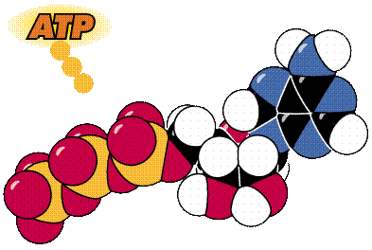
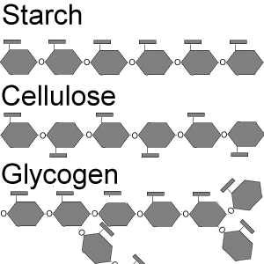

synthesis
How organisms build necessary molecules.

Slide 66
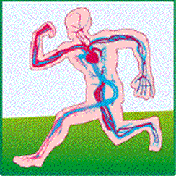
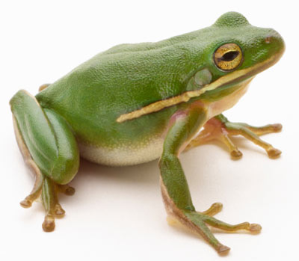
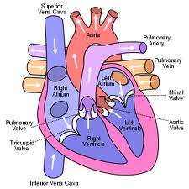
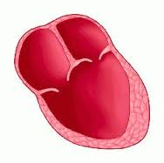
Transport
How organisms get what they need to their cells.

Slide 67
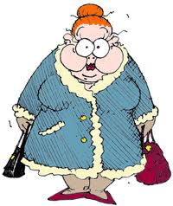
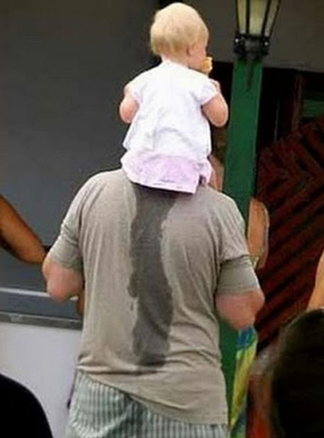

Excretion
How organisms get rid of their waste and balance their fluids.
http://www.youtube.com/watch?v=prtsIbjTjQc

Slide 68
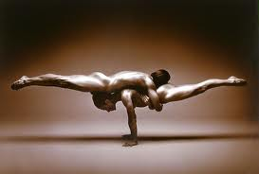
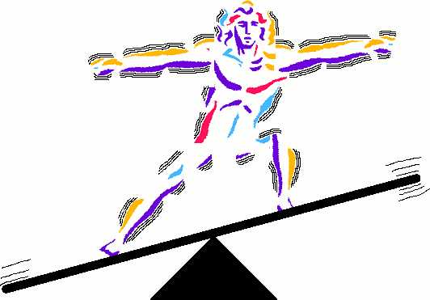
Regulation
How organisms control their body processes. (HOMEOSTASIS)

Slide 69
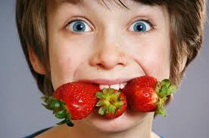
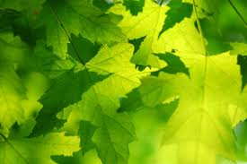
Nutrition
How organisms break down and absorb food.

Slide 70
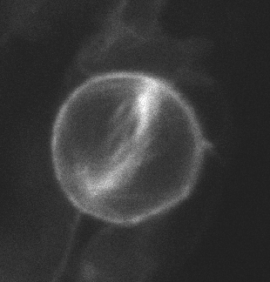
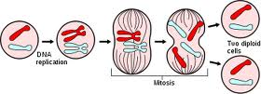
Growth
How organisms make new cells and develop necessary body parts.

Slide 71
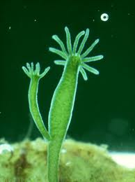


Reproduction
How organisms make new individuals like themselves.

Slide 72


Respiration
How organisms get oxygen and release carbon dioxide to make usable energy.

Slide 73

Practice
15 min

Slide 74
STERNGRR mini-poster
Include:
  Definition
  Picture
  Example
When finished: Teacher check off, hang on wall.
  15 min.

Slide 75
Exit Ticket
What is the acronym that outlines the 8 characteristics of life?
Which of the characteristics is defined as “how organisms make new individuals like themselves?”
In your own words, define regulation. Give an example.

Slide 76

Do Now
Complete the STERNGRR Do Now worksheet on your tables

Slide 77


Slide 78
Announcements
You should already have your supplies!
  Binder for this class ONLY
  Dividers
  Composition/Spiral notebook
  Pencils/pens
  Paper
Tutoring:
  Mondays and Tuesdays
  2:30 – 3:30

Slide 79
Announcements
Unit 1 test tomorrow on STERNGRR and Scientific Method

Slide 80
STERNGRR mini-poster
Include:
Must use information from the fact sheet ONLY!!
  Definition
  Example
  Picture LAST!
When finished: Teacher check off, hang on wall.
  15 min.

Slide 81

Foldable

Slide 82



STERNGRR Pictures

Slide 83
Homework
Finish Homeostasis Lab Questions
Sponge Bob Scientific Method Worksheet
Complete Unit 1 packets
STUDY!

Slide 84
Exit Ticket
On a sheet of loose leaf paper, please answer the following:
Which STERNGRR process is being described?!
A teenager goes through puberty
A mother dog has a litter of 8 puppies
Lebron James starts sweating during a game
Plants build sugar molecules in their leaves due to a process called photosynthesis
You are breathing right now
You do NOT have to write the questions!

Slide 85
Exit Ticket
What is transport?
What is respiration?
What are the 2 systems in our bodies that work together to provide nutrients to our cells? (Hint: we analyzed them in our lab)
Explain in your own words HOW these 2 systems work together.

Slide 86
Exit Ticket
Give 2 examples of reproduction.
Define synthesis. Give an example.
What does homeostasis mean?
What’s your favorite candy?

Slide 87
Do Now
Take out your notes and STUDY!! You have a quiz on Unit 1

Slide 88
Writing Prompt
Who is the most important person in your life right now? Why? What did they do? Describe them to me. Would I like them?
2. What do you see yourself doing in 5 years? Where are you? Who do you hang out with? How will you get there?
3. What has been the biggest challenge that you have overcome? Why was it “big”? How did you overcome it? How did you feel?

Slide 89
The reason most people never reach their goals is that they don’t define them, or ever seriously consider them as believable. Winners can tell you where they are going, what they plan to do along the way, and who will be sharing the adventure with them.
Denis Waitley
https://www.youtube.com/watch?v=bklNWWoJyzE

Slide 90
Vision and Goals
  In this classroom:
  We will MASTER at least 85% of the content.

Slide 91

I want to be: ________
What is YOUR big goal?!
3 min.

Slide 92
Post your Post-its!

Slide 93
I want to be: ________
How do I get there?
College
How do I get there?
High School
EOC Exams
Biology

Slide 94
I want to be: ________
College
High School
EOC / SAT / ACT
Biology

Slide 95
I want to be: ________
College
High School
EOC / SAT / ACT
What can we do IN CLASS?
Biology

Slide 96


Archer Fish
Archer fish are known for their habit of preying on land based insects and other small animals by literally shooting them down with water droplets from their specialized mouths.
Structural Adaptation

Slide 97
Grading Pre-Assessment
This is not worth a grade!
Be honest!
Record your data and pass it in.
This will help us align our days to focus on what we need the most help with! (GOAL: NO WASTED TIME!)

Slide 98
Tracking
Unit Starting Point Quiz
Unit Assessment Goal
Objective Quizzes
Unit Assessments
REMINDER: OUR BIG GOAL IS 85% MASTERY!!!

Slide 99

Tracking

Slide 100
Unit 1 Vocabulary (15 min)
1. Homeostasis
2. Synthesis
3. Transport
4. Excretion
5. Regulation
6. Nutrition
7. Growth
8. Respiration
9. Reproduction
10. Abiotic
11. Biotic
12. Absorption
13. Metabolism
14. Stimulus/Response
CHOOSE 5 and DEFINE USING THE FRAYER MODEL!
Define 3 more words for homework.

Slide 101

Frayer Model

Slide 102


Frayer Model

